Slide 1
Domiciliary Care
Market Engagement Event
March 29th 2021
Sam Morrison – Head of Strategic Commissioning
Ben Sladden –Adults Commissioning Manager

Slide 2
Agenda
1.30 - 1.50pm
1. An introduction to Bracknell Forest
2. Our Population and Our approach to commissioning
3. Our market, services and emerging needs
Breakout Groups 1.50 - 2.35pm
4. Over to you – help shape our specification
Closing Comments / Conclusions 2.35 – 3.00pm
5. Feedback / Summary and Next steps

Slide 3
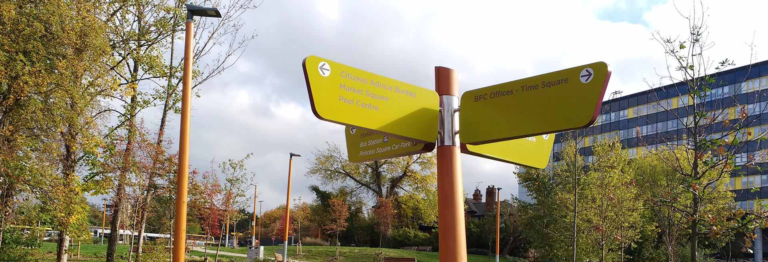
Bracknell Forest
Bracknell Forest is one of six unitary authority areas within Berkshire. Bracknell Forest covers the two towns of Bracknell and Sandhurst and the village of Crowthorne and also includes the areas of North Ascot, Warfield and Winkfield. The borough borders Wokingham, the Royal Borough of Windsor & Maidenhead, Surrey and Hampshire.
There are many distinctive local geographical communities within Bracknell Forest, from Sandhurst and Crowthorne in the south, the semi-rural communities of Binfield, Winkfield and Warfield in the north and the former new town of Bracknell in the centre, which contains most of the Borough's commercial and industrial areas.
Bracknell Forest is affluent with low unemployment levels, ranked 291 out of 326 on the Index of Multiple Deprivation. Crowthorne, Sandhurst, and the borough's rural fringes fall into the 10% least deprived areas in England. Property prices and levels of car ownership are significantly higher than the national average. However deprivation does exist in the borough - Central Bracknell is within the 30% most deprived areas in England.
Notes:
Add in for framework

Slide 4
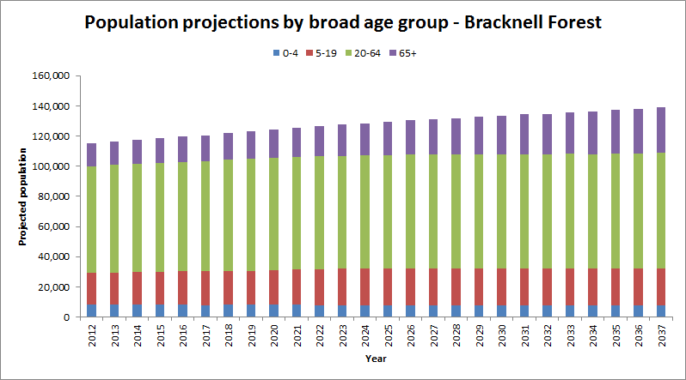
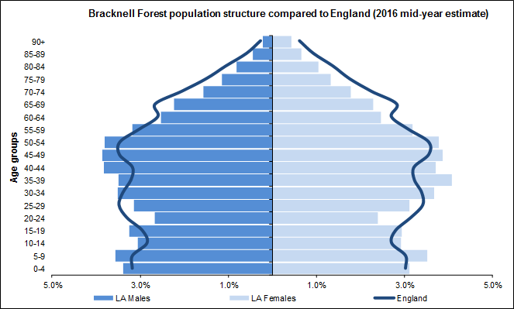
Needs and Provision
The ‘Office for National Statistics’ (ONS) produces estimates of the number of people living in the area based on factors such as births, deaths, and migration. According to the ONS the borough's population is around 115K. England’s population continues to age disproportionately with the proportion of people aged 65+ now accounting for 20% of the population, although only 11% of Bracknell Forest’s population are in the 65+ cohort.
However, trend data for Bracknell Forest suggests that the 65+ cohort has been increasing at the fastest rate in recent years. A statistically healthy population and increasing life expectancy, which now exceeds 80 years, is having a significant impact. This trend is expected to continue in the coming years.
This will impact the type and scale of future services in Bracknell Forest.
Bracknell Forest continues to work in partnership with our providers to prepare for this expected increase in need by:​
Ensuring we create conditions that enable people and communities to have the opportunities to help themselves. ​
Increasing capacity by onboarding new providers to meet increasing demand. ​
Enabling choice, supporting with Direct Payments so that residents can access and control the services they need.
Forging strong provider partnerships to ensure quality, sustainability and fit between needs & resources​ and to encourage partnership working.
Working in collaboration across the organisation to manage demand, review needs and deliver a cost effective service​.

Slide 5
Our Ambition for People Commissioning
The Strategic Commissioning team looks to understand the needs of the service whilst working with the market to ensure sufficiency and long term solutions. Our ambition is that Bracknell Forest works in partnership to use collective resources to create good outcomes delivering high quality services and value for money.
Good Outcomes
residents and communities to design, develop, deliver and quality assure what we together need to do to realise our shared outcomes
Continuously learn about our “system” (the different factors)
We will be most effective at this if we:
Look to deeply understand the needs, strengths, assets and aspirations of our residents and communities
Work alongside our partners in an equal, give-and-take relationship with Bracknell’s residents and communities to design, develop, deliver and quality assure what we together need to do to realise our shared outcomes
Continuously learn about our “system” (the different factors that work together to produce good or bad outcomes) and how our decisions affect this, leading us to try new things and change - doing more of what works and less of what doesn’t
High Quality Services
Developing a market with a range of ‘good’ providers, services that are valued by our residents as responsive, meeting needs and outcomes.
Value for Money
Commissioning so that we deliver the best price, savings, use of resources and social value
Notes:
Add in for framework

Slide 6
Statutory duties of Dom Care
Statutory Duties – Care Act 2014
Dom Care is the provision of personal care and practical support necessary to maintain an Individual’s health, well-being, hygiene and safety - allowing people to remain in their own homes and maintain both their independence and quality of life.
For Bracknell Forest this provision is primarily and foremost a regulated activity of personal care for those aged 65+, delivered by CQC registered providers with elements of additional support as required.
Although the service is predominantly for older people the service may also provide support to adults with a physical, sensory or learning disability and people with a mental health condition who are unable to care for themselves without additional support.
Domiciliary care is provided by fully trained care workers. Visits range from 30 minutes through to several hours a day and typically include: -
Personal care
Reablement
Helping to mobilise in and around the home
Support hospital discharge / discharge to assess
Support with medication
Continuing healthcare and possibly emergency care
End of life care
Support the use of assistive technology/health technology
Manage challenging behaviour
Emotional and psychological support
Household tasks and meal preparation
Accessing community and universal services
Empowerment: people are supported and encouraged to make their own decisions and give informed consent
Prevention: it is better to take action before harm occurs
Proportionality: the least intrusive response appropriate to the risk presented
Protection: support and representation for those greatest in need
Partnership: Local solutions through services working with their communities - communities have a part to play in preventing and reporting neglect & abuse
Accountability: accountability and transparency in safeguarding practice
Adhering to these principles will ensure people are able to access the support that is best suited to their needs
Notes:
Add in for framework

Slide 7
Bracknell Forest Council are looking for providers who: -
Are outcome focused, proud of the care they deliver and the impact this has on individual lives. Ensuring that all care is person-centred, striving for the best for each individual, focusing on reablement, strength-based practice and not the passive delivery of care.
Will embody the partnership approach. This should extend not only to Bracknell Forest but also to other providers. Working in collaboration not isolation. Active involvement and participation in the council’s strategic plans for development, sufficiency and sustainability. Communicating efficiently and actively participating in forums and contract management.
Will embrace innovation including the use of technology, flexibility, quality of service provision and a professional integrated approach. Creative in your approach, solution focused and willing to explore alternative arrangements to meet specific need. Thinking outside of the box and working with confidence and expertise.
Will bring competitive pricing and value for money to the local market. Transparent pricing structure with emphasis on delivery, cultivating a skilled and committed workforce for the delivery of the best care at the cost agreed.
Will focus on Quality, Continuous Improvement and Best Practice to meet the range of home care needs, including complex, challenging behaviors. Have continuous improvement plans that drive service development and shape delivery.

Slide 8
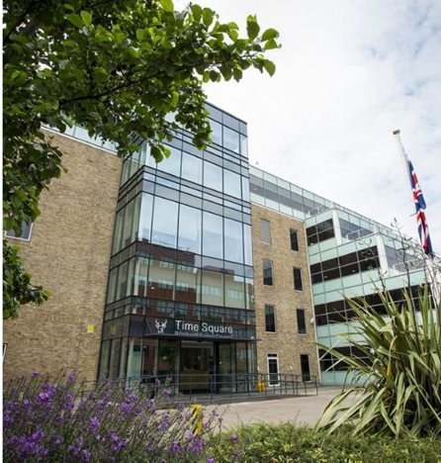
Current Market Provision
£4 Million/yr is spent on brokered personal care through spot contracts and the framework
The average hourly rate is around £18.40 however there is a wide variation on price due to spot purchasing.
This accounts for around 4000 hours per week
On top of this a significant proportion of service is delivered by Direct Payments although only a proportion of this is personal care
Reading
The brokered service is delivered through 15 Approved Providers 3 of which are on the CBS Framework.
2 are Outstanding, 11 are rated Good.
It is the Council’s intention to work with Outstanding and Good providers.
2 are large national providers but the majority are local, working within neighbouring authorities such as Wokingham, Reading, Windsor & Maidenhead, Surrey and Slough.
It is important that providers have a local presence to manage operations.
4 operate from within Bracknell, 3 from the borders and 5 from neighbouring authorities.
Bracknell Forest works in partnership with neighbouring authorities such as Wokingham, reading, Slough, Windsor & Maidenhead, Hampshire and Surrey
Slough
West London

Slide 9
Local Need
Needs breakdown
Primary Support Need | 2019/20 | 2020/21 | Change | % change
Standard Personal Care only​ | 150 | 202 | 52 | 35%
Support with Memory and Cognition​ | 48 | 83 | 35 | 73%
Learning Disability | 52 | 46 | -6 | -12%
Mental Health | 13 | 15 | 2 | 15%
Physical Support - Access and Mobility​ | 4 | 5 | 1 | 25%
Sensory Dual Impairment​ | 2 | 1 | -1 | -50%
Total | 269 | 352 | 83 | 31%
There has been an increase of 83 service users over the last 12 months which represents a 31% increase in service. However additional ‘Home First’ and ‘Discharge to Assess’ provision has inflated the 20/21 figures. These services were implemented to alleviate pressure on the NHS as part of the Covid response and are funded by the CCG.
Analysis of the proportion split of the service indicates a significant increase in demand for those suffering deficits in Memory and Cognition. This is supported by national trends in needs analysis and the increasing demands for dementia services. Support with Memory and Cognition is the most significant group after standard home care. We have also seen an increase in double up packages.
Gender breakdown
Gender | 2019/20 |  |  | 2020/21
 | 18-64 | 65+ |  | 18-64 | 65+
Female | 39 | 112 | 151 | 38 | 171 | 209
Male | 48 | 70 | 118 | 51 | 93 | 144
 | 87 | 182 | 269 | 89 | 264 | 353
The proportion of males in receipt of care is higher in the 18-64yr category but this is reversed in 65yrs+ cohort where the proportion of females in receipt of care is higher.
Number of Service Users
Ethnicity breakdown
Ethnicity​ | 2019/2020 | 2020/2021 | % change
White​ | 254 | 336 | 32% increase
BME​ | 12 | 13 | 8% increase
Unspecified | 3 | ​4
Total | 269 | ​353 | 31%
Variations in ethnicity and gender are in line with national statistics and expectations as supported by data from POPPI.
https://www.poppi.org.uk/index.php
Data collated from SALT in February 2021

Slide 10
Quality and Feedback
A service user satisfaction questionnaire was completed in March 2021. 30 service users, 1 or 2 from each provider, were selected randomly and asked a series of questions. The survey was conducted over 1 week in collaboration with the care teams.
100% positive confirmation that no calls had been missed, all care staff wear uniform, PPE is worn at all times, care staff are clean and tidy in their work and that all service users identified who they could contact if they had any concerns.
Service users rated the carers very highly (94-98% satisfied) on the care they receive, that staff are well trained, they are given the time to care for themselves (enablement, empowerment, independence) and that carers communicate well, are polite, kind and show dignity and respect.
Although still within acceptable parameters so as not to cause concern (67-83%) the survey did highlight three areas for improvement. The desire for a regular carer, not being informed if the carer is running late and carers not arriving at the agreed times.
Notes:
SCC slide if you have any questions or changes to be made

Slide 11
Developing our model and commissioning approach
Procurement and service model
All options are under consideration Blocks / DPS / Flexible Framework
Quality
Clear Qualifying Criteria eg Outstanding, Good CQC Registration / Proven Practice / References / Selection questionnaire
Price
Transparency, fairness and consistency in awarding work
Clear Service Specification and pathways
Manage costs, efficiencies, standardise rates
Consistent and transparent focus on outcomes including reablement
Well trained, knowledgeable, caring workforce
Innovation / Use of Assistive Technology
Commitment to Service Development / 7 day working
Consistent, robust contract monitoring – Performance Plans / Continuous Improvement / Care Governance / Safeguarding
Electronic Call Monitoring linked to invoicing
Clear hourly rates
Initial 3yr term from 1st April 2022 + 3yrs (or variant thereof)
Lots based on service / need / geographical focus / universal service
Value for Money

Slide 12
Break out groups
Commissioning best practice and emerging needs (10 mins)
What did you find interesting / surprising about the presentation?
In your experience what works well in the Commissioning of Domiciliary Care?
What needs are you seeing in your delivery of services in Bracknell / elsewhere?
Procurement model (10 mins)
What is your experience of block contracts/ DPS/ Flexible Frameworks?
What works? What is challenging?
Service model ( 20 mins )
What is your experience of working through lots or in geographical areas?
How do you measure outcomes of service users?
What experience do you have of using Assistive tech and call monitoring systems? What works well? What doesn’t?
Pricing models - what works best? How do these impact on your services?
What factors would encourage you to work with Bracknell Forest and tender for this service?
break out groups - vikki.chance@bracknell-forest.gov.uk

Slide 13
March 21
Market Engagement
August 21 to Sep 21
Tender period
Sep 21-Nov 21
Evaluation
Dec 21
Contract Award
1 Apr 22
Contract start date
May / June
Second Market engagement event to share proposed model and procurement timetable.
Timetable
Any questions / comments please contact:- Contracts.Team@Bracknell-Forest.gov.uk

