Slide 1
ProContract Demonstration

Slide 2
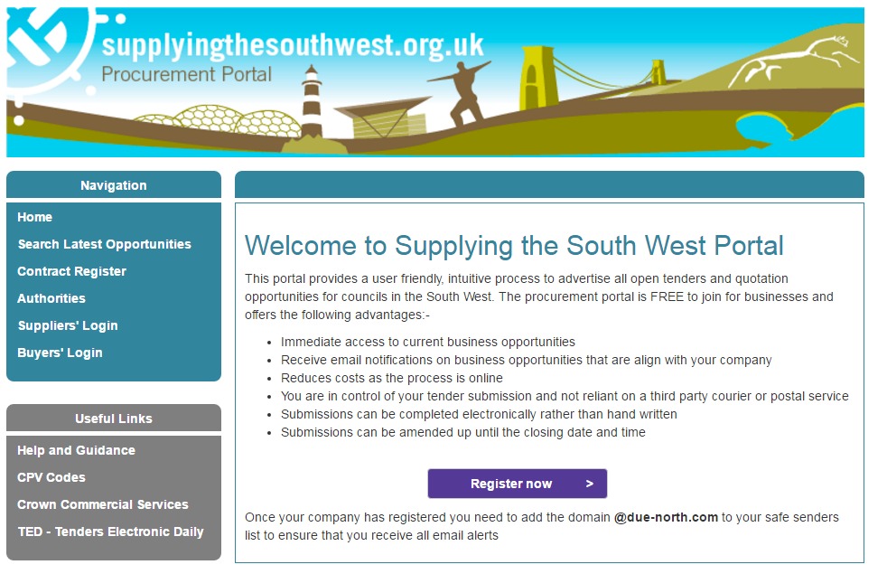
Registering on Supplying the South West
To take part in any opportunity type, you must register on ProContract with details of yourself and also the company that you work for.
www.supplyingthesouthwest.org.uk
Click the register now button.
Notes:
All opportunities from Dorset County Council are advertised via supplyingthesouthwest.org.uk. This portal is also used by neighbouring authorities such as Bournemouth and Poole, Somerset, Devon and Wiltshire. To receive the opportunities you will need to register on this portal.

Slide 3
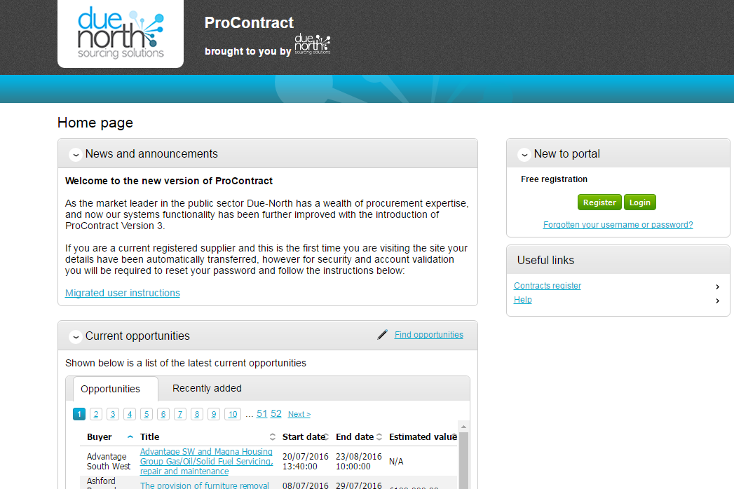
Registering on Supplying the South West
Click on the register icon on the right hand side of the screen to begin the registration process
Notes:
The portal is free to register and only takes 5 mins to input your details.

Slide 4
Registering on Supplying the South West
Once you have completed all relevant information and accepted the terms and conditions you can submit your registration by clicking the submit registration button on the summary screen.
Notes:
You will be required to enter your own contact details and your company information. The email address is extremely important as this will be the email address used for the notifications to be sent. You can use a generic email address if wanted.
Once your registration is complete you will receive an email to say that your registration is being considered. Once registration is accepted you will receive an email with a reminder of your username.

Slide 5
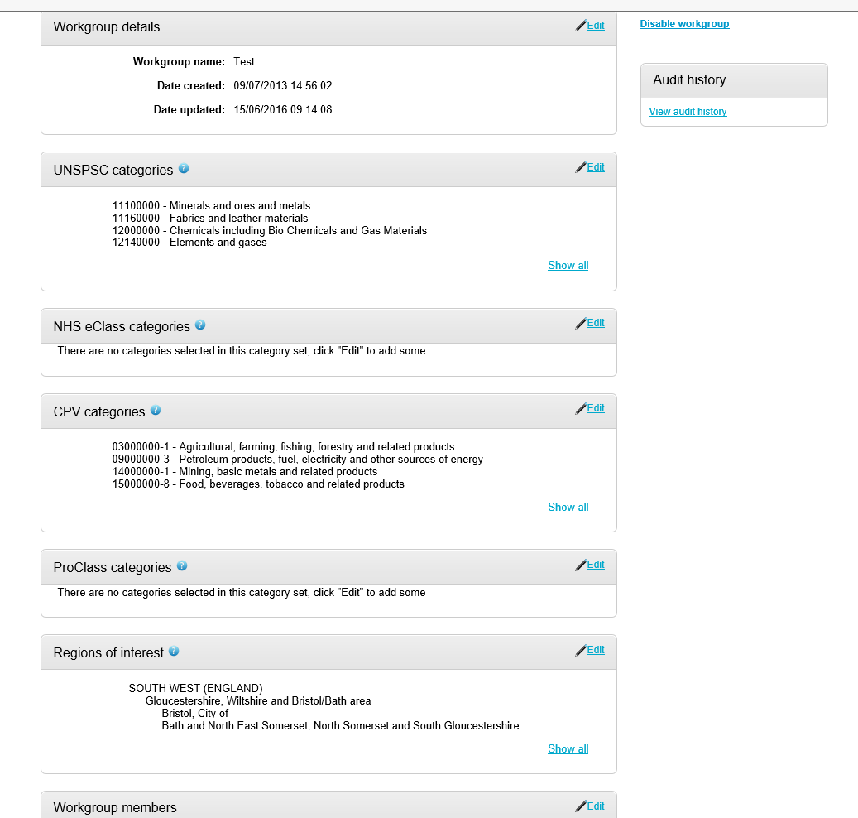
First time login
When you login for the first time you will be prompted to change your password and also you will be required to apply categories within your workgroup area. This section is where you can register your company to receive automatic e-mail notifications of new opportunities that have been published that may be of interest to your company. This will greatly assist you when using the portal and means that relevant opportunities are not missed. At least one category must be selected.

Slide 6
Searching for Opportunities
New opportunities will appear on the supplier homepage. To search for new opportunities for a particular local authority click find opportunities.

Slide 7
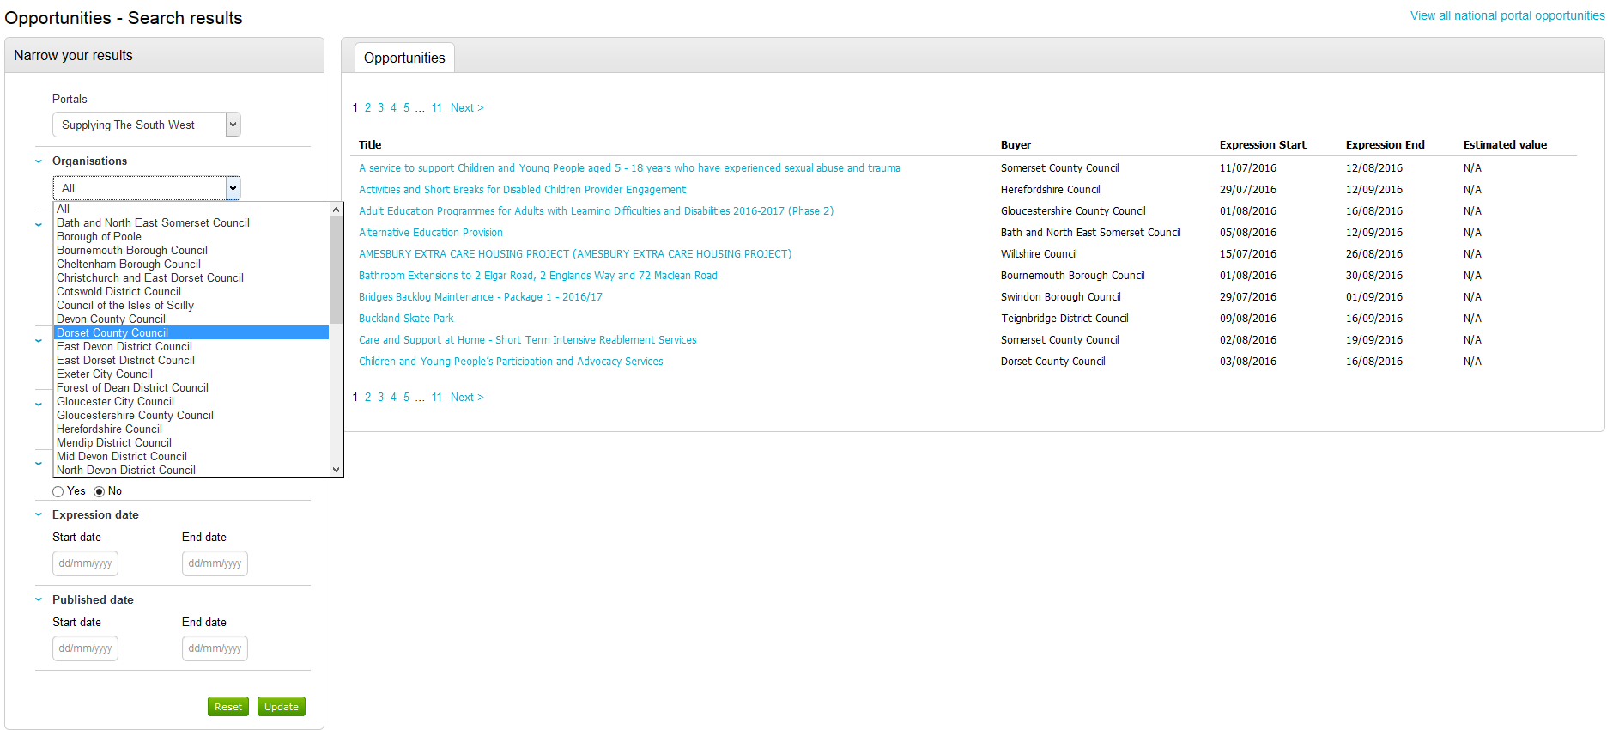
Searching for Opportunities
You can now choose the local authority you wish to search

Slide 8
Searching for Opportunities
You will then see a list of the current opportunities within that local authority

Slide 9
Accessing contract documentation
To access the contract documentation click on the title of the procurement and you will see further information about the opportunity. Click on login and register interest in the opportunity
Notes:
You will see any attachments listed in the attachments area. This will provide you will enough information for the opportunity to make a decision if you wish to express an interest in this opportunity.

Slide 10
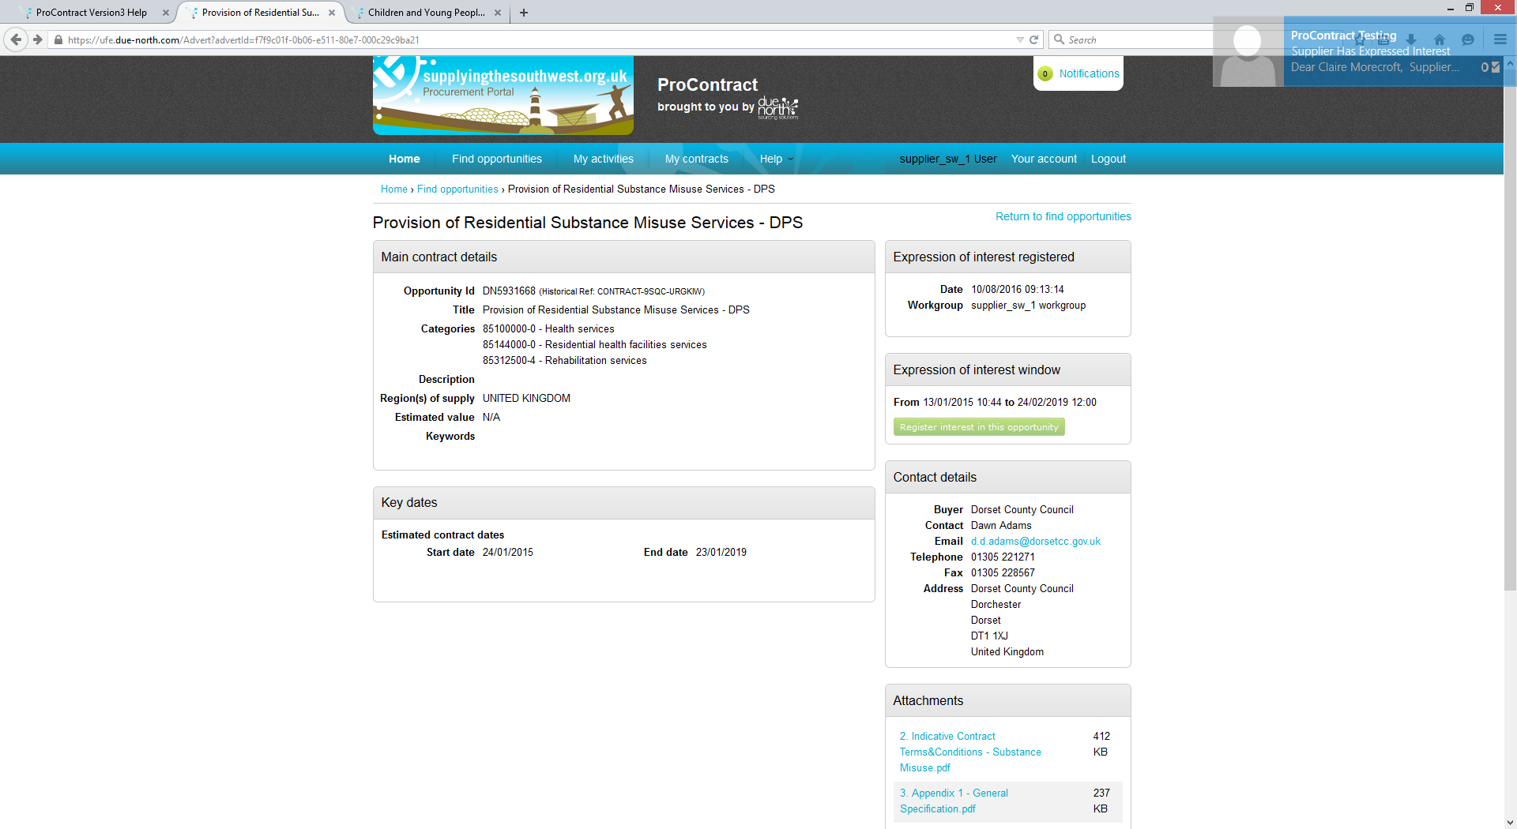
Accessing contract documentation
Once you have expressed an interest you need to click
My Activities
Notes:
The my activities area will show a list of all Dorsets opportunities that you have expressed an interest in.

Slide 11
Accessing contract documentation
Ensure you have Dorset County Council ticked and click update

Slide 12
Accessing contract documentation
You will then see a list of opportunities that you have expressed an interest in. You can access the tender documents by clicking the opportunity title.
Notes:
Any new opportunities will be highlighted with a star and you can also sort by event deadline.

Slide 13
Completing the tender documents
Click on start to access the tender documents

Slide 14
Completing the tender documents
From this screen you can access any tender documentation and also you can click on start my response to begin to complete the tender questions
Notes:
You will see any attachments relevant to this procurement. You will also see the list of question sets that you will be required to complete. To begin to complete these click start my response. You can work through the question sets in your own time and save and return to these at any time prior to the deadline date. Once you have completed all question sets you can submit your response. You can amend your application at any time up until this closing date and time and the authority will only receive your final version.
The authority does not accept any late responses. (Only in exceptional circumstances will we do this, i.e. if there was a system error and suppliers were unable to submit.
Please do not leave it until the last 10 minutes to submit. Allow yourself plenty of time because if there are any issues these can be resolved prior to the closing time.

Slide 15
Supplier Help
There are help guides available to assist with Procontract which are available via help and guidance

