Slide 1
London Borough of
Tower Hamlets
General Building Works Measured Term Contract (MTC)
Information Presentation
London Borough of Tower Hamlets
Via Microsoft Teams
21st / 22nd July 2021

Slide 2
Introduction
Welcome
Overview of contract
Procurement Overview
Summary of Procurement Process
Timetable
Social Value
Example Buildings

Slide 3
Welcome
"Innovation is key"
Please read this presentation......
What we would like from you today is
Your view on what works well with similar contracts
What doesn’t work well with similar contracts
Our aim is to construct a contract and specification that serves the Tower Hamlets residents, staff and building users in the best possible way.
Once you have had a chance to consider the content of these slides you are welcome to arrange an appointment with members of the Council’s Facilities Management service. Please register your interest via the portal by Tuesday 20th July 2021.

Slide 4
Overview of contract
The annual contract spend for planned works, small projects and reactive repairs is circa £700k
There are currently approximately 220 no. of Corporate (housing is excluded from scope) sites in scope of the current contract
The Council operate an internal helpdesk function that will be responsible for managing and issuing repair and maintenance instructions
All Council operated buildings are in scope including offices, libraries, children’s centres and day centres
Services will include planned works, project works and reactive repair service for the Council’s building fabric
Activities would typically include gutter clearing, roof, brickwork and paving repairs, decorating, general carpentry and window repairs and refurbishment projects

Slide 5
Procurement Overview
Single supplier
Emphasis on quality​
Self-delivery​ expected with local supply chain​
Long term commitment​
Partnering approach​
2-year term​ with option to extend by 36 months (24 months + 12 months)
60/40 quality/price evaluation
Contract form JCT MTC 2016
National schedule of rates​ pricing
Service specialism​

Slide 6
Summary of Procurement Process
Bidder Briefing Session
Publish Tender Notice
Publish Tender Opportunity
Tender Submission Deadline
Evaluation Period
Contract Award Period
Mobilisation
Service Commencement

Slide 7
Timetable
Activity | Programme
Bidder Briefing Session | 21st & 22nd July 2021
Bidders Invited to Tender | 6th September 2021
Tender Submission Deadline | 7th October 2021
Evaluation Period | 11th – 29th October 2021
Bidder presentations | 1st – 5th November 2021
Contract Award Period | 8th – 26th November 2021
Mobilisation Period | 27th November – 1st February 2022
Service Commencement Date | 1st February 2022

Slide 8
LB Tower Hamlets Social Value
The LBTH Procurement Strategy 2016-2019 sets out our aim of pursuing procurement excellence through deploying innovative and effective sourcing strategies to achieve value for money whilst stimulating local markets and securing community benefits.
Social benefits through contracts focus on four strands:
Promoting local employment
Investing in skills and training
Supporting local supply chains.
Supporting Community Projects
Tower Hamlets Council - Issue details - Procurement Strategy 2016-2019

Slide 9
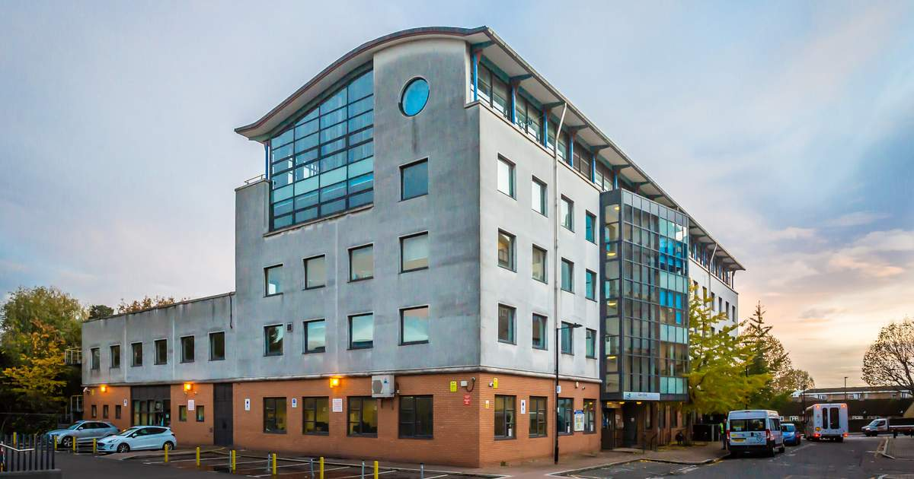
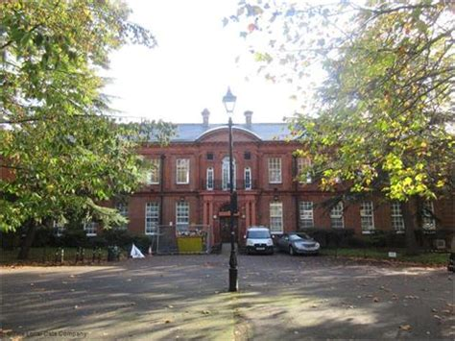
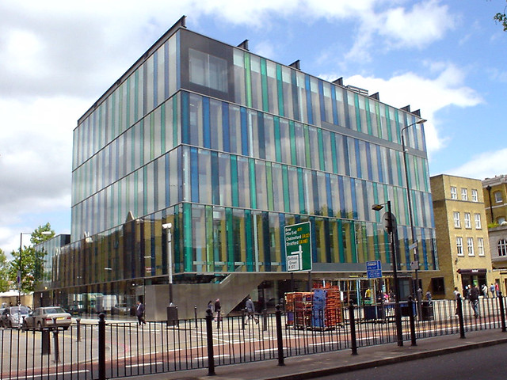
Example Building
Jack Dash House
Bethnal Green Library
Whitechapel Idea Store

Slide 10
Thank you
For further information on the council please visit www.towerhamlets.govuk

