Slide 1
Homecare in Somerset
Dynamic Purchasing System
17th January 2024

Slide 2
Somerset Council Introductions

Slide 3
New Home Care Dynamic Purchasing System (DPS)
Current contract has been in place since March 2017 (Currently referred to as an Open Framework)
New contract needs to be in place to start on 1st April 2024.
Simpler and easy to read specification. Application process also simplified.
Going to the market at end of January/ early February.
Market Engagement event on 17th January. Advertised on www.supplyingthesouthwest.org.uk
One contract but must state which of the 13 zones you wish to work in.
Focus on local providers. Registered Office must be within 10 miles of Somerset border(excluding Live In Care lot only).
As now, you will need to be on the DPS to provide local authority funded care.
Client Contributions to remain with the providers for now.

Slide 4
Introduction to a Dynamic Purchasing System (DPS)
A DPS is a two-stage procurement tool where new suppliers can join at any time.
In the initial set-up stage, all suppliers who meet the selection criteria must be admitted to the DPS. In the second stage, all suppliers on the DPS are invited to bid for a specific contract through a competitive process.
SC will conduct the wholly electronic procedure in accordance with the Public Contracts Regulations 2015; the Treaty Principles of Proportionality, Transparency, Non-discrimination and Equal Treatment will be followed; and stage one of the DPS will be advertised via the Proactis System, Find a Tender Service and in Contracts Finder.

Slide 5
Indicative DPS Timeline
Stages of the DPS process | Dates & Additional Info
Build structure of DPS and finalise selection criteria documentation | October 2023 to January 2024
DPS specific Market Engagement event | January 2024 Updates, Timeline and Q&A
Find a Tender Service Notice to advertise the DPS | End of January/ early February 2024 Advertise DPS
Issue Request for Expressions of Interest (EOI) - 30 days | End of January/ early February 2024 Providers who Express an Interest will then have access to the Selection Questionnaire (SQ) Completed SQ to be submitted Able to ask queries through the system
Receive/ Evaluate SQ responses | February/ March 2024
Approve and accept those that have passed the SQ on to the DPS | March 2024
Go Live for individual contract sourcing opportunities | April 2024 Only providers who have passed the SQ will have access to sourcing opportunities Providers who do not pass the SQ on the first attempt will be able to resubmit at any point during the term of the DPS

Slide 6
DPS – initial steps
Setting up an Account:
Go to https://supplierlive.proactisp2p.com Register to sign up to Proactis;
Complete and submit self-registration online form; and
Click on link in email sent to activate your account to enable you to log-in.
Registering an Interest:
Log-in to Supplier Network;
On the Dashboard page, go to Opportunities;
Search for the DPS Opportunity;
Click on Register Interest; and
Complete all mandatory fields and submit.

Slide 7
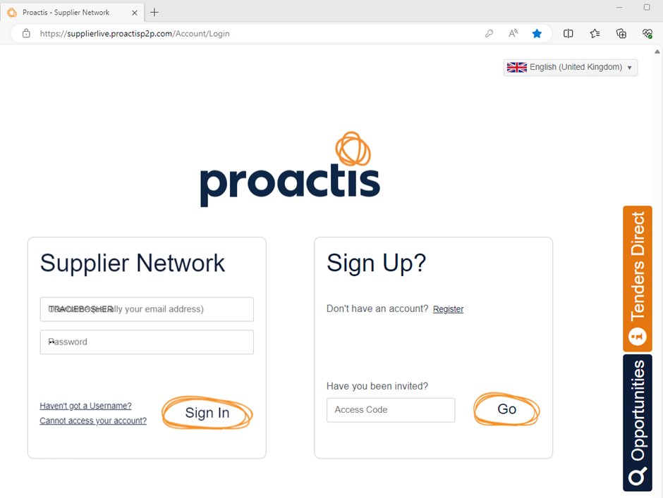
Setting up an Account
Step 1: Set Up
Go to https://supplierlive.proactisp2p.com
Go to the ‘Sign Up?’ box on the right and Click on Register

Slide 8
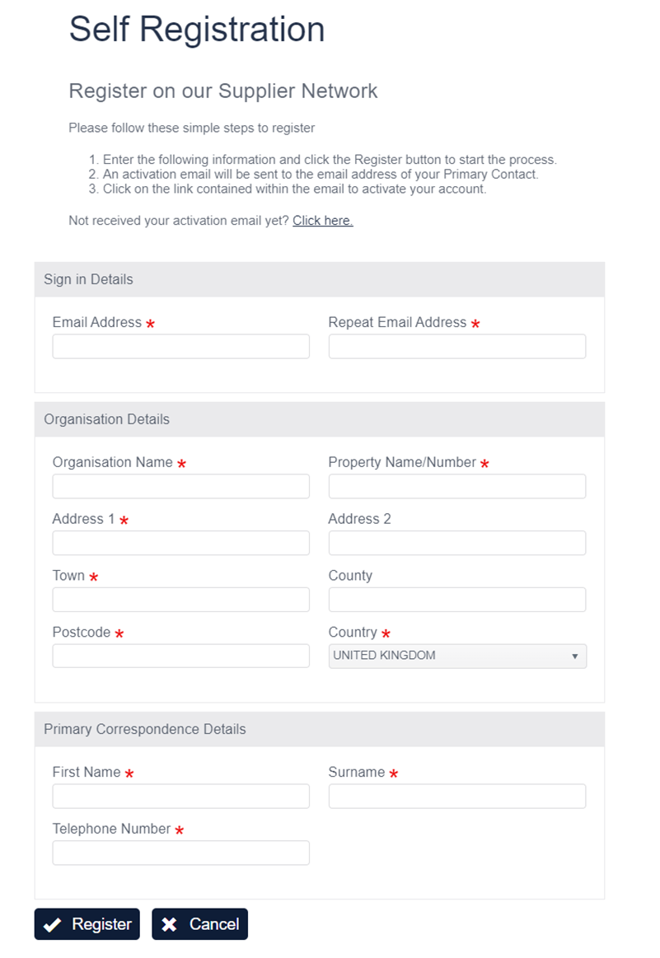
Setting up an Account
Step 2: Self Registration
You will need to complete the form below where a is indicated
Once completed, Click on ‘Register’ at the bottom of the page and an activation email will be sent to you. Click on link provided in the email to activate your account which will allow you to Log On.

Slide 9
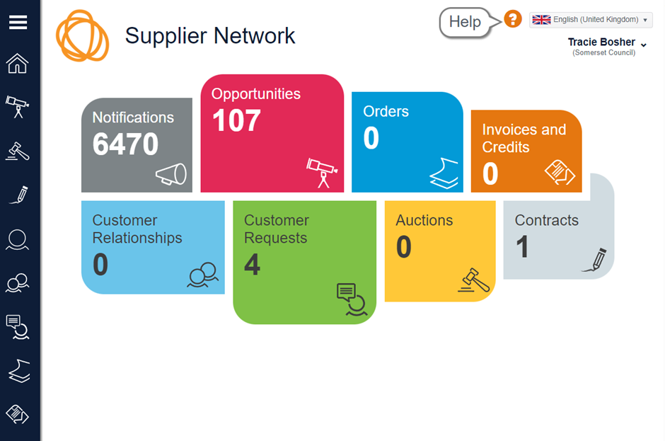
Registering an Interest
Step 3: Supplier Network Dashboard
Once Logged in it will take you to the Dashboard below. Click on ‘Opportunities’ which will enable you to search for this DPS
Note: there is a Help option, located on the top right of the Dashboard

Slide 10
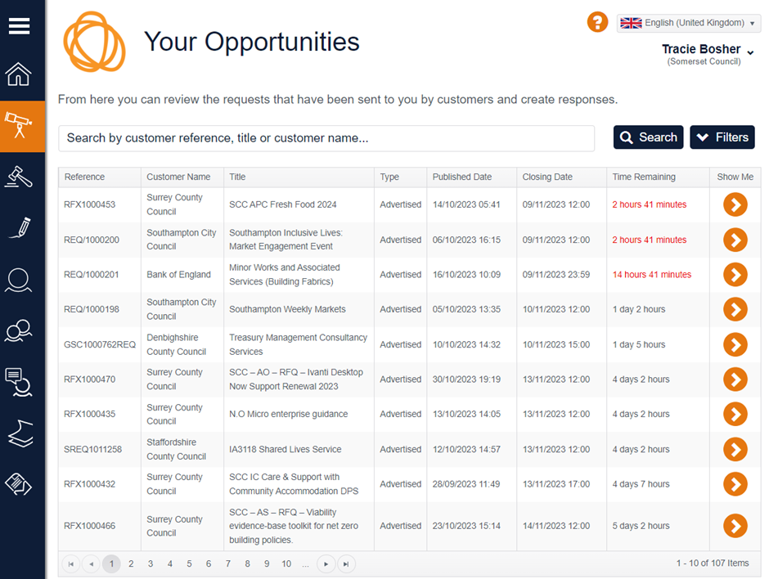
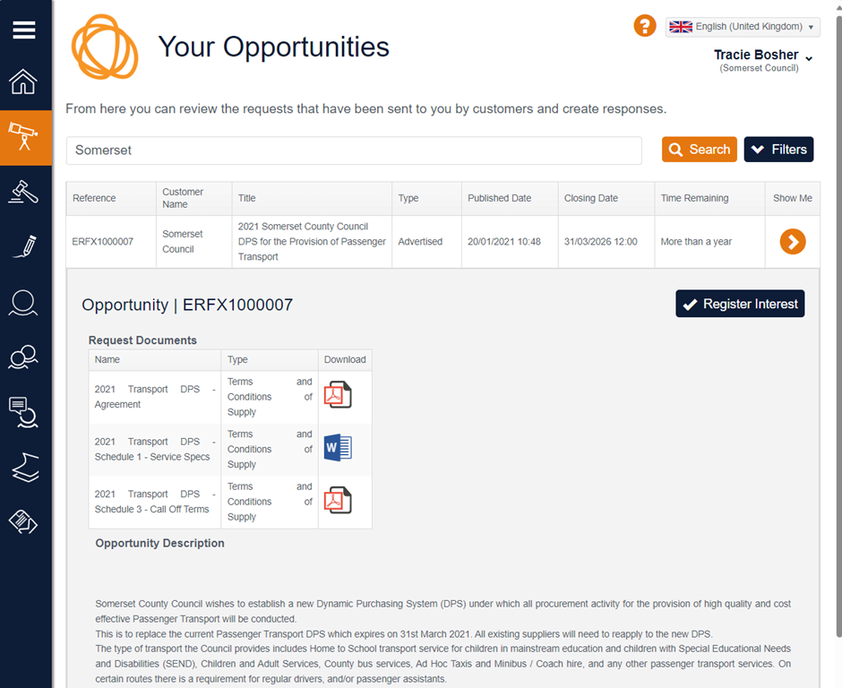
Registering an Interest
Step 4: Selecting an Opportunity
Once you have selected the ‘Opportunity’ option the following page is displayed:
You will be able to search to find the relevant opportunity. Once found, you need to click on 'Register Interest':

Slide 11
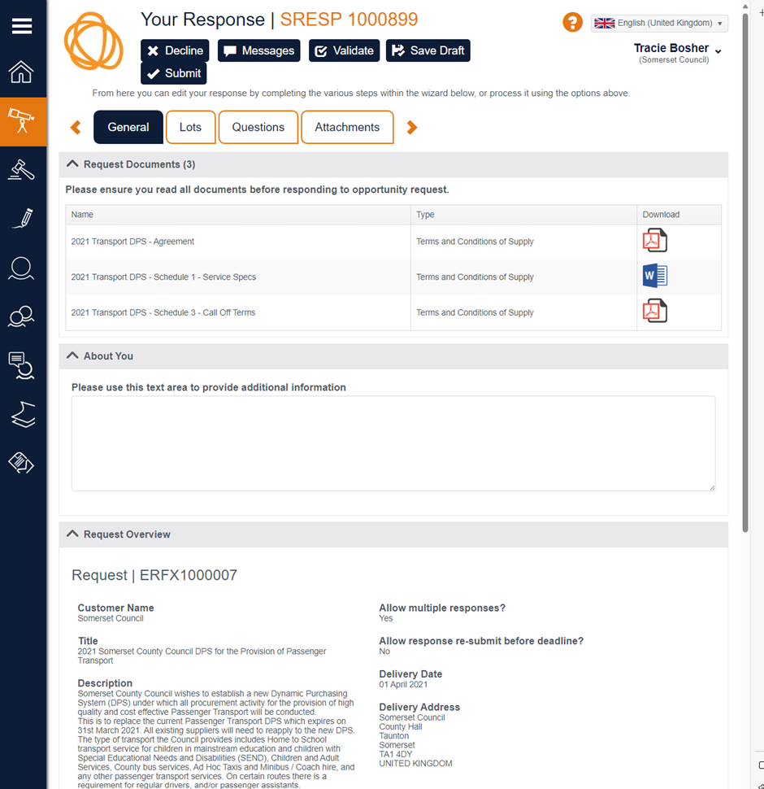
Registering an Interest
Step 5: Register an Interest
Clicking on ‘Register Interest’ will take you to the page opposite. You will need to complete all the mandatory fields by going through the General, Lots, Questions, Attachment etc Tabs.
You can save and validate each section as you proceed and then once all the details have been completed you need to click on the 'Submit' at the top of the page displayed. If you decide this opportunity is not for you, you can 'Decline' the option.
If you want to ask a question to validate any points relating to the information on this page, select 'Messages' and we will respond.

Slide 12
Next Steps
Go to https://supplierlive.proactisp2p.com
Register to sign up to Proactis;
Complete and submit self-registration online form; and
Click on link in email sent to activate your account to enable you to log-in.
Get yourself familiar with the ProActis Supplier Network;
Until the DPS is live, all Messages will still be sent via ProContract; and
Provider Market Engagement Event presentations will be shared on ProContract www.supplyingthesouthwest.org.uk

Slide 13
Time for Questions
Contact email

