Slide 1
KCC SEN Home to School Transport – Phase 2
Market Engagement
June 2016

Slide 2
House keeping

Slide 3
Introductions
Philip Lightowler- Head of Public Transport
Shane Bushell – Client Transport Manager
Stephen Brown – Procurement Manager

Slide 4
Purpose of today
Explanation of Home to School Transport and the responsibilities of The Council.
Information as to how The Council is changing:
A commissioning model
Kent Business Portal
Tendering for services
Pipeline of work and future opportunities
Pilot for SEN Schools- Phase 1
Procurement:
Bulk routes
Individual routes
Kent business portal

Slide 5
Home to School Transport
What is it?
To provide assistance to eligible clients as defined by the education department.
Why do we do it?
Governed by the Education Act 1996
SSFA 1998
Who decides the type of assistance and vehicle?
Coordinating Transport Officers (Client Transport team)
Education department

Slide 6
Home to School Transport
Roles & responsibilities.
Kent County Council:
Manage the public purse
To ensure the clients arrive in a fit state to learn
To make suitable arrangements based on the clients’ need
Safeguarding and compliance
The operator:
To ensure the clients arrive in a fit state to learn
Safeguarding and compliance
To provide a quality service to us and our clients.

Slide 7
SEN Home to School Phase 1
The pilot background:
Savings need to be identified due funding cuts
Three schools were identified to run a whole school contract with one supplier- St Nicholas School, Ifield School & Grange Park.
Two whole school contracts were awarded out of the three.
Results from the pilot
Savings have been generated
Improved customer service
Feedback from the market
Reluctant to sub contract
Tender documents too complicated
Guidance on pricing would be useful.

Slide 8
Lessons Learnt
You said… | We Did…
Tender documents were too complicated. | For Phase 2 we have started the development of the documentation and this has been streamlined and a bidder briefing will be held to explain the documents.
Pricing document was overly complicated. | This has been reduced in size and made a lot more streamlined. A bidder briefing will be held to explain the documents.
Reluctant to sub contract. | Reviewed commissioning model with that in mind.
Guidance on pricing would be useful. | All new tenders will have an expected range of pricing included in order to inform the market where the Council expects pricing to be.

Slide 9
Commissioning Model
Following on from SEN Home to School Phase 1 we have taken your feedback and developed a new commissioning model.
For all contracts starting in January 2017 the routes will be split up as follows –
Bulk routes – Where routes for a particular school are geographically close they will be tendered as one contract.
Individual routes – If a route is not suitable to be combined with others for reasons of geographical spread or size a it will be tendered individually much like they are now.

Slide 10
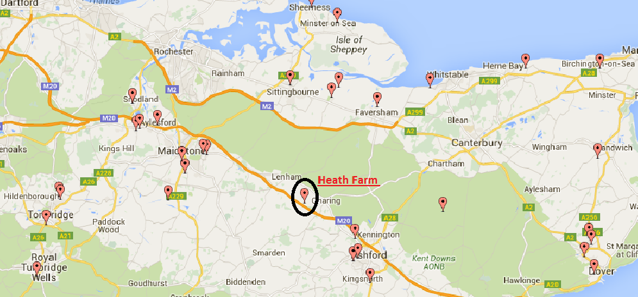
Commissioning Model

Slide 11
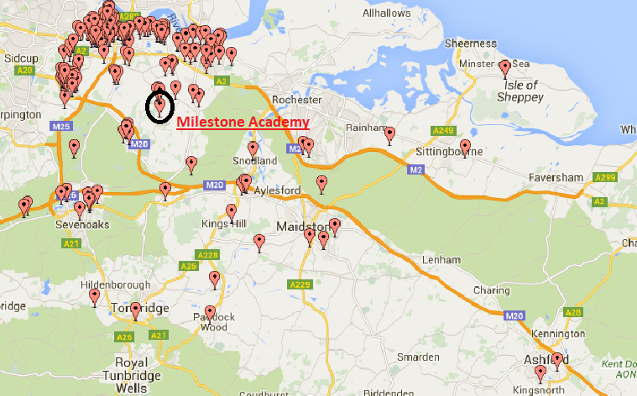
Commissioning Model

Slide 12
Pipeline of Schools
The following schools will be re-tendered in time for a January 2017 start date.
A complete two year list will be distributed once all sessions are concluded.
School | Method
Wyvern School | One School contract bundle, excluding PSV and long distance clients
Broomhill Bank School (West) | One School contract bundle, excluding PSV and long distance clients
Ifield 16+ Unit (NWK College) Ifield School Ifield School Post 19 | One School contract bundle, excluding PSV and long distance clients
Milestone 16+ @ Wilmington Academy | DPS- individual routes
Orchard School | DPS- individual routes
Trinity School (Rochester) | DPS- individual routes
Valence School | DPS- individual routes
Archbishops C E School | DPS- individual routes
National Autistic Society | DPS- individual routes
Simon Langton Boys Grammar School | DPS- individual routes
St Anselms Catholic School | DPS- individual routes

Slide 13
Procurement

Slide 14
Procurement Processes
Bulk Routes – Due to the value these will be tendered for using the same method as for Phase 1.
Individual Routes – These will be tendered using a Dynamic Purchasing System.
ALL opportunities will be advertised through the Kent Business Portal – Please note that paper or emailed responses will NOT be accepted as of 1st November 2016.

Slide 15
Bulk Routes
Due to the value of these contracts we must use what is known as an open procedure, this will be very similar to phase 1.
Currently developing the documentation but have taken on board feedback from Phase 1 and are looking to streamline and simplify.
We will be holding a bidder briefing to allow you to ask questions face to face.

Slide 16
Individual Routes
A Dynamic Purchasing System (DPS) will be used and is an electronic process for submitting proposals in response to a tender issued and involves two steps:
Pre-qualification
Only have to complete once if successful
Must keep Insurances and documents up to date
Streamlined
Be very similar to some of the questions in the Open procedure
Mini Competitions
Quick and easy process
Will be evaluated 100% Price
Very similar to the documents you receive currently

Slide 17
How the process will work?
Initially the pre-qualification element will be advertised on the Kent Business Portal if you are interested you will express an interest and complete the document.
The document covers things such as –
Company details
Insurance
Health and Safety
Agreement to Terms and Conditions
Agreement to core requirements
Once available, the earlier you complete this the better, you can complete it at any stage but if not done so by November then you will not be able to tender for routes unless you have.

Slide 18
How the process will work?
Mini Competitions –
All routes advertised on the Kent Business Portal, operators receive email notification of a route with a link to the opportunity.
Standard procedure gives operators 10 days to respond although this may be shortened for urgent requirements.
Documentation will be similar to current format.
Operator submits price before deadline.
All bids are evaluated and all bidders are notified of the outcome.

Slide 19
Kent Business Portal
If you have not already registered then please do so at the following address: www.kentbusinessportal.org.uk
If you require assistance on the portal please contact procurement.tw@kent.gov.uk

Slide 20
Next Steps
Drop in sessions – W/C11th July 2016
Held over the County – Timetable will be sent to you shortly.
Gives you the opportunity to speak with us one to one and ask any questions you may have.
We can support you in getting registered on the portal.

Slide 21
Tender Timescales
Tender for bulk schools issued August 2016
Bidder Briefing
DPS initial stage issued August 2016
Bidder Briefing
DPS Mini Competitions begin November 2016

Slide 22
Questions

Slide 23
Thank You

