Slide 1
Market Engagement
Extra Care Housing Tender
2016

Slide 2
Our Strategy
Extra Care Housing is an important focus of Hounslow Council’s strategic plans to maintain residents independence while providing suitable levels of care when needed. The Council has a target of developing 180 units of Extra Care by 2019, this tender forms part of our ambitious plans for a modern and diverse Extra Care community in our Borough.
We want our older and disabled residents to lead healthy, safe and independent lives. With the aim that people achieve their full potential in a safe and secure place which supports them, to improve their health and have a positive sense of wellbeing.

Slide 3
What is Extra Care Housing
Extra Care Housing is purpose built housing with 24 hour personal care and support. The level of support is dependant on and adaptable to the needs of the resident.
Extra care Housing offers residents communal living and opportunity for social interaction, activities and facilitates other health and social care services that the resident may use from time to time.
The main ethos of Extra Care is the promotion of independence. Wherever possible, people are encouraged to perform tasks themselves, rather than having them done for them;
In Hounslow the schemes are currently accessible to people aged 55 years (50 years old with a disability) and older who fit the eligibility criteria.

Slide 4
Setting the Scene
Hounslow Council is tendering the care and support element of Extra Care Housing across 3 schemes.
The buildings are owned Sanctuary21 and Octavia Housing and they will continue to manage the housing element. The care and support element will be tendered out.
The current care and support provides a service for 110 people across 3 schemes at any give time.
The care provided is onsite, 24 hours per day and 7 days per week.
Eligible residents access Extra Care once the nomination is approved by the Extra Care panel, where the case is presented by the Social worker. The care and support provider also completes an assessment to ensure the prospective residents needs can be catered for.

Slide 5
Greenrod Place
Greenrod Place is located in Brentford, Hounslow. It is a 43 unit scheme, with 38 flats which Hounslow Council nominates residents for occupation. The building is owned by Sanctuary 21 and they manage the housing element. Sanctuary 21 currently provide the care service.
Greenrod Place
Sanctury21 provide Housing Management and own the building
Sanctury21 currently provide Care Provision (these services will be tendered)

Slide 6
Park Lodge House
Park Lodge is a 36 unit scheme which Hounslow Council nominates residents for occupation. The building is owned by Octavia and they manage the housing element. Octavia currently provide the care and support. The care and support contract expires in 2017 and will be tendered
PARK LODGE
Octavia provide Housing Management and own the building
PARK LODGE
Octavia provide Care Provision (these services will be tendered)

Slide 7
Bridge Wharf House
Bridge Wharf House is a 36 unit scheme and located in Isleworth. It is currently under construction and will be open for residents in November 2016. The building is owned by Octavia and they will manage the housing element. The care and support service will be tendered.
Bridge Wharf House
Octavia provide Housing Management and own the building
No current Provider
Care Provision to be tendered

Slide 8
Current Care Provision
Service | Greenrod Place | Park Lodge House | Bridge Warf House
Units | 38 | 36 | 36
Waking Night Cover | Required | Required | Required
Housing Management | Not part of tender | Not part of tender | Not part of tender
Current hours delivered per week (approx.) | 600 | 530 | 500-600
Indicative Contract start date | December 2016 | July 2017 | December 2016

Slide 9
Tender Process
The services will be tendered in 3 separate Lots. A potential provider can bid for 1, 2 or all 3 Lots.
Lot 1: Bridge Wharf House Care & Support
Lot 2: Greenrod Place Care & Support
Lot 3: Park Lodge House Care & Support

Slide 10
Tender Process
The council will use an Open Procedure – which is a 1 stage procurement process
Most Economically Advantageous Tender (MEAT) – 60% Quality 40% Price
This procurement will only be available on the London Tenders Portal all submissions must be made through this portal. www.londontenders.org

Slide 11
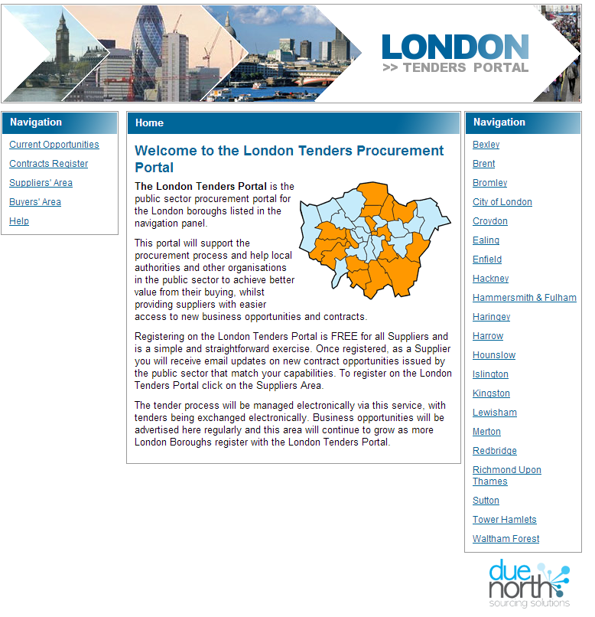
www.londontenders.org

Slide 12
Indicative Tender Timeline
Contract Notice and the release of ITT | July 2016 (TBC)
ITT Submission Deadline | August 2016 (TBC)
Contract Award (Alcatel Period) | September 2016 (TBC)
Contract Mobilisation | September 2016 (TBC)
Contract Commencement | December 2016 (July 2017 for Park Lodge) TBC

Slide 13
TUPE
The Council envisages that the Transfer of Undertakings (Protection of Employment) Regulations 2006 (TUPE) are likely to apply if the services transfer to a new Service Provider.
Providers must take their own professional advice on the potential application of TUPE and their pricing models must include the costs associated with TUPE.

Slide 14
Contract Details
The contract will be between Hounslow Council and the service provider.
The contract will be for 5 years ( with the option of 2 single year extensions, 5+1+1).
Hounslow Council want a block contract for the provision of care and support with spot purchase to manage variations in care.
The contracts for each Lot will be awarded at the same time but the mobilisation of services will be staggered depending on the winnings bids.
Bridge Wharf House (Lot 1) will be the priority for mobilisation of services.
Hounslow Council requires suppliers to pay their staff the London Living Wage.

Slide 15
Further Business Opportunity in Hounslow
Hounslow Council is currently in the process of building an Extra Care Scheme in Feltham which is due to open in 2018. The scheme will comprise of 94 flats. There will be a Dementia cluster (approx. 12 flats) and Learning Disability cluster (approx. 16 flats). The remaining flats will be for general needs, similar to the current residents of Extra Care housing in Hounslow.
The Housing element will be managed by Hounslow Council. The care and support service will be tendered in late 2017.
We welcome any questions regarding this opportunity and any feedback. Please see link to plans on the Hounslow Council Website.
http://www.hounslow.gov.uk/index/council_and_democracy/consultations/redev_prop_feltham_site_consult.htm

Slide 16
Questions & Feedback
If you have any question or feedback then please direct this via the London Tenders Portal. The deadline for questions and feedback is 12pm Friday 8th July 2016.

