Slide 1
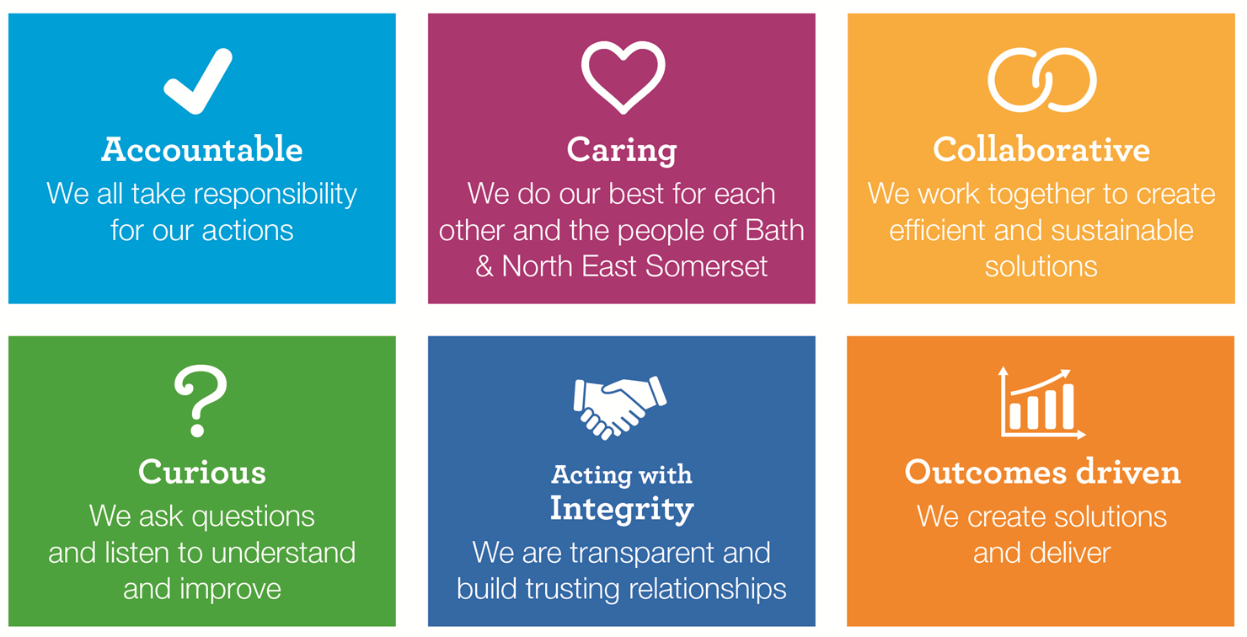
29 April 2019
Construction and Maintenance Frameworks & Term Contracts Market Engagement Event

Slide 2
Welcome and Introductions
Graham Lewis Head of Construction, Maintenance & FM Val Dawes Project Manager, property procurement lead Jon Wellington QS Michelle Vittozzi Procurement & Commissioning Manager Emma Petch Procurement Transformation Team David Cooke Procurement Transformation Team

Slide 3
Agenda
Purpose
The BANES Property Portfolio
ADL / ACL
Procurement Overview
Anticipated Workload
Systems
Values
Things to think about
Procurement Programme
Next Steps
Q&A

Slide 4
The Purpose of Today
Existing Arrangements
Our priorities
What we expect
Background to Requirement
Desired of Outcome from Procurement Exercise

Slide 5
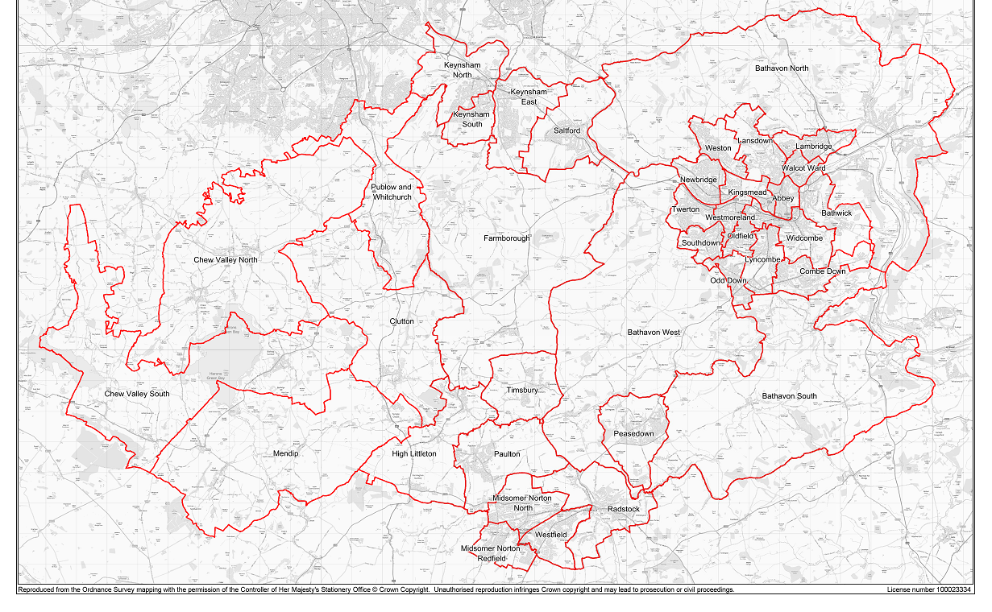
Bath & North East Somerset
Unitary authority (part of WECA)
65 elected members changing to 59
Ward boundary changes – 37 reduces to 33
Current administration is a Conservative majority
Local elections 2 May
Chew Valley to East of Bath
Keynsham to Midsomer Norton

Slide 6
The BANES Property Portfolio
~1,150 property assets:
~450 Commercial estate properties
~700 Non-Commercial assets

Slide 7
The BANES Property Portfolio
World Heritage City
448 Listed Buildings (some of which are multiple listings on one site):
6 Scheduled Ancient Monuments
1 Grade C
20 Grade I properties
36 Grade II*
385 Grade II

Slide 8
The BANES Property Portfolio
Allotments
Arches and vaults
Bridges and Culverts
Car Parks
Care homes
Cemeteries
Children’ s Centres / Youth Centres
Closed burial grounds
Community centres
Conveniences
Crematorium
Depots and workshops
Garages
Heritage buildings (eg Guildhall, Roman Baths)
Hostels
Industrial
Land
Leisure
Libraries
Licensed facilities
Masts
Mines (abandoned)
Museums
Monuments, tombs, obelisks and fountains
Offices
Open Space
Parks and gardens
Play areas
Private roads
Residential
Retail
Schools
Waste and recycling facilities

Slide 9
ADL / ACL
Aequus Developments Ltd (ADL)
Wholly owned by B&NES for development of a variety of residential sites in the local area for sale and or long term rental income stream.
Aequus Construction Ltd (ACL)
Subsidiary of ADL
Several HMO / open market rental schemes now complete and occupied in Bath
Currently delivering 95 units in Keynsham
37 unit scheme pending planning determination
Other development schemes pre-planning
Several flat refurbishment schemes pending in Bath
Exploring JV development opportunities with neighbouring authorities

Slide 10
Procurement Overview
Term Contract: Minor Building Work & Responsive Repairs
Term Contract: Engineering Services
Lot 1 Mechanical (including responsive repairs)
Lot 2 Electrical (including responsive repairs)
Term Contract: General Building Works (including new build
Lot 1 up to the value of £150,000
Lot 2 – up to the value of the OJEU Works Threshold
Single tender action
Non-exclusive agreements
Agreements will be minimum 4 year duration

Slide 11
Term Contract: Minor Building Work and Responsive Repairs
DN387819 2019/S 021-045877
NEC 4 Term Service Short Contract
Max order value £5k
Anticipated Nr of Suppliers: 3
Total estimated value £2.1M over period
To include basic plumbing and electrical, roofing, fencing, glazing, locks etc.
24/7, 365 responsive service required.

Slide 12
Term Contract: Engineering Services
DN389208 2019/S 021-045879
NEC 4 Term Service Contract (Option A)
2 lots – electrical and mechanical
Max order value £300k, but majority of works sub £15k
Anticipated Nr of Suppliers: 3 electrical, 3 mechanical
Total estimated value £6M over period
Routing servicing, testing & remedials
Planned maintenance
Mini-competition (discretionary)
24/7, 365 responsive service required.

Slide 13
Term Contract: General Building Works
DN387849 2019/S 021-045878
Framework Contract for use with NEC4 contracts. Anticipated that most call off contracts to be NEC 4 Option A
Lot 1 - Building Works to £150k
Lot 2 – Building Works to OJEU threshold
Anticipated Nr of Suppliers:
Lot 1 – 3 nr
Lot 2 – 7 nr
Mini Competition
Total estimated value £48M over period

Slide 14
Anticipated workload (projects)
Cameley Primary
Peasedown St John Primary
Roman Baths heat exchange
Somerdale bridge
1-2 Orange Grove
Lewis House refurbishment
Guildhall refurbishment
Public Realm schemes
Household waste recycling site
Commercial estate refurbishments / dilapidations
Fashion Museum
Assembly room dilaps
Pulteney Bridge works
Pulteney Weir Radial Gate
Bog Island / Island Club
Grand Parade & Undercroft
Workplaces
Corporate Capital Planned Maintenance
Commercial estate refurbishments / dilapidations
Regeneration / WECA

Slide 15
What wont be included
Highways works
Parks soft landscaping
IT
Cremation equipment

Slide 16
BIM / Information Systems

Slide 17
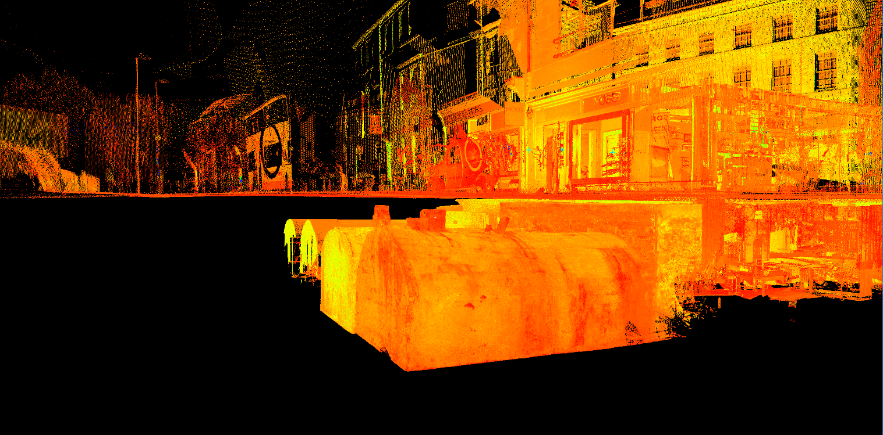
BIM / Information Systems

Slide 18
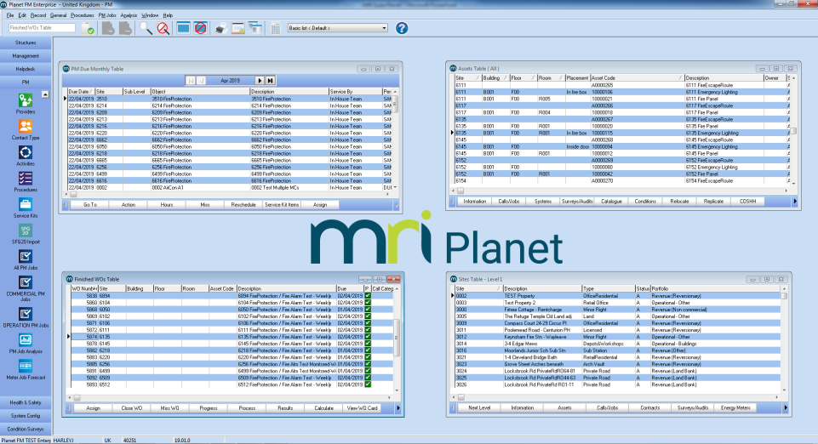
Asset management and compliance database
Compliance certification available to all via web portal
Mobile and web use for contractors

Slide 19
Our Values and Procurement

Slide 20
Things to think about
It’s not all about cost
B&NES have declared a climate change emergency
Heritage
Safety
Quality
Efficiency
Response times
Stakeholders
Social Value
Design management
Flexibility

Slide 21
Procurement Programme
Key Dates :
PIN and section 20 notices issued
ITT documents and contract notices issued 7 June
ITT response deadline 12 July
Contract Award (post standstill) Sept
Note: dates may be subject to change, check www.supplyingthesouthwest.org.uk for latest details

Slide 22
Next Steps
Supplying the South West Portal – please ensure you are registered:
www.supplyingthesouthwest.org.uk
Monitor the portal to ensure you can access documents on time
Queries or clarification questions should be addressed to Val Dawes and sent through the messaging area of the e-tendering portal
We will not respond to queries or clarifications sent directly to an e-mail address
Deadline is timed and automated – do not be late and make sure it is submitted!

Slide 23
Q&A

