Slide 1
Supported Living Service
Housing Management
Soft Market Testing

Slide 2
1. Purpose of Engagement
Bracknell Forest Council (The Council) are looking to create accommodation and support for an ageing population of people with Learning Disabilities, built around demand, need and best practice which is informed by the market and community.
To assist with the Business Care and Options Appraisal, the Council are undertaking some soft market testing to gain views on 1) Housing Management and 2) Care and Support.
This gives potential providers the opportunity to feed in their views on the concept building design and service model.
Your current experience, knowledge and expertise as a registered Housing Association (HA) will provide a useful steer in the development of a viable service model whereby people with Learning Disabilities are supported to live independently and are supported individually with innovation and care.
Notes:
Add in looking for Registered Housing Provider

Slide 3
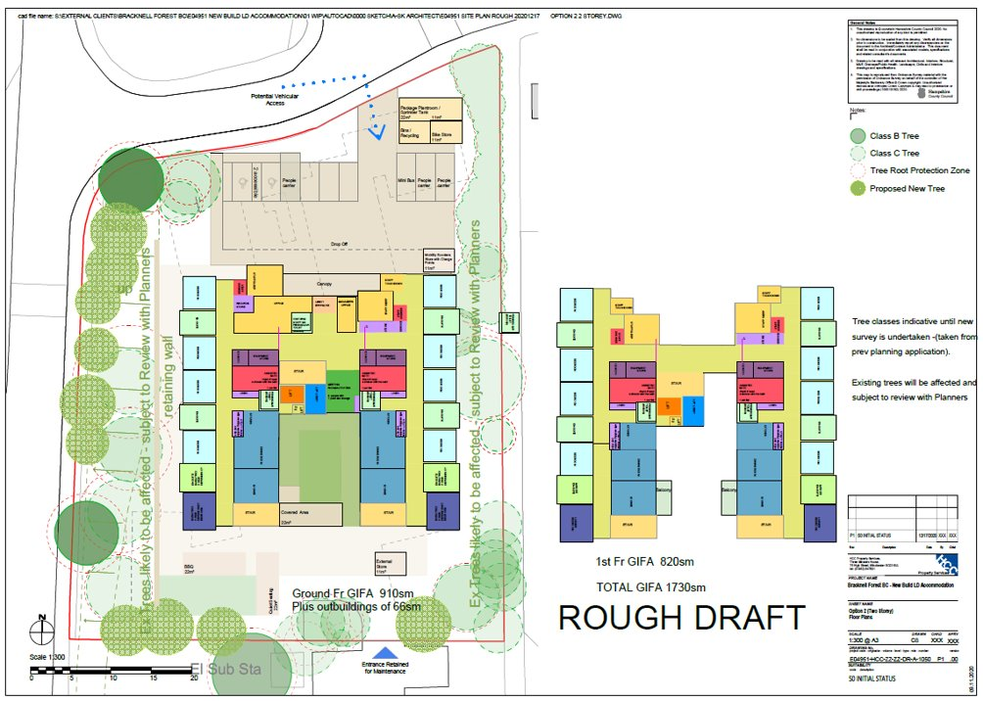
2. Proposed Supported Living Building Model
New build – 2-storey building
Consisting of four households of five
10 residents per floor
En-suite bathroom for each room.

Slide 4
3. Sourcing Options
Various approaches have been considered:
Item | Option | Item Description
1. | Make | The Council designs and constructs the building. Upon completion, the building is leased to a Registered Provider for Housing Management who will operate it. Ownership of the asset remains with the Council.
2. | Buy | The Council sells the land (and current building) to a provider to design, build, finance and operate the facility. Ownership of the asset passes to the provider, with a long term contract for the service to be provided to the Council.

Slide 5
4. Need and Demand
Bracknell Forest Community Team for People with a Learning Disability currently manages a caseload of 420 people (21/22)
162 of these individuals are tenants of BFC commissioned properties.
All individuals are in receipt of individually tailored support packages.
Some of the properties are not suitable to meet the needs of these individuals and are not able to be adapted further to accommodate these needs.
The graph below and table indicates the no of people with a significant likelihood of requiring new accommodation in the next 5 years
No of individuals….
Living at home with carers over the age of 65 | 45
With support needs likely to increase significantly | 20
Who will need to move for other reasons | 10
Transitioning into ASC in the next 4 years requiring accommodation | 9
Currently living at home with challenging behaviours which may require alternative care | 6
Living in private lets who are at risk of being served notice

Slide 6
5. Next Steps
Item | Action | Date
1. | Finalise Business Case with market input | December 2021
2. | Construction period including planning permission | April 2022 – May 2024
3. | Procurement of Housing Management and Care and Support Provider Services | July 2022 – September 2023
4. | Provider Mobilisation | October 23 – June 2024
5. | Service Commencement | August 2024
If you would like to discuss this opportunity further please contact contracts.team@bracknell-forest.gov.uk

Slide 7
In order to access our survey please click on the link below:
Bracknell Forest Council - Supported Living - Housing Management (bracknell-forest.gov.uk)
Many thanks for your time and expertise.

