Slide 1
Community Based Wellbeing Services
Procurement Approach
Workshop 3
January 2020

Slide 2
Contents
Section 1 – Specification Feedback
Section 2 – Contract values
Section 3 – Procurement Process
2

Slide 3
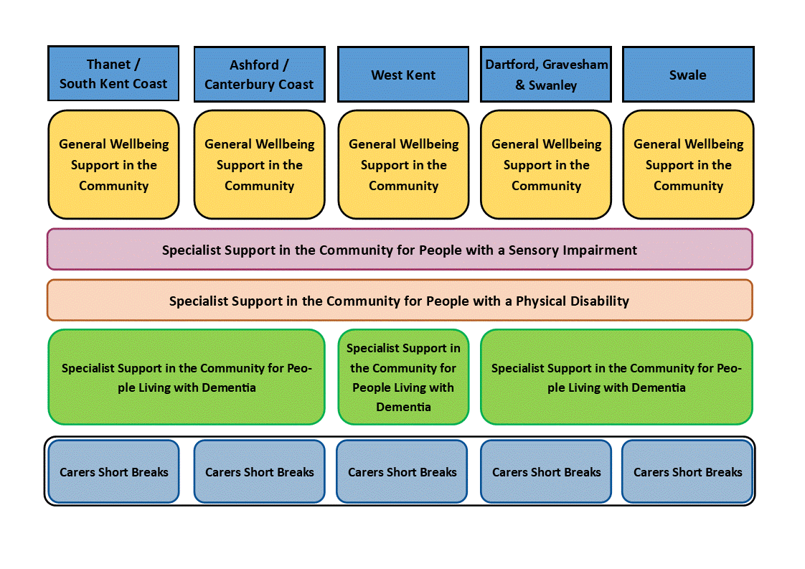
Specification
The model for service delivery has been slightly amended following engagement:
The changes are to the Specialist Dementia contracts.
Instead of 5 separate contracts, smaller contracts have been combined to create more attractive contracts for delivery across 3 areas.
12

Slide 4
Specification
Specification Sections:
Introduction / Strategic Context
The Service – Aims and Objectives
The Outcomes – Personal
The Outcomes – System
Social Value
12

Slide 5
Contract Values
Contract Values
 |  | 1 | 2 | 3 | 4 | 5 | TOTAL
 |  | 2020/21 | 2021/22 | 2022/23 | 2023/24 | 2024/25
PHASE 1 | GW: TSKC | £ 1,231,840.75 | £ 1,235,000.00 | £ 1,240,000.00 | £ 1,245,000.00 | £ 1,250,000.00 | £ 6,201,840.75
 | GW: WK | £ 975,866.17 | £ 980,000.00 | £ 990,000.00 | £ 1,000,000.00 | £ 1,015,000.00 | £ 4,960,866.17
 | S: SI | £ 1,089,532.96 | £ 1,074,000.00 | £ 1,058,000.00 | £ 1,030,000.00 | £ 1,000,000.00 | £ 5,251,532.96
PHASE 2 | GW: DGS | £ 734,460.80 | £ 700,000.00 | £ 660,000.00 | £ 630,000.00 | £ 600,000.00 | £ 3,324,460.80
 | DEM: E | £ 164,750.90 | £ 192,000.00 | £ 250,000.00 | £ 300,000.00 | £ 345,000.00 | £ 1,251,750.90
 | DEM: W | £ 286,395.54 | £ 300,000.00 | £ 320,000.00 | £ 350,000.00 | £ 375,000.00 | £ 1,631,395.54
 | DEM: DGSS | £ 263,499.72 | £ 265,000.00 | £ 270,000.00 | £ 280,000.00 | £ 300,000.00 | £ 1,378,499.72
 | S: PD | £ 148,616.20 | £ 148,616.20 | £ 155,000.00 | £ 160,000.00 | £ 165,000.00 | £ 777,232.40
PHASE 3 | GW: ACC | £ 639,885.84 | £ 640,000.00 | £ 650,000.00 | £ 660,000.00 | £ 670,000.00 | £ 3,259,885.84
 | GW: S | £ 357,464.84 | £ 358,000.00 | £ 325,000.00 | £ 300,000.00 | £ 275,000.00 | £ 1,615,464.84
 | Carers SB |  |  |  |  |  | £ -
12

Slide 6
Procurement Process
The phased procurement approach is set out below, also indicating the length of grant extensions required for those organisations that are currently funded, up until their area has completed procurement:
Phase 1 | Phase 2 | Phase 3
January - March 2020 | April – June 2020 | October – December 2020
Sensory Impairment | Physical Disability | Carers Short Breaks
Wellbeing: Thanet / SKC | Wellbeing: DGS | Wellbeing: Ashford / Canterbury
Wellbeing: West Kent | Specialist Dementia (all) | Wellbeing: Swale
Grant Extension to: End June 2020 | Grant Extension to: End September 2020 | Grant Extension to: End March 2021
13

Slide 7
Procurement Process
The procurement timetable is set out below.
Stage | Anticipated Date
SQQ issued to Providers | Monday 3rd February 2020
Deadline for Providers’ questions | Monday 10th February 2020
KCC response to Providers’ questions | Wednesday 12th February 2020
SQQ returned by Providers | 12:00 Monday 17th February 2020
Evaluation and shortlisting | 17th – 28th February 2020
Invitation to Tender (ITT) dispatch | 2nd March 2020
Tender return | 16th March 2020
Tender evaluation and clarification, inc potential negotiation meetings | 17th – 25th March 2020
Potential issue of Invitation to submit Final Tender | 30th March 2020
Final tender return | 15th April 2020
Issue award letters | 1st May 2020
Standstill period complete | 11th May 2020
Contract award | 12th May 2020
Mobilisation | 12th May – 30th June 2020
Service Commencement | 1st July 2020
13

