Slide 1
E-tendering and contract management system – Due North

Slide 2
WELCOME
Housekeeping
• In case of fire • Toilets • No smoking • Mobile Phones • Timescales for today’s session

Slide 3
Objectives of the session
E-tendering (DueNorth)
Registering as a Supplier
Where to find an opportunity
Registering an interest in an opportunity
How to start your response
What do the online submission templates look like?
Notes:
Introduction to Commercial Services, then David to give a brief overview of what will be covered in the session.

Slide 4
Why move on to an e-tendering system?
UK Public Contract Regulations mandated the use of e-tendering by 2018
Efficiencies for buyer and supplier
One advertising portal for the South West
Saves supplier information
No costly paper tenders
Quicker tender processes where appropriate

Slide 5
Due North (Proactis)
An electronic Tendering and Contract Management System has been introduced for Cornwall Council - this system is called Due North.
The main benefits expected from the system include making it easier and simpler for the Council and partners to advertise tenders in a way that is consistent, easier for suppliers to view opportunities and bid for work.
Notes:
Most of the other South West Authorities use DueNorth

Slide 6
Registering and signing in for the first time
Visit:
https://www.supplyingthesouthwest.org.uk

Slide 7
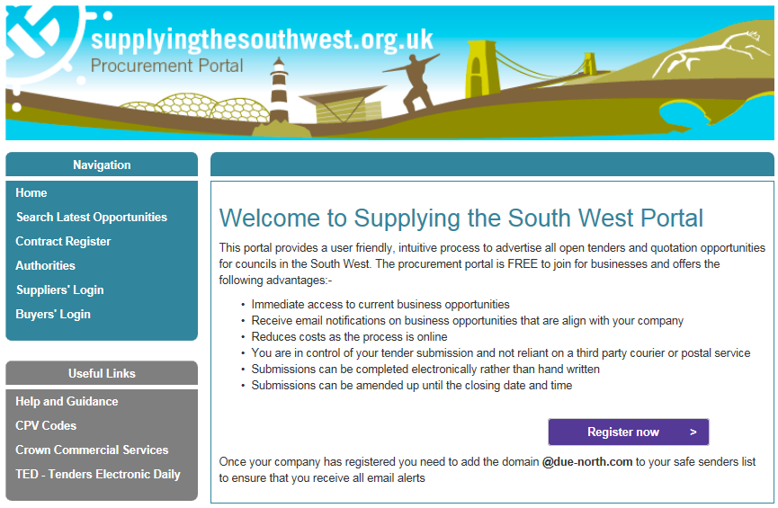
Notes:
Click the register now button

Slide 8
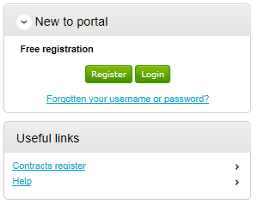
Notes:
New to Portal - Click the Register button and follow the instructions.

Slide 9
Supplier Guidance
All suppliers will need to register on Due North in order to receive alerts for Cornwall Council opportunities including:
Soft market testing
Tender opportunities
Supplier events

Slide 10
Supplier set up (Requirements)
Notes:
Follow the wizard - in 7 steps. This is step 1.

Slide 11
Supplier set up (Contact information)
Contact details
User name
Password
Memorable data
Notes:
Step 2 – Enter your own contact details, a username, a password, and a memorable word/hint.

Slide 12
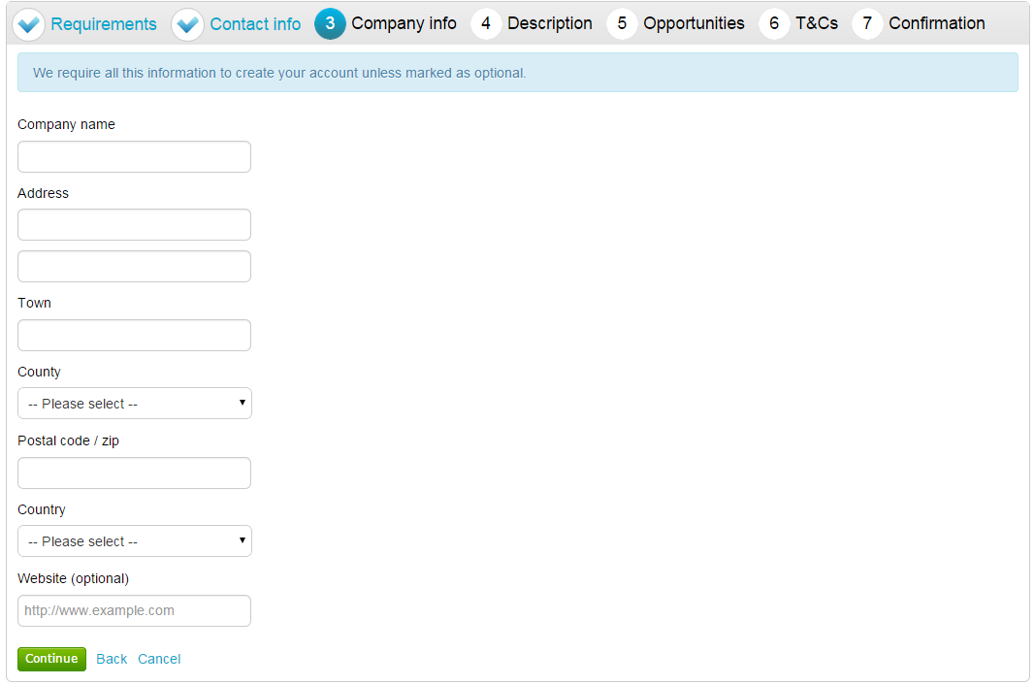
Supplier set up (company info)
Company Name
Address
Notes:
Step – Company Name and Address

Slide 13
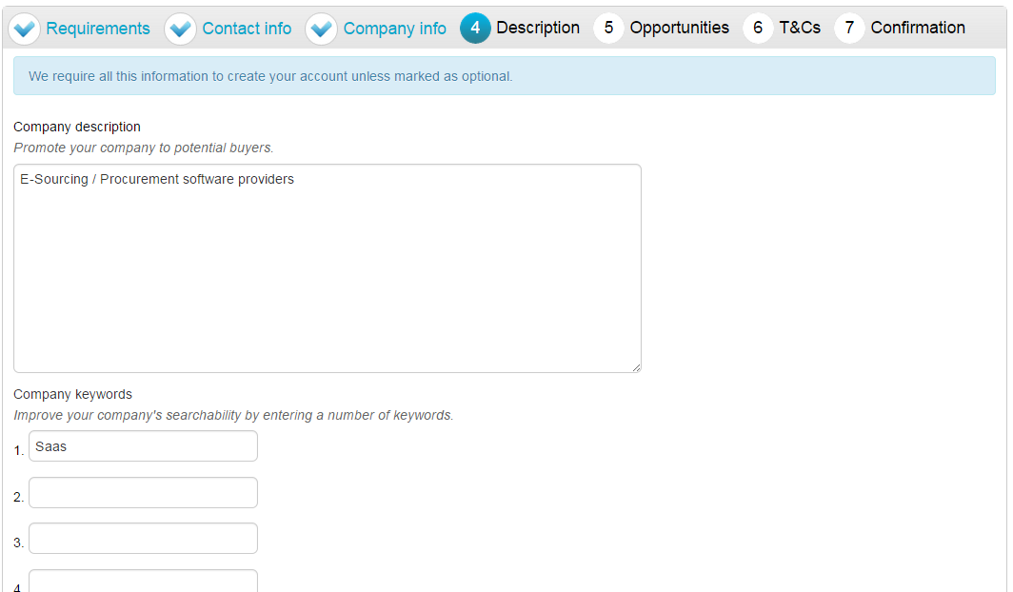
Supplier set up (Description)
Company Description
Keywords
Notes:
Step 4 – The description helps promote your company to potential buyers, while the keywords can improve the ‘searchability’ of your company.
It is important that you complete this information as the procuring organisations can search for a company based on the description or keywords specified.

Slide 14
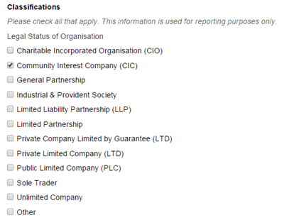
Supplier set up (Description)
Classify your company
Notes:
Step 4 – This is where the supplier can highlight the classifications that the company belongs to (which is used for reporting purposes only). You can tick as many that apply to your organisation.

Slide 15
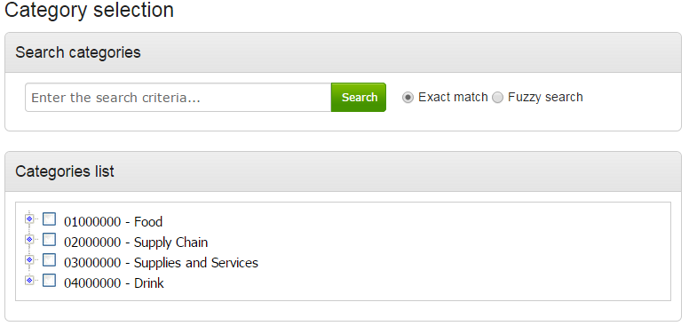
Supplier set up (Opportunities)
Select categories of interest
Receive automatic e-mail notifications
Notes:
Step 5 – receive automatic e-mail notifications of new opportunities that have been published that may be of interest to your company

Slide 16
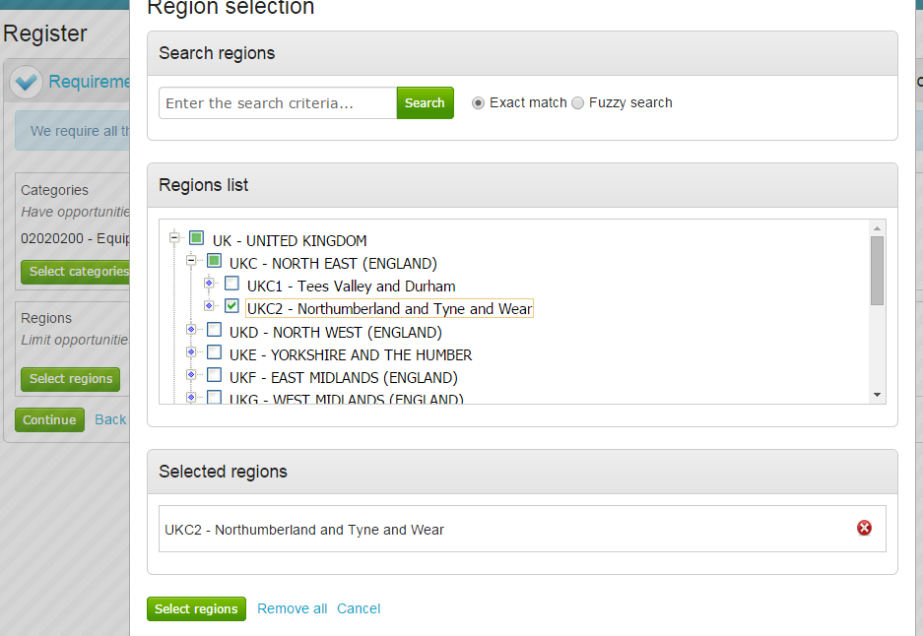
Supplier set up (Opportunities)
Select categories of interest
Receive automatic e-mail notifications
Notes:
Step 5 – Select the region that you want to supply to – this will limit the opportunities that you are emailed to only regions that you have selected.

Slide 17
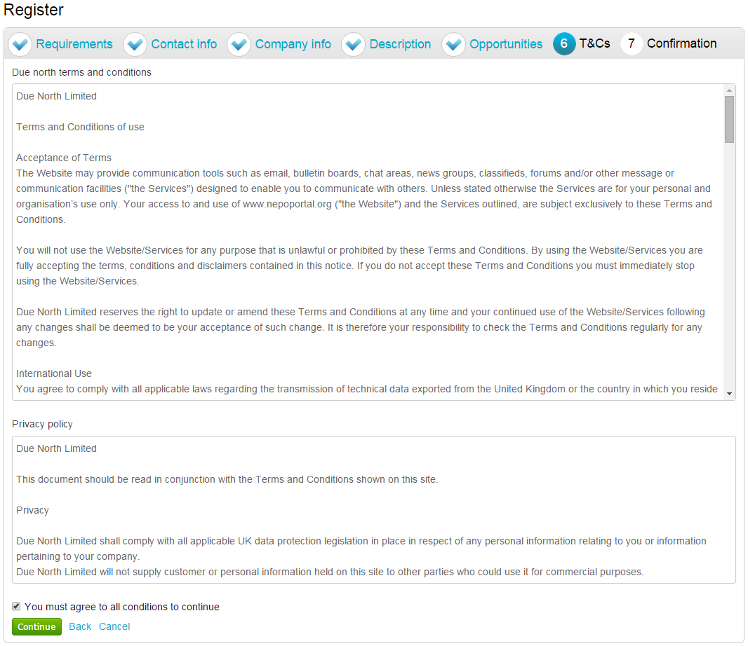
Supplier set up (T&Cs)
Notes:
Step 6 – Terms and Conditions of using the system, and also the privacy policy as laid out by Due North.

Slide 18
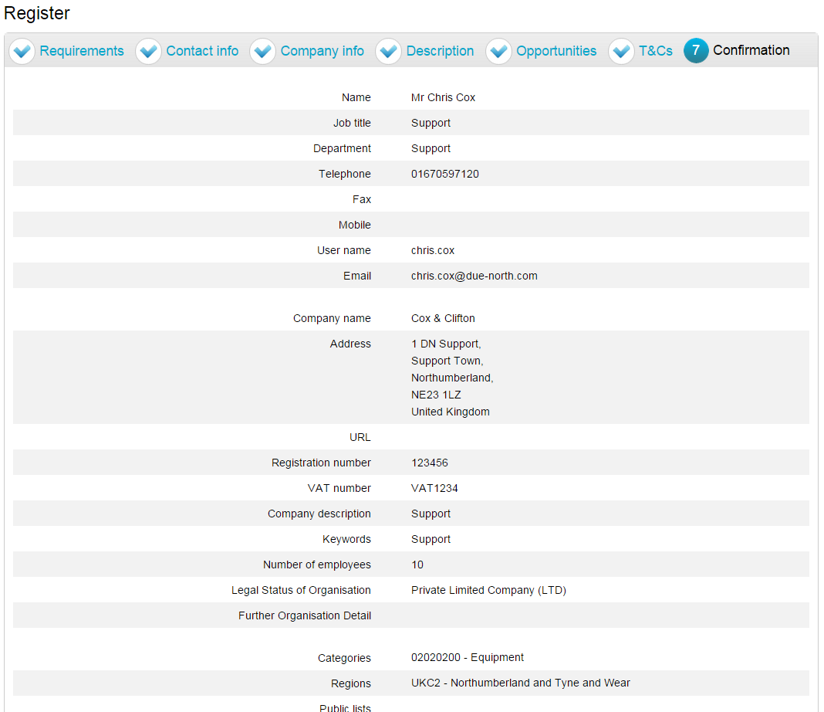
Supplier set up (Confirmation)
Notes:
Step 7 – summary of the details that have already been entered into the system, to be checked before completion of registration.

Slide 19
Supplier set up (Submission)
Notes:
When the registration is accepted then you will receive an email containing a reminder of your username and the link to access the opportunity portal. Takes about an hour

Slide 20
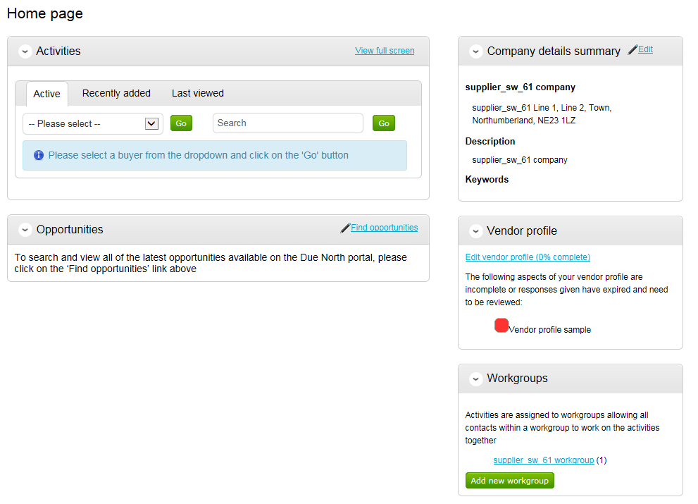
How to Register an interest
Click the Find Opportunities link on the Home page
Notes:
After you have logged in you will be taken to your Home page.

Slide 21
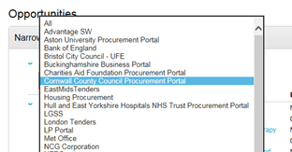
How to Register an interest
Select Cornwall Council from the list.
Notes:
Use the Narrow your results panel at the left. Select Cornwall Council from the list.

Slide 22
How to Register an interest
You will be presented with a list of opportunities that match your search criteria.
Click the link
Notes:
Opportunities for Cornwall Council.

Slide 23
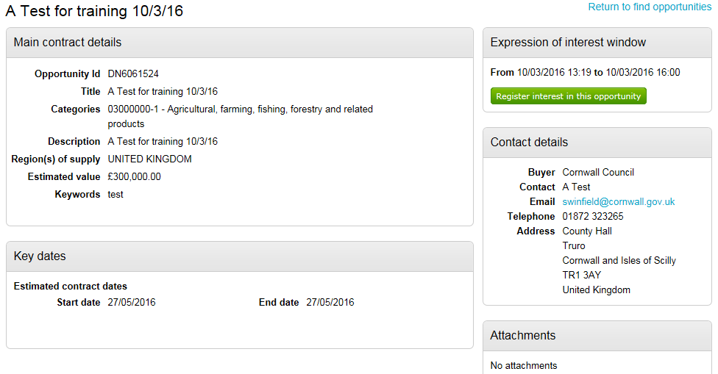
How to Register an interest
Click the Register interest in this opportunity button
Notes:
Click Register interest in this opportunity button.
Registering an interest is necessary to enable the supplier access to the tender documents.
The supplier will then be required to respond to the tender it is interested in.

Slide 24
How to start your response
After registering an interest
Notes:
You have to log out and then log back in to get to My Activities

Slide 25
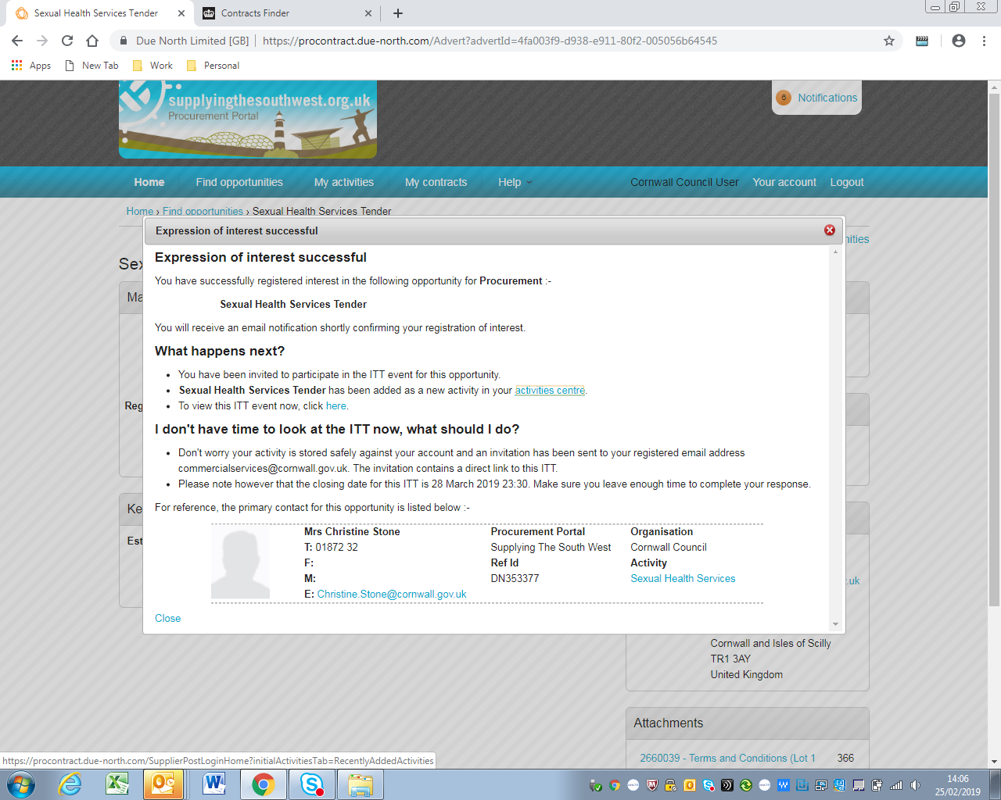
What happens when you register an interest in the opportunity
To view this ITT event now, click here.

Slide 26
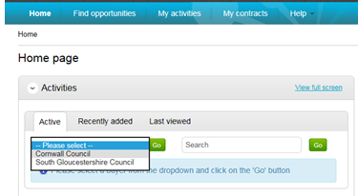
How to start your response
Select Cornwall Council

Slide 27
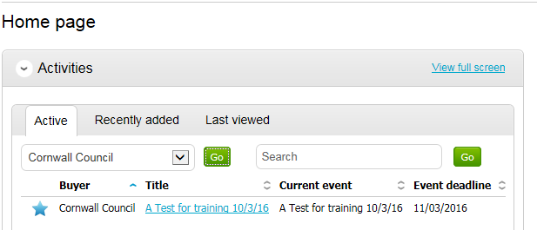
How to start your response
Click the tender link
Notes:
Click on the tender link

Slide 28
How to start your response
Click the Start link
Notes:
Click the Start link

Slide 29
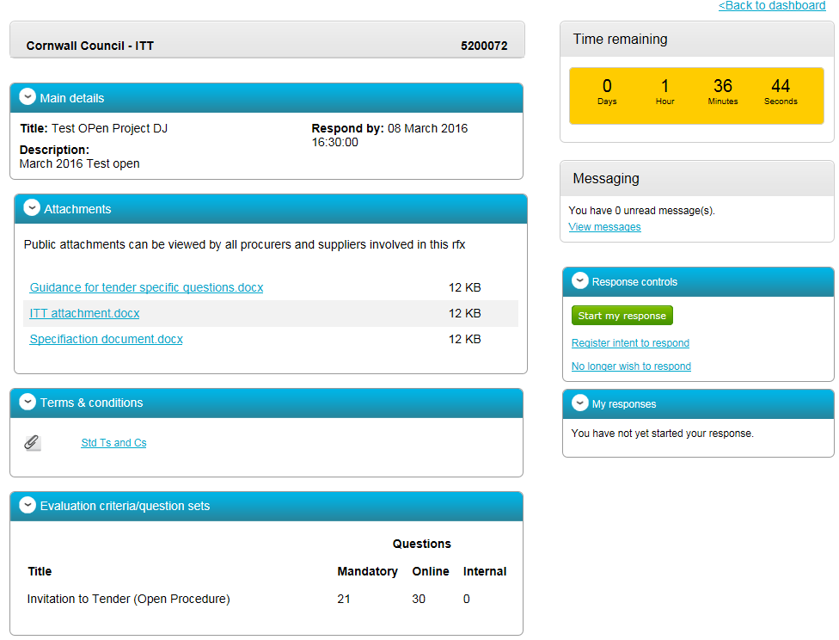
How to start your response
Press the Start my response button.
Notes:
This is effectively the supplier home screen Countdown Messaging system (important) TCs ITT Spec
Click Start my response to access the tender (not sure if you can access the docs on the links on the left)

Slide 30
What do the online submission templates look like?
Follow the response wizard
Notes:
Response wizard will help you through

Slide 31
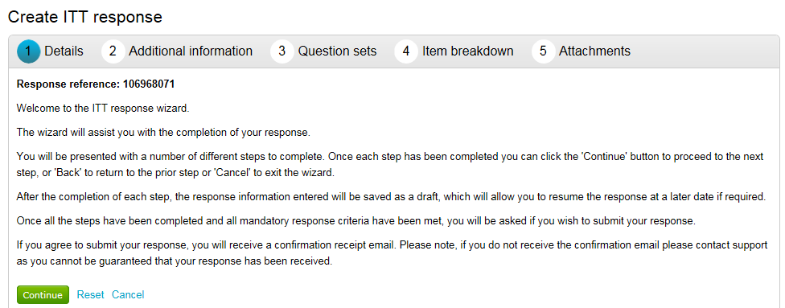
Online submissions
Follow the response wizard
Notes:
Details on how to step though your response

Slide 32
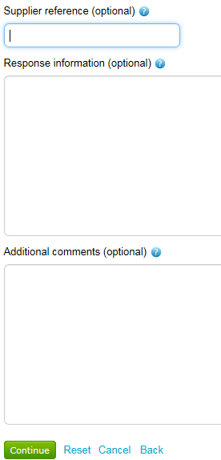
Online submissions
Notes:
Details on how to step though your response Anything optional – you don’t need to do

Slide 33
Online submissions
Progress Bar
Notes:
Click Edit response

Slide 34
Online submissions
Supplier Guidance document will be attached
18 minute time out Red traffic light ? Read the question.
Notes:
Click Traffic light system – got to turn them all green If you’ve done a bid before most sections will already be green

Slide 35
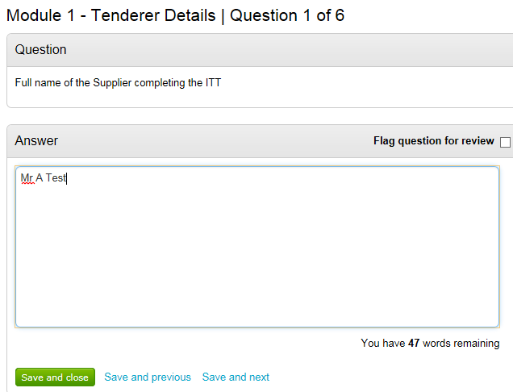
Online submissions
Notes:
Enter your response in the Answer box, then click either save and close or save and next to page through the questions. Most questions are straight forward yes no declarations

Slide 36
Online submissions
Notes:
Notice the traffic light on that question is now green. Answer all the questions until they are all green.

Slide 37
Online submissions
Notes:
Notice your progress bar is fully green. Click continue. Until it is completely green you wont be able to submit your tender There is a save and continue button

Slide 38
Online submissions
Notes:
Where we are able to attach pricing documents/schedules.

Slide 39
Online submissions
Notes:
Where you are able to attach documents and also accept the Terms and Conditions of the Tender.

Slide 40
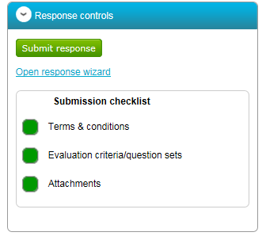
Online submissions
Notes:
Click the Submit Response button. When you have completed the evaluation, read the TCs and added attachments where required everything will be green and you can submit

Slide 41
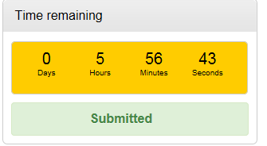
Online submissions
Notes:
Click the Submit Response button.

Slide 42
System Help

Slide 43
System Help
Notes:
Expand for step by step guides

Slide 44
Due North (Proactis) Supplier Helpdesk
Tel: 0330 0050352
Cornwall Council County Hall Truro TR1 3AY Tel: 0300 1234 100 www.cornwall.gov.uk
Notes:
Or contact me direct

