Slide 1
PASSENGER TRANSPORT
SUPPLIER INFORMATION WORKSHOP
COMMISSIONING
OPERATIONS
COMMERCIAL & PROCUREMENT
April 2015

Slide 2
Introduction
Welcome / Housekeeping
Format of the session:
Current Information
Your Feedback
Why We Need to Change
Learning From Feedback
Proactis
How Routes Are Divided
Accessing Work
Timescales
Next Steps for Suppliers
Questions & Answers

Slide 3
Current Information
Systems
E-Tendering through @uk
Call off contract for Ad-hoc Health and Social Care
Public Transport contracts by individual manual tenders
Facts & Figures
Number of Contracts
650 Mainstream School/SEN
648 Regular Health & Social Care
70 Public Transport
Value of Contracts
£11.9m Mainstream School/SEN
£3.6m Public Transport
£1.5m Health & Social Care Transport
11,000 Ad-hoc Health & Social Care trips per annum

Slide 4
Your Feedback
Soft Market Testing – Feedback from operators
Working collaboratively with schools – school times
Combining services, public, school and social care
Operator knowledge
Too prescriptive with tenders
Annual subscription for @UK
Current tendering can be a painful process!
Rates not often reviewed when changes take place on contracts
Duplication of effort – invoices, DBS
Overall
Better engagement with operators – building relationships

Slide 5
Why we need to change
Responding to your feedback
Responding to the 2013 Transport Review
Work more efficiently
Exploring options for tendering differently
Improve data information and storage
One system
Automatic alerts for information
Building a system fit for the future
- Legislative Changes in Social care & Education

Slide 6
Learning From Feedback
Feedback
Solution
A system which remains open to allow you to join at any time..
No access or annual fee.
Pre-populate with responses previously given.
Clearly and logically laid out. Simple to use and touchscreen and PC/Laptop compatible.
Being able to use a Smartphone/Tablet. Pre-populated so only enter route specific (such as price) information.
A dedicated ‘Contracts’ area to view this information.
A dedicated ‘Documents’ area to save this information.
A dedicated ‘Opportunities’ area which will show all the available opportunities unique to your vehicle sizes and geographical coverage.
Missing out on opportunities as Frameworks are closed to new entrants.
I can’t see all of the opportunities available to me in one place because of the different systems and Frameworks in place.
I can’t manage all of my documents on the system.
I can’t see all of my awarded contacts in one place
Duplication of time and effort when bidding.
The current system is difficult to use.
Missing out on opportunities with a short turnaround time when away from a computer
Sign up fees and an annual cost for access.

Slide 7
New System
Dynamic Purchasing System via Proactis.
Tailored system to provide solutions to your feedback and optimise potential for working together in a smarter way.
The next few slides will provide an overview of the Proactis system:

Slide 8
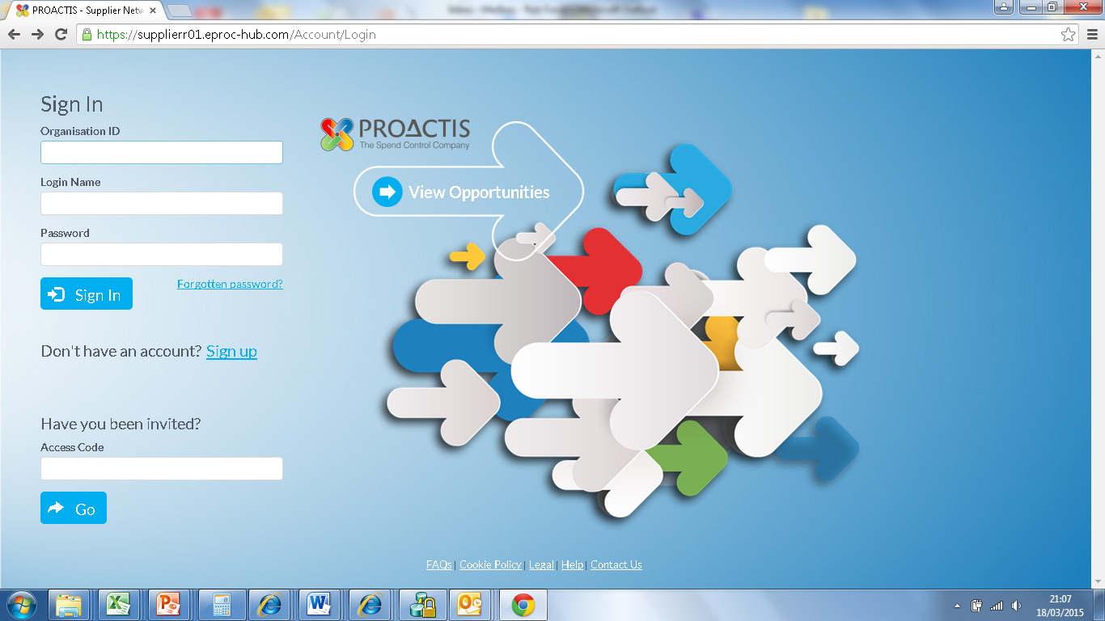
Sign Up
Information You Will Need for this stage
Name/Email/Basic Company information will provide access to the site

Slide 9
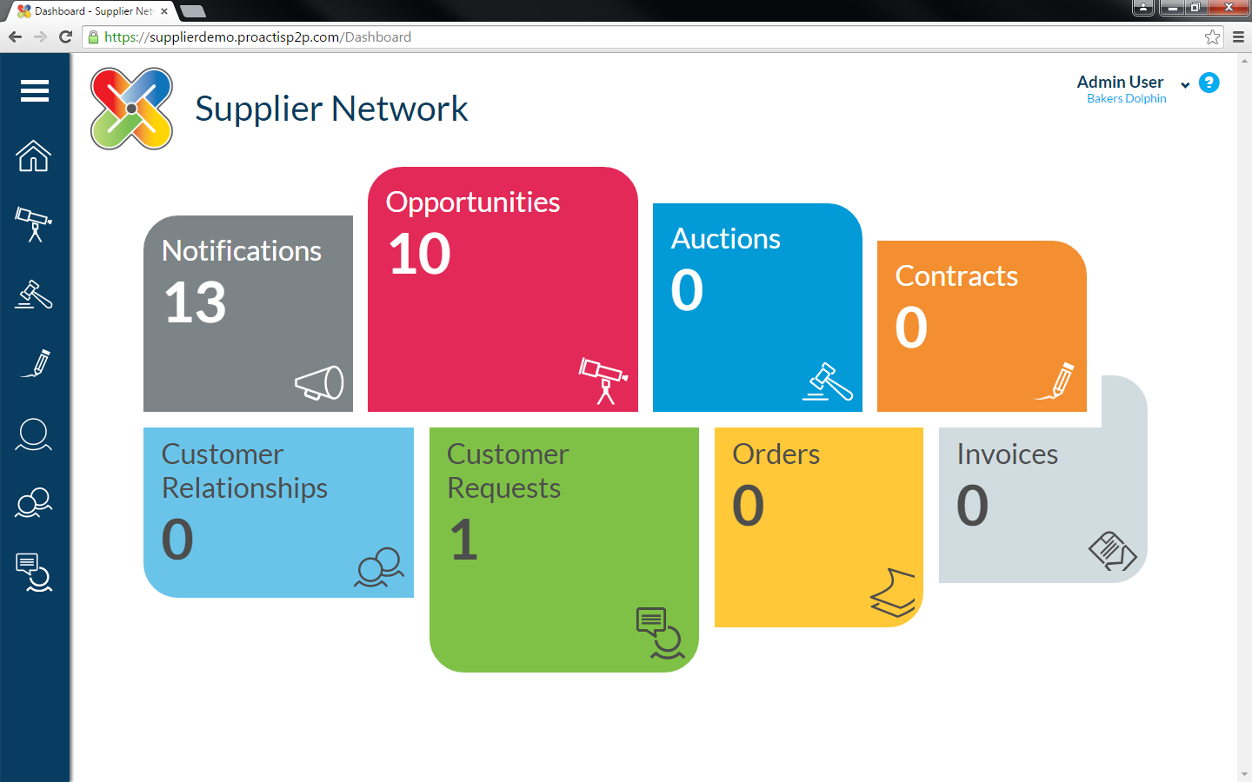
Home Page
(Screenshot and explanation of homepage)
Clear and simple navigation
Touch Screen and Desktop compatible
Clearly see all opportunities/documents/contracts available to you

Slide 10
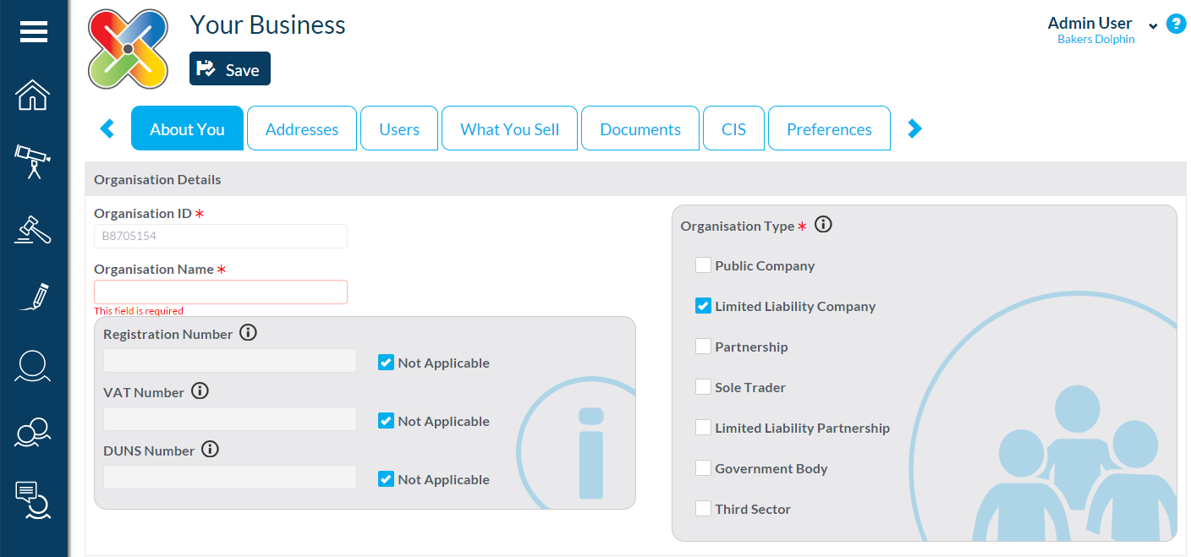
Registration
(picture of registration page)
Information You Will Need for this stage
Company details and minimum standard information such as H&S and previous accounts/turnover.
Mostly Yes/No questions.

Slide 11
How Routes Are Divided
1. Buses (22 seats or more)
2. Mini Buses (up to 21 seats + driver)
3. Taxis (up to 8 seats)
4. Ad Hoc Taxis (up to 8 seats)
Why these Lots?
Vehicle size
You state which areas you want to see

Slide 12
Accessing Work
One off
multiple routes
Price & quality
Price only
Urgent
Long term
Qualification
Multiple Call Off Options
PQQ
Quality
Lot Specific Information
General to all Lots
Pass/Fail questions
Simple and flexible call
off process
Split by Lot
and geographical area
You will not be required to enter duplicate information, even when applying for multiple Lots

Slide 13
Timescales
In the coming weeks you will be able to sign up / register on the system.
Phased approach.
Further communications will let you know order when opportunities will be offered. Check email for further details.

Slide 14
Next Steps For Suppliers
Sign up and get registered as soon as possible. Contracts will only be let through this system.
SCC will be providing sign up workshops to assist in accessing system and uploading documents (in County Hall).
Follow up emails will let you know further information, including workshop details

Slide 15
Questions and Answers

