Slide 1
Submitting a Good Social Value Offer

Slide 2
Dos and Don’ts
These guidance notes are provided to assist Bidders to submit a good Social Value offer. They are aimed at providing bidders with dos and don’ts to ensure that your bid stands the best chance of getting maximum marks and isn’t subject to any clarification questions.
It is important that bidders should be confident of their ability to deliver Social Value proposals made, as the Council will contractualise these commitments with the winning bidder which will then be monitored and reported on periodically.
2 The Social Value Portal – Social Value Briefing

Slide 3
Dos and Don’ts
Don’t double count!
Each social value offer made may be claimed once only.
Examples:
If a reduction in CO2 emissions is proposed through implementing a flexible working initiative, bidders may not claim the same reduction in emissions achieved through a different initiative.
If £ spent are claimed under the ‘Spend in the local supply chain’ measure, that £ value cannot also be claimed under the ‘Spend with local SMEs’ measure.
If hours volunteering in the local community are claimed, these same hours cannot also be claimed under hours volunteering to improve green infrastructure.
3 The Social Value Portal – Social Value Briefing

Slide 4
Dos and Don’ts
Do account for employment accurately
Employment (FTE): Bidders should only include the actual time spent on the contract by individuals being employed. This is calculated as Full Time Equivalent (FTE). For example, a project lasting six months using one person has an FTE of 0.5.
Quick Reference
Time spent on Project FTE:
Full time for 1 year 1
6 Months 0.5
3 Months 0.25
1 Months 0.083
1 Week*1 0.022 Note: *1 - assumes 6 weeks of holiday
4 The Social Value Portal – Social Value Briefing

Slide 5
Dos and Don’ts
Don’t offer anything that
is required in the core contract
Services or actions that the bidder is required to provide
as part of the core contract requirements cannot
also be counted as social value.
Example: If the contract is about supporting people back to work, you cannot claim social value for getting people back to work as that is part of the requirement of the core contract.
Social value is about ‘additionality’, i.e. what will you provide over and above the core contract.
5 The Social Value Portal – Social Value Briefing

Slide 6
Dos and Don’ts
Do make sure you deliver locally
The definition of ‘Local’ has been set as being within
London Borough of Waltham Forest’s boundaries.
Any Social Value offer that does not provide benefits to the communities within this definition will be excluded in the evaluation. Equally, bidders must not include elements of spend in their proposals which are expected to occur outside this definition (for example, central overheads or head office costs where the bidder’s head office is outside the local area as defined).
In estimating the level of local spend, bidders must only include projections of spend that occur as a result of this contract and can be influenced by their own spending decisions. Bidders must not include estimates of local spend within their supply chain which are outside their direct control.
6 The Social Value Portal – Social Value Briefing

Slide 7
Dos and Don’ts
Do make sure you only include
committed local spend in your
supply chain
In estimating the level of local spend, bidders must only include projections of spend that occur as a result of this contract, and can be influenced by their own spending decisions. Remember that your social value offer will be contractualised therefore any offer to include local companies in your supply chain must not include estimates of local spend which are outside of your direct control.
7 The Social Value Portal – Social Value Briefing

Slide 8
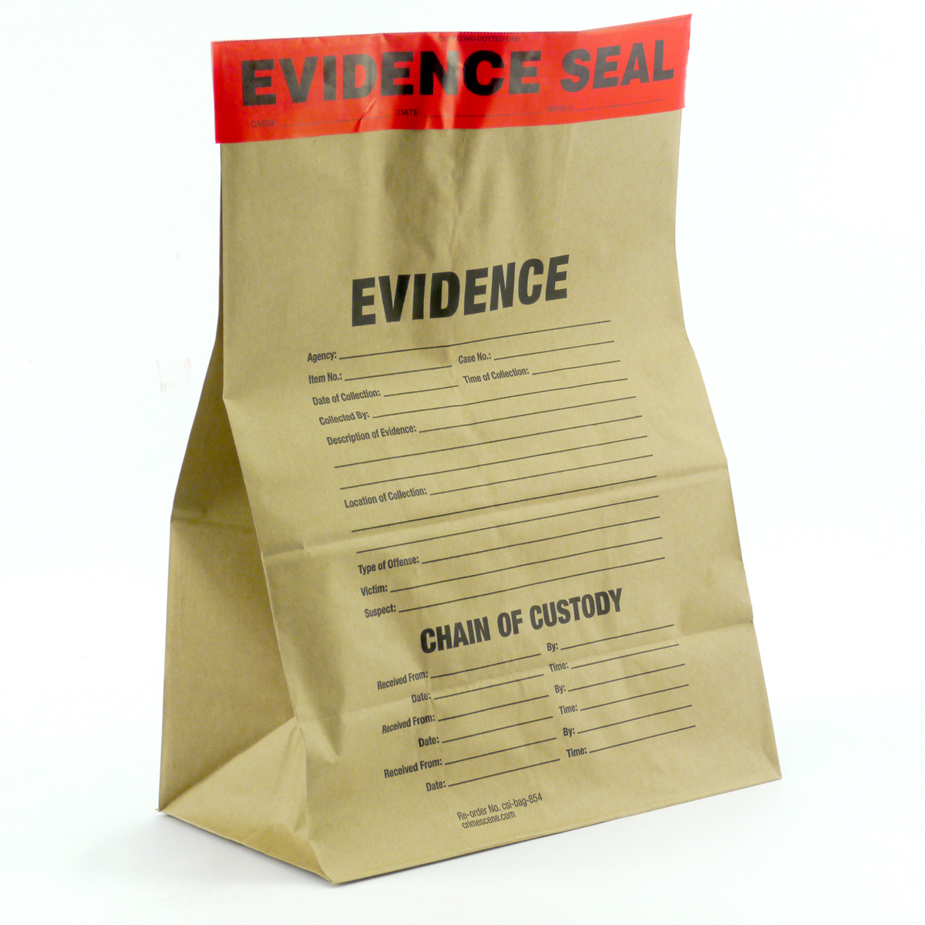
Dos and Don’ts
Do Provide Good Evidence of how
you will deliver your social value offers
When making your social value offers you need to upload evidence on to the Portal about how you are going to deliver what you are committing to.
Examples:
When recording local employment:
Records of employment, including the duration of the contract together with the first three digits of the resident post code of your employees (i.e. the postcode district), should be attached as evidence. Records should be made compliant with data protection issues.
When recording staff hours, e.g. visiting local schools:
HR reports of the number of staff involved, including the hours spent and the number of attendees, should be attached as evidence.
8 The Social Value Portal – Social Value Briefing

Slide 9
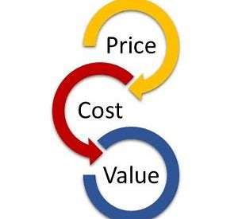
Dos and Don’ts
Do not make any amendments to the proxy values or units:
The proxy values and units are not to be amended.
Offers will be adjusted if any values/units are amended.
9 The Social Value Portal – Social Value Briefing

Slide 10
Dos and Don’ts
Do consider if your intervention might be a partial contribution
Partial Contribution:
An identified intervention might only be a partial contributor
to an outcome because:
i) there might have been other interventions
ii) an investment could have been made in partnership with other organisations
iii)the activities were a small part of a larger initiative
In these cases, bidders should include only a percentage of the value that can be directly linked to the project in question.
10 The Social Value Portal – Social Value Briefing

Slide 11
Read More: www.socialvalueportal.com
info@socialvalueportal.com

