Slide 1
Market Engagement Event CP2395-23 – Sexual Health & Reproductive Health Service
Monday 22nd January 2024
9:30 – 12:30
https://www.slido.com/ #2905 983

Slide 2
Agenda
Welcome
Overview
BREAK
Workshops
Procurement Process
Q & A
https://www.slido.com/ #2905983

Slide 3
Background
Challenges across all public services, including sexual and reproductive health
COVID-19 pandemic impact
Generally, sexual and reproductive health in Devon and Torbay is good
Addressing inequalities and changing population wants and needs

Slide 4
Devon key indicators

Slide 5
Torbay key indicators

Slide 6
A series of listening and engagement exercises
Population
10 STRANDS
Local Authorities
13
Market
7
Strategic Partners

Slide 7
Barriers
Facilitators
Travel to clinic
Opening times
Young age specific clinics
Lack of GP knowledge of (perception of)
Getting through to anyone
Travel/distance
GPs not giving (latex free) condoms
Finger prick test at home
Confidentiality
GP limited trans knowledge
Services by post
Women's health service
Expert sexual health clinic / regular fittings
Local and confidential
Local pharmacy
Walk in
Unbiased and specialist
Online = more private (when free)
Self-testing
GP – closer, easier and better opening hours
Gay pub or venue
Local hospital

Slide 8
Population lens, what did we hear?
KNOWLEDGE OF SEXUAL AND REPRODUCTIVE HEALTH
(high level of deficits about SRH, strong awareness of medications, risk perceptions inexact, lacking opportunities and motivations)
KNOWLEDGE AND PERCEPTION OF SERVICES
(confidentiality, attitude of staff, age)
INCLUSIVITY
(trans inclusive, better for people with disabilities, developing trust)
PATIENT CHOICES
People want a range of options which are easily accessible, highly advertised and delivered in different way to access those services e.g. online and F2F)
WORKFORCE
Strong response asking for experts and SRH clinics. Lack of GP knowledge in primary care. Regular fitting, experienced professional. Able to have holistic conversation and incorporate all elements of SRH including healthy relationships

Slide 9
Population lens: what did we hear?
BOOKING / GETTING APPOINTMENTS
challenges for many, especially disabled and learning-disabled populations. Range of access required, from bookings to walk in to closed clinics
LOCATION AND TRAVEL
Location more important than establishment, local means local (hence preference for GPs and pharmacies by many, seeking convenience)
OPENING HOURS
Preference for flexible including evening and weekends – particularly 4-8pm
ADVICE AND GUIDANCE
(as above & particularly contraceptive advice, citing little time or apparent choice with GP)

Slide 10
The Market Listening
‘No fixed view on the sexual and reproductive system’
7 responses from NHS, private and voluntary sector
Positive, enthusiastic conversations
An array of ideas and good solutions
no simple or single solution

Slide 11
Themes from market engagement conversations
Collaboration
Resilience
Accessibility
Stability
Flexibility
Development & Data
Efficiencies
Notes:
​

Slide 12
Conversations with other Local Authorities
Diversity of models
Shared challenges nationally
Channel shifting - diversifying access with a digital option can increase demand but the appropriate people are seen face to face and addressing inequalities
Relationships
Plan for opportunities

Slide 13
National context
Increased role of pharmacies
HIV treatment and care responsibilities to NHS Devon ICB from 2025/26
Women’s Health Hubs, delegated commissioning from NHSE and ICB, Primary Care Networks, PSR

Slide 14
Contract and funding - Devon
The total reported spend on sexual health across prescribed and non-prescribed services by Devon County Council since public health came into the Council has been:
2022/23 £6,944,000
2021/22 £6,895,000
2020/21 £5,087,000
2019/20 £6,785,000
2018/19 £6,933,000
2017/18 £6,171,000
2016/17 £6,414,000
2015/16 £6,504,000
2014/15 £6,437,000
2013/14 £5,983,000
Our ambition is to bring separate budget lines together in this one new contract and to take around £1m p/a out of the total sexual health spend

Slide 15
Contract and funding - Torbay
The total reported spend on sexual health across prescribed and non-prescribed services by Torbay Council in the last two full financial years:
2022/23 £1,435,800
2021/22 £1,387,000
Our ambition is to bring separate budget lines together into this one new contract, bringing with it efficiencies in systems and processes.
It is anticipated being a ‘flat cash’ budget in Torbay based on 22/23 spend.

Slide 16
Contract and funding – Devon & Torbay (1)
Commissioners will need to design an evaluation approach that combines price and quality to identify the “best value” bid (or bids) – ‘what residents want and need’ vs ‘what we must have’ vs ‘what we can afford’.
Requirement therefore for providers expected to evolve delivery model to maintain (and ideally expand) capacity/access routes whilst absorbing inflationary pressures.

Slide 17
Contract and funding – Devon and Torbay (2)
Anticipating a 5-year contract with extensions up to 5 years
Seeking a ‘System Leader’ and strategic partner
lead the whole sexual health system
recognise, identify and collaborate with multiple other partners
support, develop and grow partnerships to the benefit of an effective and efficient ‘system’
Would like to procure a partner receptive to an iterative contract
flex and change with population needs and technology evolution.

Slide 18
Current model
Prevention
Primary Care
(LARC + Chlamydia screening) Community Pharmacy
(EHC + Chlamydia Screening)
Specialist care

Slide 19
Draft proposed model
Digital Front Door
Engagement, Prevention and self-management
Level 2 services
Level 3 services
Digital
Sexual Health and wellbeing
‘Places ’
Primary Care (GPs and pharmacies)
Prevention and outreach
Women’s Health Hubs
Community engagement and co-production
Substance misuse services
Domestic Abuse and Sexual Violence
Face to face

Slide 20
Proposed Scope
Service area | In scope 2025 | Potential to be included 2025-2035
Open access level 3 GUM testing and treatment services (incl PrEP)
Contraception
National Chlamydia Screening Programme (NCSP)
Sexual and reproductive health prevention and health promotion*
Sexual health elements of psychosexual support
Sexual and Reproductive Health services in Pharmacies
Long-Acting Reversible Contraception in Community Settings/General practice
Online STI testing / sampling
*Examples of this include condom distribution, community-based interventions and non-clinical workforce training

Slide 21
Proposed Scope continued
Service area | Current responsible commissioning body | Potential to be brought in scope 2025-2035
HIV Treatment and care | NHSE (specialised commissioning)
HPV Vaccinations for MSM | NHSE
Cervical Screening | NHSE
Abortion | NHS Devon ICB
Non-contraceptive LARC in general practice | NHS Devon ICB

Slide 22
Women’s health – Local GP case study
Women’s Health Clinics
Life course
Listening
LARC
Professional Network
Roaming
Remote
F2F
Professional links, support and pathways to local specialist services and secondary care

Slide 23
BREAK
https://www.slido.com/
#2905983

Slide 24
Workshop 1 1. Do you understand and agree with our proposed model? If so, what does the community level / 2 part look like? For example, general practice? Community settings or something else? 2. If GPs and Pharmacies are part of the community-based arrangement, should they be in this specification? If yes, how would you manage this? If no, why not?
Community provision
Meeting local needs of people
Creating complementary high quality digital and place-based offers

Slide 25
Workshop 2
What conditions need to be in place to enable the System to meet the needs of the population against a backdrop of continuing budget constraint?
How do you suggest commissioners should balance price and quality in the submission of your bids, to achieve the best value service?

Slide 26
Questions

Slide 27
Procurement Process
As of 1st January 2024 – the sexual health services come under The Health Care Services (Provider Selection Regime) Regulations 2023.
We are currently considering our options under what PSR route we will use as the regulations have only just come live. This will be made clear in our procurement notices and within the tender documentation.

Slide 28
Indicative Timeline
Date and Time | Stage
Monday 8th July 2024 | Dispatch of the FTS Notice by the Authority.
Tuesday 9th July 2024 | Procurement Documents made available on the Procurement Portal.
Monday 23rd September 2024 | Deadline for clarification questions.
Tuesday 1st October 2024 – 12 noon. | Deadline for return of Bids (to include SQ and ITT responses).
2nd October – 22nd November 2024 | Evaluations
Friday 10th January 2025 | Completion of the Authority’s approval and award decision processes.
Monday 13th January 2025 | Commencement of standstill period.
Thursday 23rd January 2025 | Expiry of standstill period.
Monday 27th January 2025 | Appointment of the successful Bidder(s) and award of the contract.
Tuesday 1st July 2025 | Commencement of Service following 4 months mobilisation.

Slide 29
Procurement Portal

Slide 31
Expressing an Interest – Narrow Search

Slide 32
Register Interest

Slide 33
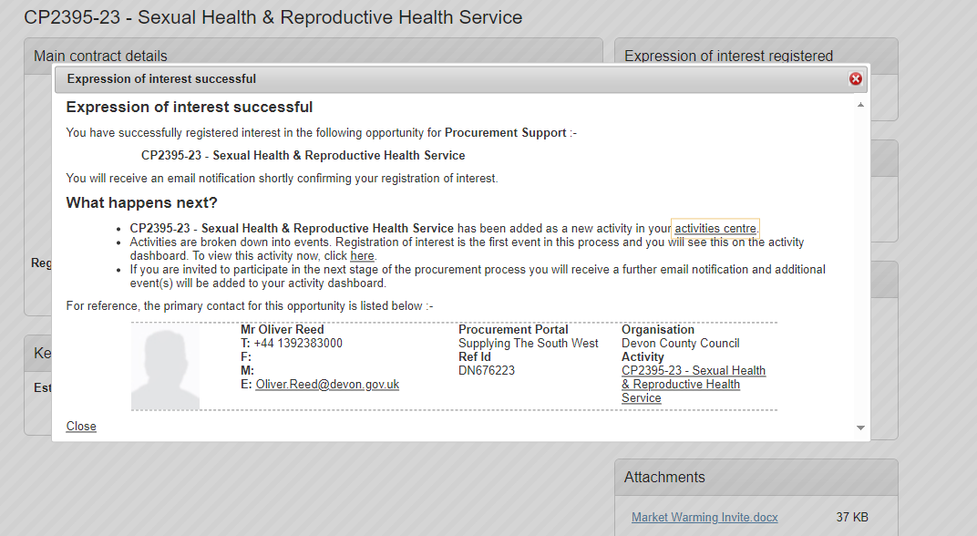
Expression of Interest Confirmation

Slide 34
Messages

Slide 35
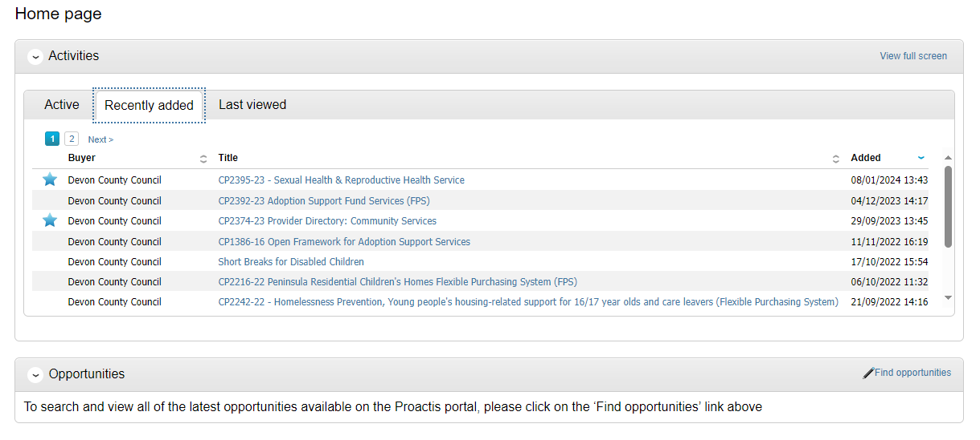
Locating Tender Documents

Slide 36
Help & Support
Due North Technical Support Team
Telephone: 0844 334 5204
Email: swsupport@due-north.com
(08:30 to 17:00 Monday to Friday, excluding English public holidays).

Slide 37
Questions

Slide 38
Thank you
The presentation slides and questions & answers from the events will be collated and published on the electronic tendering system www.supplyingthesouthwest.org.uk
Any questions you wish to raise after the event should go through the Messaging section on the Procurement Portal.

