Slide 1
MANTA Team System
Joining Services with Better Communication

Slide 2
We are Footwork Solutions
Halo - Case Management System
Installed in 30 treatment and care communities across the UK
Includes Torbay, Devon, Plymouth, Somerset
Includes Manta components including Messenger
Manta - Multi Agency CoLab Workspace
MARAC - Cornwall
ASBO Target Group Meetings - Cornwall
CoLab Workspace - Plymouth Alliance

Slide 3
What is Manta?
Central Referral portal
Searchable active caselist
Co-Lab Workspace
central secure messaging
referrals
document storage

Slide 4
What Manta isn’t?
A case management system
Each service will usually need their own CMS
Manta integrates with Halo, all Halo data can be shared with Manta
Records can be imported easily from other system
A fixed process
Manta will evolve with the service as needs change

Slide 5
A single shared system
A single client list
Includes key needs, latest contact details, risk flags
Provides a single story for the client
Upload appropriate files
Shared group messaging attached to each client record
No ‘mixed security’ emails chains
Dynamic Data Sharing Agreement and GDPR compliance

Slide 6
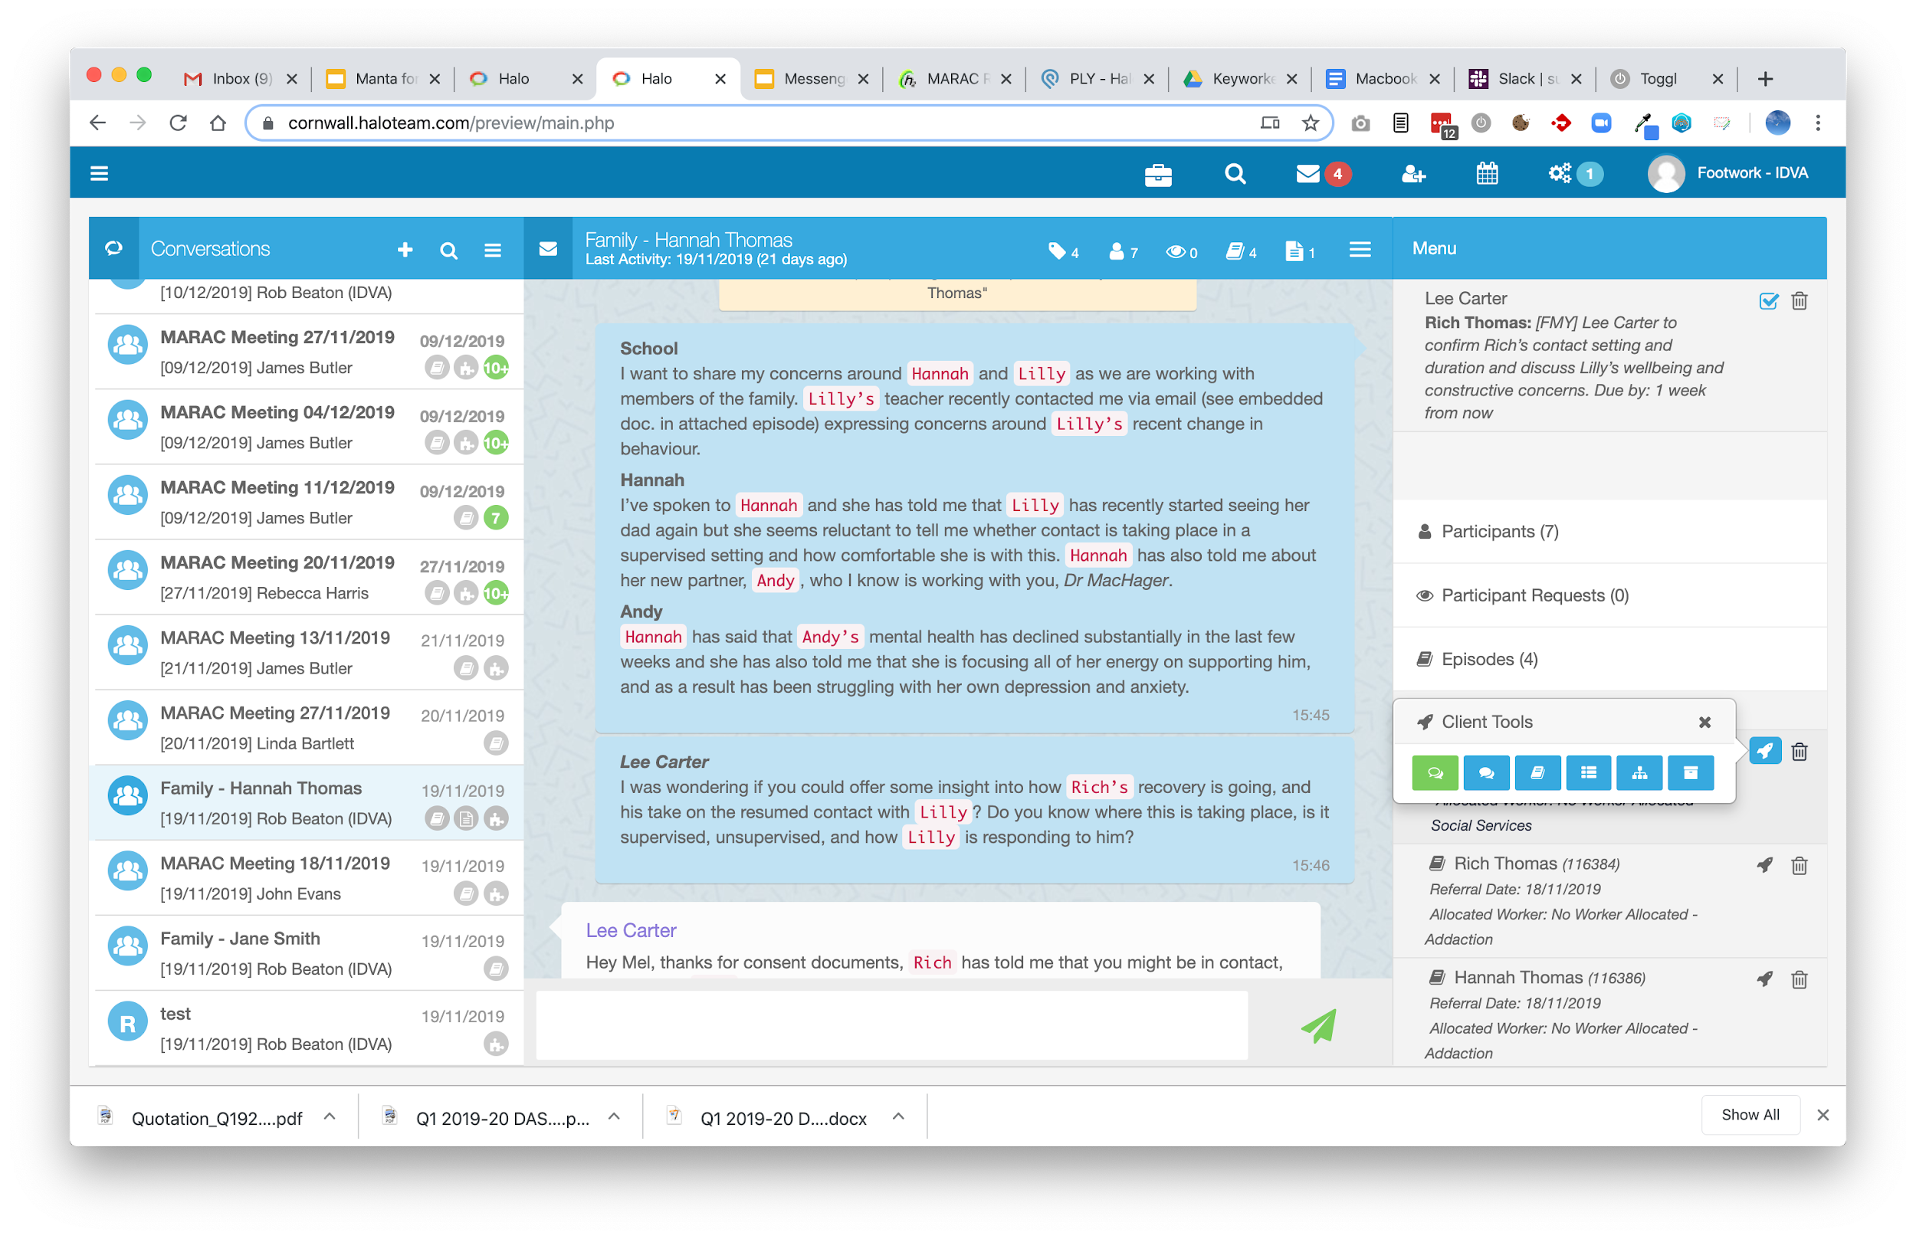
Manta Collaboration Workspace
Simple, secure, shared space
Discuss clients - in real time
Share files and forms
Share status and risk
Invite new users
Mobile ready
Integrated DSA

Slide 8
Find out more
Local workshop to explore Manta in Torbay - Feb 2020
To find out more or attend the workshop
Contact rob@footworksolutions.co.uk
01752 547381

