Slide 1
Welcome to
Meet the Buyer
Date: 2nd July 2024
Time: 12-2.00pm

Slide 2
Introductions
Delivered by: Caroline Sturman, Sarah Pacey & Jolene Jefferson
Purpose – Who are we?
What do we want?
What is Proactis?
How do I respond to a tender?
Please be respectful and polite, mute and turn camera off if not speaking, ask questions via the chat box.

Slide 3
Who are we?
Introduction to Luton Council
Luton Council is a unitary Council covering an area of approximately 17 square miles (44 km²) and the current population of Luton is estimated at 220,000 (and rising).
The Council employs approximately 3,000 people based in a variety of locations such as offices, schools, nurseries, crematorium, parks pavilions, community centres, sports centres, day care, residential, police station, hospital, etc. These locations are located across the Borough.

Slide 4
Luton Population & Demographics
Luton is an ethically diverse town with an estimated 150 languages and dialects spoken. It is densely populated, with some pockets of overcrowding. Luton has a younger than average population, however, forecasting suggests this will rise in the future with an increase in the holder age group.
Luton is comparatively deprived, with some wards among the most deprived areas in the country and high levels of child poverty. These population characteristics contribute to the needs within the town.
Our model delivery for drug and alcohol services will focus on:
Unmet need across the demographic
Engaging and supporting those with multiple complex and interconnected needs
Clinical treatment
Recovery
Prevention

Slide 5
Joint Strategic Needs Assessment
Luton's JSNA is under review for 2024, 2023’s can be found here:
https://www.luton.gov.uk/Community_and_living/Lists/LutonDocuments/PDF/JSNA/jsna-overview-health-social-care-needs-2023.pdf

Slide 6
What do we want?
LOT Information
Alliance Clinical: | Adults, children and young people’ specialist treatment services, hospital and criminal justice system in reach
Alliance Care: | Identify and address the wider health and wellbeing issues of those individuals who are not willing or ready to engage with treatment services. Using effective interventions and support
Alliance Recovery: | High quality recovery support for those in Luton. Building a robust, safe and visual recovery community
The aims of the Alliance is to better meet the needs of Luton’s diverse population. The Alliance services will share accountability to meet agreed delivery outcomes.

Slide 7
Lot 1- Alliance Clinical
The follow highlights standard clinical treatment elements, we would also expect to see further detail and innovation in delivery
Opiate Substitute Therapy - consumption and dispensing
Pharmacological service
Detox/Rehab
Testing and Vaccinations
Counselling/key work sessions – Psychosocial interventions
Trauma Informed Delivery
Clinically Led- NICE guidelines
Provision of needle exchange
Harm Reduction
ABI assessment
Case management for those detox/rehab
Prolonged release injectables

Slide 8
Alliance Clinical: In-reach and Specialist Services
Hospital: Continue to deliver the innovated model of hospital in-reach in place, building on delivery and outcomes for service users.
Criminal Justice: Offer intensive support to address substance use among those open to the criminal justice system in line with the National Drug Strategy and OHID ambitions.
Children and Young People (8-24yrs): Provide specialist, evidence-based prevention, early intervention, harm reduction and treatment to enable CYP to adopt a more sustainable and healthier lives.

Slide 9
Lot 2- Alliance Care
The service will identify and address the wider health and wellbeing issues of those individuals who are not willing or ready to engage with treatment services, using effective interventions and support.
SPOC – Single Point Of Contact
Aftercare and re-integration
Women’s Groups
Rough Sleepers
Family and carers
Harm reduction programmes
Dual Diagnosis
Roll of out opioid antagonist medication
Supporting positive requirements for anti-social behaviour

Slide 10
Lot 3 – Alliance Recovery
Providing community lead services and clear progression for service users on their treatment journey, allowing long term recovery support. Embedding recovery in the community through lived experience and peer centred intervention.
High quality, recovery support for adults in Luton
Building a robust, safe and visual recovery community
Flexible support focusing on supporting individuals to reduce or end their drug and alcohol use and to rebuild their lives
Supporting access and engagement in to employment, education, training, housing and health services
Building recovery capital; social, physical, human and cultural
Supporting service users in relapse to reengage in treatment
Liaison with wider teams; Alliance Clinical, Alliance Care, homeless services, mental health etc

Slide 11
Outcomes/Key Criteria
Innovation specific to Luton, addressing the needs of the diverse demographics
Specialist services to address complex vulnerabilities found in Luton
Specialist services to meet unmet needs and improve engagement and retention in services

Slide 12
Tender Process
Supplier: You should already be registered with Proactis make sure the email address on Proactis is current and correct or you will miss the opportunity.
Buyer: Upload all tender documentation to Proactis
Supplier: invited via Proactis to tender
Transparency: All correspondence and clarifying questions taken and answered via Proactis. If you ask a question – all can see it and all can see the response but not who asked the question.
Proactis is also known as ProContract and The Portal was Due North
Technical issues and support
Email: procontractsuppliers@proactis.com

Slide 13
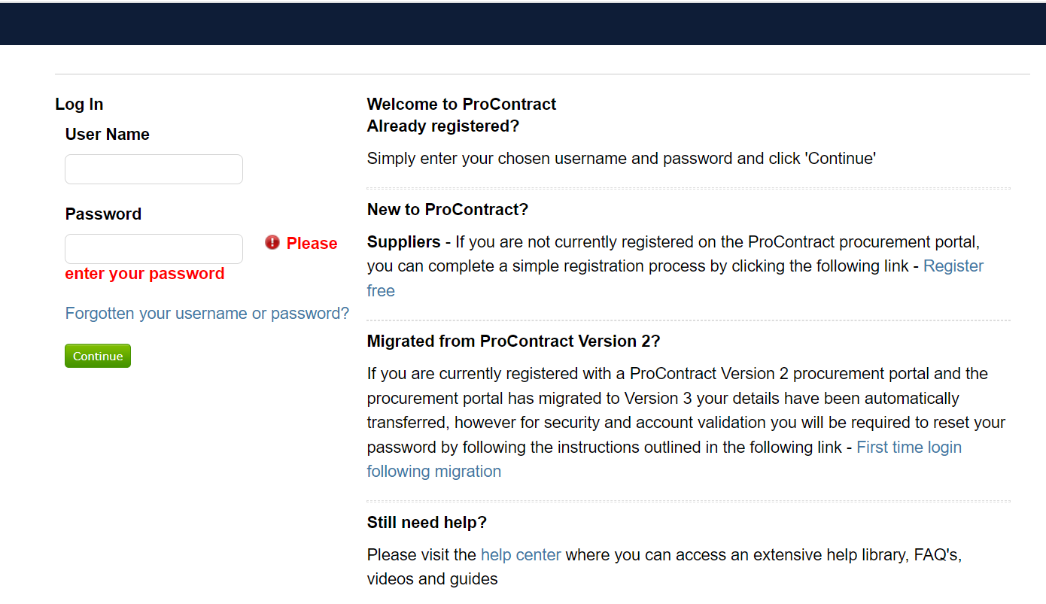
Help centre

Slide 14
Provider Selection Regime
Tender is being conducted under the Provider Selection Regime (PSR) Open Competitive Process came into effect January 2024.
The Health Care Services Regulations (PSR) 2023
Main differences from ‘open’ tender process;
Notice of Intention – award notice on Find a Tender Service
Standstill 8 working days

Slide 15
Tender Process cont…
Upload Tender Documen-tation
Implemen-tation
Contract go live
Deadline for bidder submission
Contract award
Contract + Agreement sent for signing
Evaluation and Moderation
Successful / Unsucces-sful letters
Standstill period
1 2 3 4 5 6 7 8 9
Supplier:
Read all tender documentation carefully, in full, before you start writing your bid
Re-read it before you submit clarification questions
Read your bid before you submit it

Slide 16
Indicative Timeline
Tender goes live – September 2024
Tender closes – October 2024
Evaluate, Moderate and Review Pricing
Financial Due Diligence
Internal Approval sought
Notice of Intention to Award - December
Letters sent all Bidders – December 2024
Standstill
Award + send contracts – December 2024
Mobilisation
Contract Start Date 01 April 2025

Slide 17
Specification
Read the spec
Make sure you fully understand the spec
Can you fully meet the spec?
If you don’t understand, ask clarification questions

Slide 18
Quality Questions
It’s like completing a job application – you need to ‘sell’ the positives of your company
Cover every point with clarity and detailed information – assume that Luton have never heard of you before
DO NOT go over the word count – this will be clearly stated
There may be pass/fail questions
There may be minimum score questions
Some tenders may have more than 1 LOT
THINK ABOUT LUTON

Slide 19
Pricing
You will be provided with a Pricing Schedule
DO NOT amend the document in any way – no other forms of pricing will be evaluated
Pound sterling £
The evaluation criteria of pricing will be made very clear in the tender documents
Excluding VAT

Slide 20
Social Value
The Public Services (Social Value) Act 2012 requires Luton to make the following considerations at the pre-procurement stage:
How might the economic, social and environmental well-being be improved in the local area and;
Small offering – BIG IMPACT!
Toolkit will be uploaded to portal
Relevant and proportionate to the contract’s value and term
Sign posting to groups in need
Question/s are weighted at 20% of the overall score
Social responsibility is separate from Social Value
Your tender will ask you to think about the environmental pillar

Slide 21
Social Value
Environmental Social Value could include:
Your company working to improve the environment and contribute to Net Zero –
Train an agreed number of staff as Mental Health First Aiders
Working with Adult Learning to offer opportunities to those on the Passport to Employment courses
Support prevention by working with the Council's Public Health service on education and publicity campaigns with specific targets
Opportunity for the unemployed to volunteer and gain experience
Taking on Apprentices
Offering free services to community groups, charity groups, schools etc.

Slide 22
Luton 2040
Our shared vision for Luton​​​​​​​;
Luton will be a healthy, fair and sustainable town, where everyone can thrive and no-one has to live in poverty.
Luton 2020-2040 is a town-wide vision built around a single-unifying mission for everyone in Luton:​​​​​​​
To ensure that everyone in our town has the opportunity to thrive and no-one has to live in poverty. Poverty and inequality are at the heart of some of the most significant challenges in Luton and the impact of COVID-19 has further demonstrated the need for shared focus on addressing this.
As well as tackling poverty, the vision has three underlying commitments for Luton:
to be a child-friendly town
to be a town built on fairness and social justice
to be a carbon neutral town
Full strategy is available on the Luton Council website.

Slide 23
Taken from our 2040 vision
A CARBON NEUTRAL TOWN
Working together to achieve our commitment to be a carbon
neutral town by 2040, by growing our economy in a
sustainable way and enhancing our neutral environment.
Achieving net-zero carbon emmissions by 2040
Supporting clean growth and the growth of green businesses and social enterprises
Improving air quality and the neutral environment throughout Luton
Enhancing digital connectivity, and green infrastructure – including the greenest airpaort in the UK – and increasing active and sustainable travel

Slide 24
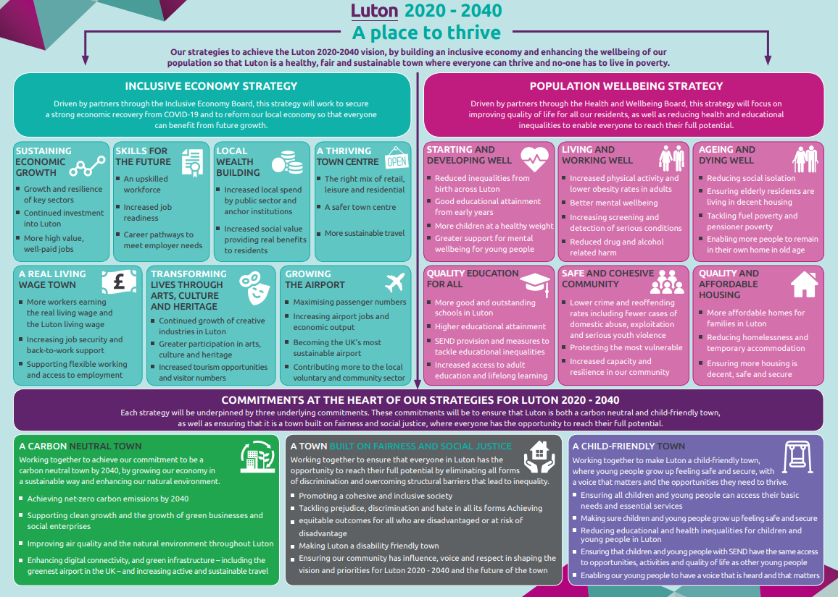

Slide 25
Instructions upon completion
Check the deadline for the return of tender – allow time to upload.
Check clarification deadline date if any – queries will not be responded to after this date.
Check if the instruction is to return your submission in a specific format and adhere to that, check attachments to be uploaded.
Where a word count/page limit has been given, please adhere to this. Any words over the word count will not be considered.
Don’t leave anything blank – use N/A if appropriate.

Slide 26
Evaluation and Award Criteria
Check that you understand the evaluation/award criteria, included in the tender documents, which be split between social value, quality and price.
There are at least 2 pass / fail questions
Minimum thresholds to be reached (minimum score)
Adhere to the word count
Financial evaluation
Case studies – quality will be assessed against the examples provided
Ensure all uploaded, signed and dated within the timeframe, late submissions will not be accepted. The council holds no responsibility for late or incomplete submissions.

Slide 27
Clarification question/s
Submit a question via the portal
If the question is relevant to all organisations it’ll be a public response, if it’s commercially sensitive – a private response
READ THE DOCUMENTS – most of the answers to your questions will be within the ITT documents
Contractors should not insert qualifications and caveats to their tender bid. All clarifications must be sought before the clarification deadline. Any qualification or caveats that come with the bids that have not been sought at the clarification period will be disregarded.

Slide 28
Questions

Slide 29
Good Luck!
We look forward to working with you

