Slide 1
WELCOME!
Future Homecare Arrangements for Merton
Provider Market Engagement
March 2023
Chima Amiaka
ASC Commissioning Manager

Slide 2
Merton's Future Homecare Arrangements
Key features of Merton’s Future Home care arrangements include:-
Five-year contract, starting from October 2023.
Providers are required to operate from premises located within the borough or within an area which borders the Council’s boundary.
London Living Wage to be paid by providers to all staff delivering services under the contract.
Signing up to Unison's Ethical Care Charter.
New geographical arrangement consisting of two zones, with two prime providers per zone, with an additional six supplementary providers covering both zones.
Lots allocation.
Use of CM2000 by all Providers under Lot 1 2 & 3 providers.

Slide 3
London Living Wage
The Council is an accredited London Living Wage Employer.
It is considered that the London Living Wage will promote social wellbeing of employees, including improved productivity and retention together with lower staff training costs. A commitment to pay London Living Wage (LLW) will be a requirement of this contract where services are delivered within London Borough of Merton.

Slide 4
Ethical Charter
Ethical Care Charter Key requirements
Visits – The time allocated to visits will match the needs of the customers. In general, 15-minute visits will not be used as they undermine the dignity of the customers. Providers are required to deliver care in line with individual customers’ assessed needs as per their personalised care plans.
Homecare workers will be paid for their travel time, their travel costs and other necessary expenses. Merton’s hourly rate will take into account of such expenses. The hourly rate will be prorated for 30minutes and 45 minutes calls.
Providers are required to schedule visits in such a way that homecare workers are not forced to rush their time with customers or leave their customers early to get to the next one on time.
Providers are required to enrol into an occupational sick pay scheme so that care workers are covered and paid statutory sick pay when necessary.

Slide 5
Ethical Care Charter Key requirements cont’d
Customers will be allocated the same homecare worker(s) wherever possible.
Zero hour contracts will not be used in place of permanent contracts.
Providers will have a clear and accountable procedure for following up staff concerns about their clients’ wellbeing.
All homecare workers will be regularly trained to the necessary standard to provide a good service (at no cost to themselves and in work time).
Homecare workers will be given the opportunity to regularly meet co-workers to share best practice and limit their isolation.

Slide 6
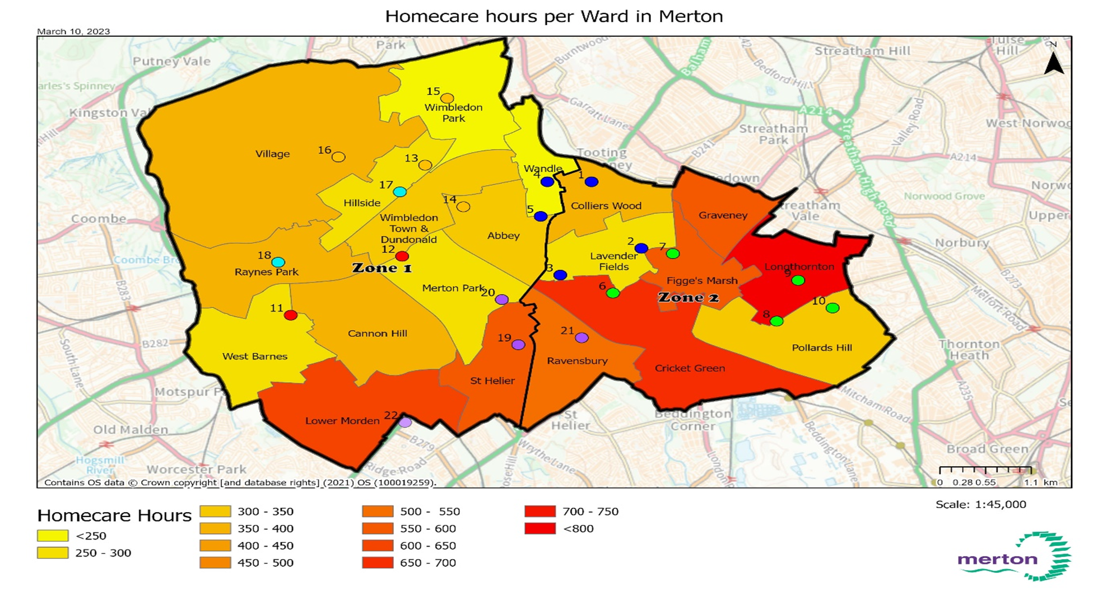
New Geographical arrangements

Slide 7
Homecare Service Delivery
The home care service will be delivered in five Lots as follows:-
Lot 1 - Zone 1 (West): 2 Prime Providers
Lot 2 - Zone 2 (East): 2 Prime Providers
Lot 3 - 6 Supplementary Providers covering the whole borough
Lot 4 - Providers delivering Mental Health specialist services for adults and older people covering the whole borough
Lot 5(a) - Providers offering adults and older people specialist services e.g Deaf /Blind and complex LD cases for older people with challenging behaviours
Lot 5(b) - Providers delivering Personal Care Services for children and young people covering the whole borough
All Lots:- There are no guaranteed number of hours offered to any Provider category. For Lots 1 to 3, there is an expectation on Prime Providers to meet demand first, but if not in position to do so, Supplementary Providers would step in.

Slide 8
Procurement Timetable
Stage / Activity | Dates
Publication of ITT | March/April 2023
Closing date for receipt of ITT | May/June 2023
Contract Award | July 2023
Mobilisation period | July – September 2023
Contract start date | October 2023

Slide 9
Mobilisation Plan
Lot 1 to Lot 3:- All current Providers [Lots 1 – 3 (3 Prime Providers) and Lot 4 (Supplementary Providers)], who successfully bid for any Lots [Lots 1 (2 Prime Providers), Lots 2 (2 Prime Providers), Lot 3 (6 Supplementary Providers)] in the new service, will retain their existing care packages.
Lot 4 (Mental Health Specialist Providers): - Existing care packages will be assessed on a case by case basis. Where it is deemed possible and in the interest of the Customer, individuals will be offered an option to transfer to the new Provider. In all other circumstances existing care packages will continue to be delivered by the incumbent provider(s) until there is a need to change for whatever reason.

Slide 10
Mobilisation Plan Cont’d
Lot 5(a) Specialist Providers: - Existing care packages will be assessed on a case by case basis. Where it is deemed possible and in the interest of the Customer, individuals will be offered an option to transfer to the new Provider. In all other circumstances existing care packages will continue to be delivered by the incumbent provider(s) until there is a need to change for whatever reason.
Lot 5(b) Personal Care Providers: - With regards to Personal Care Services for children and young people, existing packages will continue to be delivered by the incumbent provider(s). There is no obligation for the Council to contract with Provider(s) to offer Personal Care Services for children and young people, but may opt to do so if need arises.

