Slide 1
Supporting the Met Office to deliver their purpose Early Market Engagement Background information
20th July 2020
Notes:
Please use this pack to make an initial assessment of the Met Office as a potential partner, to understand our purpose and values, and our procurement processes, how and where to engage.

Slide 2
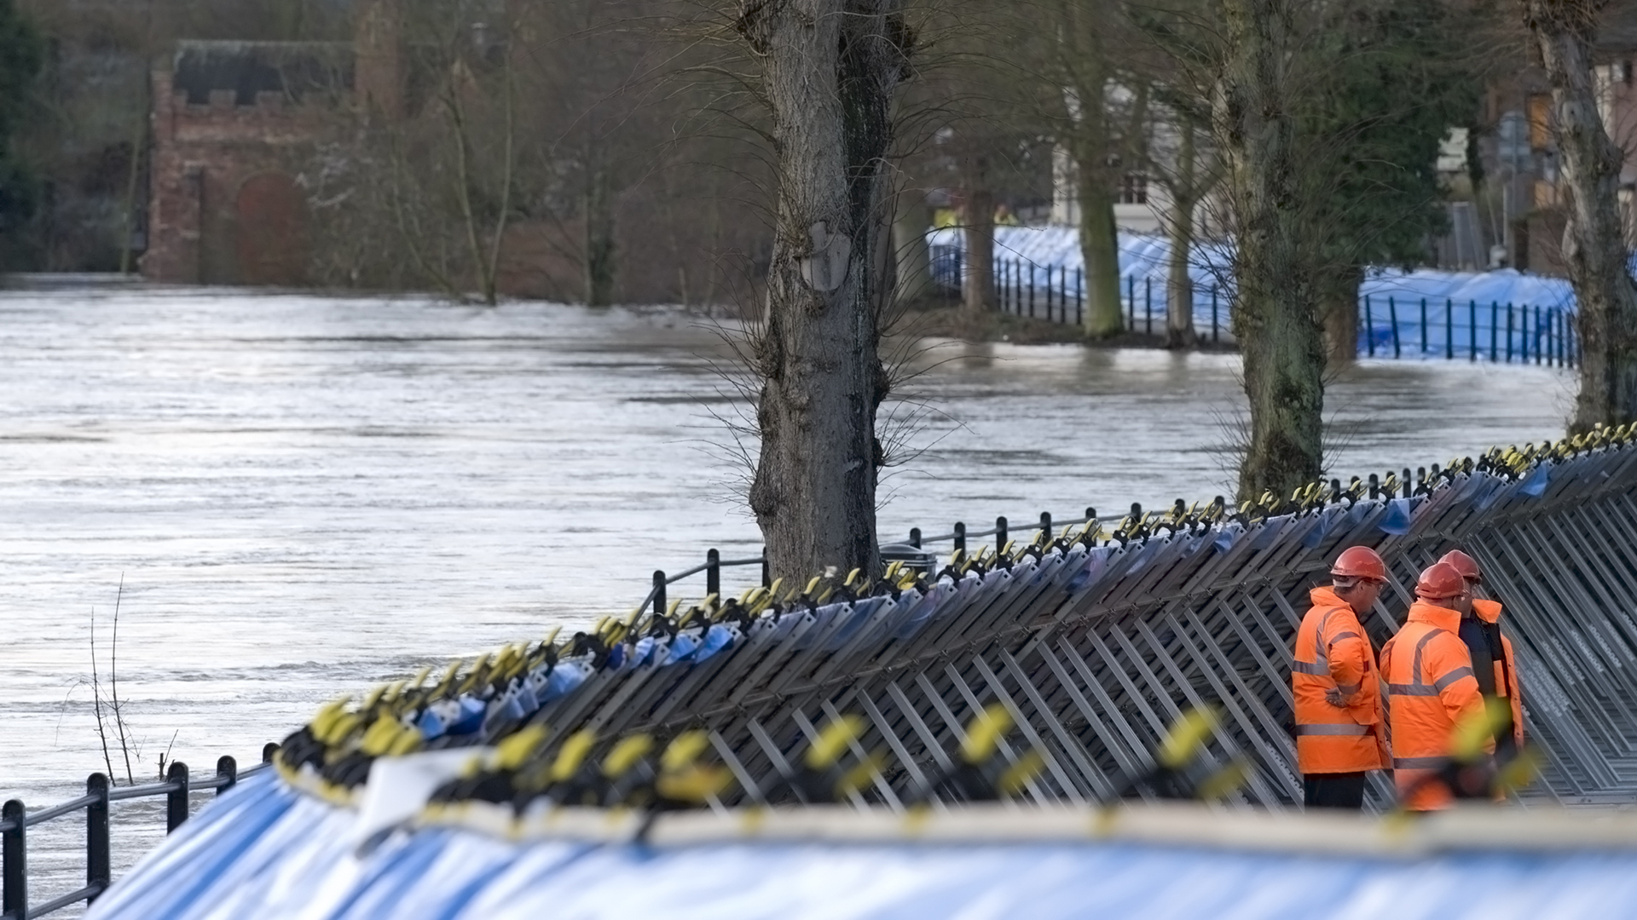
CONTENTS
Welcome – slide 3
Who we are; Our purpose; Our values; Our strategy - slides 4 - 15
Why work with us – slides 16 – 20
How we work – slides 21 - 26
When and how to engage with us – slides 27 - 29
Notes:
We hope to provide you with the information and background needed to make an informed choice to work with the Met Office.
Further information can be found online, including our website, Youtube channel, podcasts, Facebook and twitter.
For the latest weather and climate information visit - www.metoffice.gov.uk and https://www.youtube.com/user/TheMetOffice
To learn more about the history of meteorology and the science behind the weather headlines, you can listen to our audio podcasts here: https://soundcloud.com/metofficepodcasts

Slide 3
Welcome
Notes:
The Met Office has evolved over 160 years.
Although we're committed to constant innovation, we're also proud of our rich history. Over the years we have proven ourselves to be a major national asset and a part of the critical national infrastructure. Our drive to protect lives has been at our heart since the begging, demonstrated when, in 1854, Robert Fitzroy developed the first weather forecasts to save mariners at sea. Since then we have sustained regular, accurate, world-leading forecasts.

Slide 5
Who we are

Slide 6
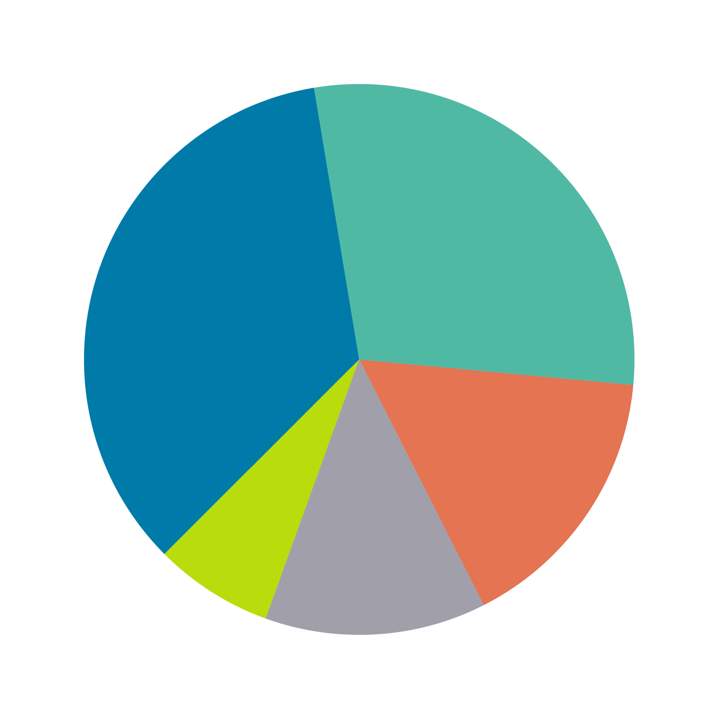
29%
Science & research
35%
Forecasting & observations
16%
Technology (IT)
7%
Corporate service
13%
Industry services & government business
Notes:
We are around 1900 staff working at 50 locations, in the UK and overseas, including a Marine Centre of Excellence in Aberdeen. We also have many more automated observing sites including four permanent and Mobile Met Unit overseas sites.
Working areas:
Forecasting and observations: 35%
Science and research: 29%
Technology (IT): 16%
Industry services and government business: 13%
Corporate service: 7%

Slide 7
Our purpose

Slide 8
Helping you make better decisions to stay safe and thrive
Notes:
This is our purpose – helping you make better decisions to stay safe and thrive.
Who are we? We are many things:
Met Office forecasts provide essential early warning and advice to enable the public, emergency services, critical infrastructure (e.g. water, power, transport networks and telecoms), and businesses to prepare for and respond to severe weather events.
We provides 24/7 support to monitor and advise on the impacts of severe weather; flooding; air quality and airborne hazards (including nuclear, chemical or biological contamination); and space weather (solar activity in the earth’s atmosphere)
We advise and supports the UK’s emergency responders in advance of and during severe weather; and provide advice to the UK and Devolved Governments.
We work closely with all forms of media to ensure the public has access to clear and consistent information.
Met Office capabilities in understanding and predicting the climate are essential for guiding wise investments in UK resilience, adaptation and mitigation.
The Met Office’s role in supporting the resilience of the UK benefits the UK’s economic growth and prosperity. Whether directly through services or indirectly through providing meteorological data, the Met Office supports a wide range of critical industries including transport; farming, fishing and the rural economy; retail; construction and the energy industry.
We enable the public and businesses to draw on weather and climate information to make better-informed decisions to improving prosperity.
We have a resilient infrastructure, including mutual backup facilities internationally to ensure business continuity
We supports the economic growth of the UK, its prosperity and international competitiveness by providing a world-leading and internationally-respected centre of scientific excellence in weather and climate; and providing the data and services to help businesses innovate and grow.
We are focussed on improving health and well-being now and in the future. Our forecasts help communities plan to be more resilient and better prepared. We enable individuals to make the most of their free time helping them to plan for the ever-changeable British weather.

Slide 9
Our values

Slide 10
Notes:
We stand by these values and behaviours and expect our partners, collaborators and suppliers to have complementary and similar ones.

Slide 11
Our strategy

Slide 12
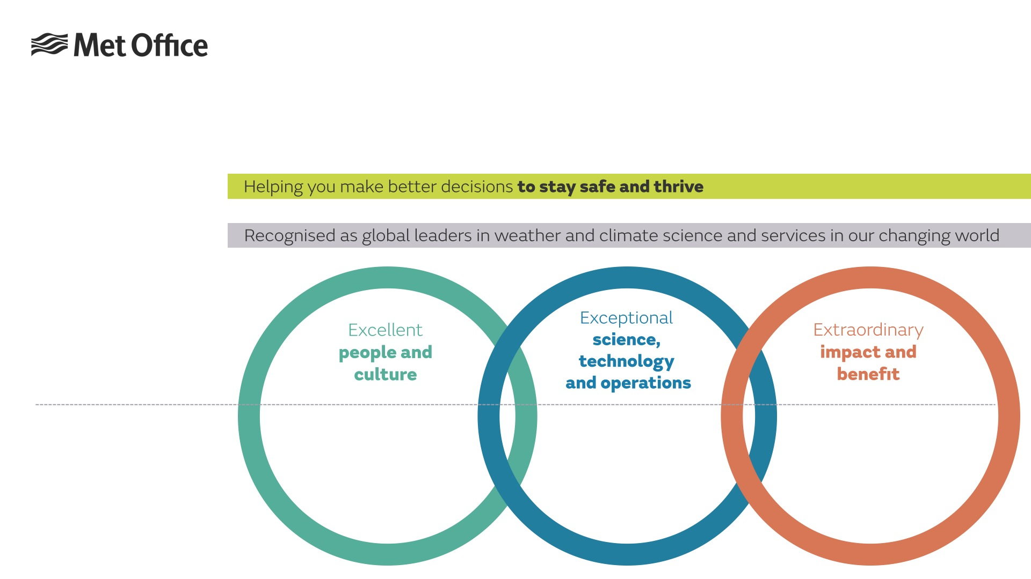
Our strategy
Our purpose:
Why we exist
Our vision:
What we will achieve by 2024
Strategic anchors:
These are the areas we will focus on.
The three areas overlap and complement each other.
Strategic actions:
Transforming our leadership capability for the future
Enhancing equality, diversity and inclusion
Enabling and developing our people
Transforming the way we manage our people information
Delivering our future supercomputing capability
Exploiting the future of data sciences
Delivering our next-generation modelling capability
Developing and nurturing capability partnerships
The future of Operational Meteorology
Taking a common approach to customer data services
Delivering a common Met Office data platform
Improving our 0-2 hour forecasts and warnings
Understanding the boundaries through which we can trade
Our priority activities which we’ll monitor & measure.
Notes:
We know that that world in which we operate is changing and we have a new strategy in place to help us, launched in October 2019.
To meet these challenges, we need excellent people and an organisational culture to match in which we can deliver exceptional scientific, technological and operational expertise that, when in the hands of our customers delivers extraordinary impact and benefit.
We cannot do one without the others and it is this approach that will guide our decision-making and priorities.
Our actions are the 13 priority activities we have chosen that will help us move forward towards our vision.

Slide 13
How this fits together
Notes:
Our anchors Excellent people and culture - We will invest in and lead our people and culture to make the Met Office a great place to work for all.
With great leadership and management comes the ability to embrace the skills of our people, retain our talent, recruit effectively and enable people to develop and add their skills in areas outside their ‘day job’. We will put in place actions to do just this, ensuring strong, inclusive leadership throughout the organisation that provides clarity and direction. We will strive to give the space and resource for individuals to develop skills that benefit both our people and our customers, and we will work to make our organisation more reflective of the world in which we live. Around all of this we will transform our people management systems and processes, so they are suitable for modern ways of working.
Our reputation is built on our exceptional scientific, technical and operational capabilities and we must remain pioneering in these areas to meet our vision as a global leader.
We need to build the right partnerships to fully exploit our science, technology and operations.
Finally, extraordinary impact and benefit. Everything we do in the Met Office must be about focusing on the ends rather than the means, putting our customers and stakeholders first. To this end we will focus on ensuring that we have the technology and processes in place that will not only allow our own experts, but also our customers and partners, to discover, interact and access our data easily. The role of our experts to analyse and make important and often safety related decisions will remain significant and we will invest in the future of operational meteorology. As the markets in which we operate change, our Government owners are constantly seeking to maximise the value of the Met Office, expanding our global and regional influences and growing profitable revenue. Understanding the boundaries through which we can trade commercially will also be key to our future success

Slide 14
Met Office Technology Strategy
"The need for transformation, driven by the need to be more efficient in all aspects of our work, along with the need to transform a service architecture which is increasingly resistant to change and not meeting the organisations needs is fully recognised and supported."
Notes:
Our technology strategy vision, that underpins our Met Office Strategy, is to achieve:
A simplified technology estate will be easier to operate, employ automation to streamline the end to end delivery chain and enable the organisation to respond to changing customer requirements without compromising operational reliability.
The efficient and effective discovery and exploitation of data assets created by our world class science will be a key focus of the Met Office technology capability.
Working within multi-disciplinary teams, we will develop the tools required to exploit exa-scale HPC along with a resilient data, information and content platform that enables value generation by both internal and external users, supporting the delivery of Met Office services on a global scale.
Commodity, cloud-based services will enable greater flexibility, enabling the Met Office to be easier to work with, easier to work for.
A culture of innovation and learning coupled with the use of agile methodologies, experimentation and horizon-scanning will enable the Met Office to better exploit emerging technologies in the wider marketplace, reducing the uncertainty of technology driven change and disruption.

Slide 15
Notes:
Understanding our approach to data https://www.youtube.com/watch?v=e6QH6sEH8Hc

Slide 16
Why work with us

Slide 17
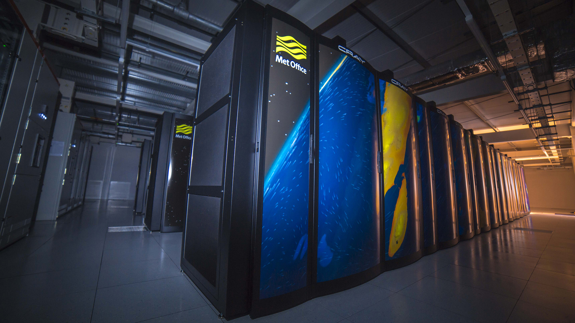
Reliable brand - Trusted provider of public weather information and data services to organisations across the globe.
International leader in weather and climate science - Our international expertise dates back to our beginnings in 1854. Today we are recognised as a world-leader in climate and weather science.
Licensed distributor - Entrusted as the UK licensed agent for Meteorological data from ECMWF, EUMETSAT, ECOMET.
Recognised accuracy - Our global Numerical Weather Prediction model, the foundation of our accurate weather provision, is recognised as a world leading National Met Service model, verified using standards defined by the World Meteorological Organization.
Notes:
World-leading science and technical expertise available for businesses, researchers and academics
Our extensive portfolio offers a range of global weather and climate data and services to clients across industry, academia and broadcast media. As well as our own Met Office data we also supply third party licensed data on behalf of ECMWF, ECOMET and EUMETSAT in the UK.
As the UK’s National Meteorological Service, we are well versed in collecting, generating, verifying, interpreting and applying data. Many organisations already rely on the data we provide for critical decision-making or commercial reuse.
Our data services include the provision of Public Sector Information (PSI) data, data available for re-use under license, open data sets available with free access and industry specific data for business use.
UK Met Office Public Sector Information (PSI) re-use data
View our catalogue for a complete listing of categories of data and available data sets, including our Numerical Weather Prediction (NWP) model data and observational data sets.
Met Office DataPoint
Get free access to our open data sets for weather data and map overlays via API’s. Available for re-use within innovative applications.
ECMWF
The UK Met Office is a member of The European Centre for Medium-Range Weather Forecasts (ECMWF) and a leading licensing agent of ECMWF products and services.
EUMETSAT
The UK Met Office is a member and licensing agent of European Organisation for the Exploitation of Meteorological Satellites (EUMETSAT) products and services.
ECOMET
The Met Office is a member of ECOMET and a licensing agent for the meteorological data catalogue for the European National Met Services (NMSs).
Met Office Weather DataHub
This new, fully operational, API data channel provides freely available data that is more useable and useful than existing DataPoint data and will, ultimately, replace the DataPoint service. New data and map overlays will be added progressively, providing an increased range of datasets.
Business data services
Our business data services team can provide you with a range of industry specific data sets and advice services. We can help you address industry weather risks or make it easier for you to understand how weather impacts your business.

Slide 18
We are actively seeking partners
To deliver our strategy
By extending our capacity we can move faster and focus on the areas we add real value by leveraging the expertise and advances of others
The scale of the changes ahead are complex and we cannot make these changes alone.

Slide 19
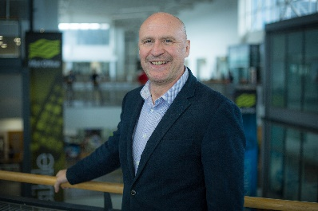
Part of our Technology Strategy 2018-21
We are actively seeking partners
Charlie Ewen, Director of IT (CIO)

Slide 20
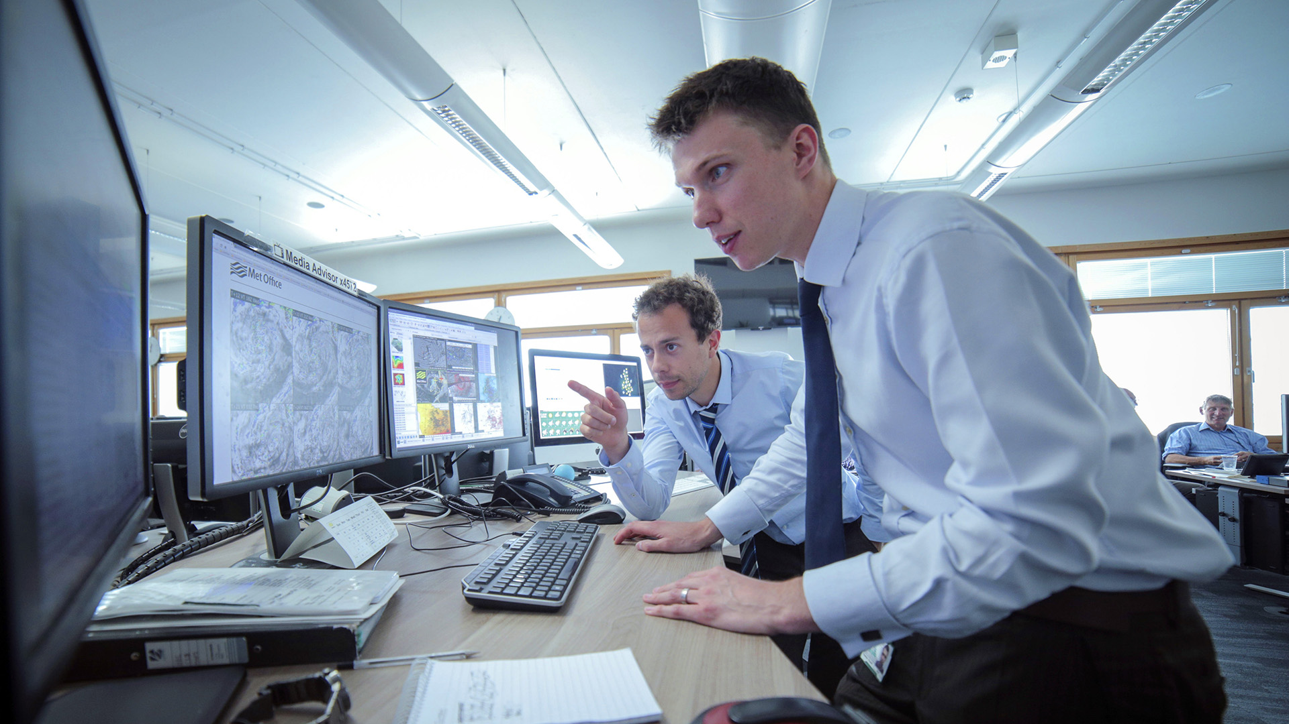
We are actively seeking partners
Recent Delivery Partner contracts for agile software development and transformational advice and support requirements include:
Digital Channel Partner
Defence Modernisation Programme
Business Group Delivery Partner
Space Weather
Common Data Platform
This covers Modes 2 and 3: Teams to deliver capability against our outcomes/deliverables that are linked to payment.
The supply of Contingent Labour is out of scope.

Slide 21
How we work

Slide 22
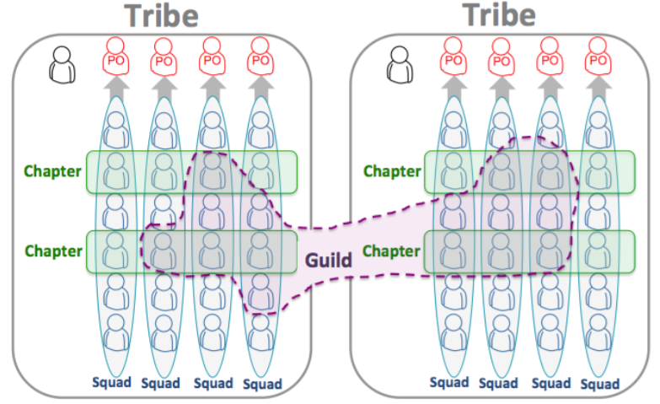
Operating in an agile environment
Notes:
In our technology sphere, and increasingly across other areas of the Met Office we work in an agile way, within a structure of tribes and squads, with a range of active Guilds. We have adopted the Spotify Tribe Engineering model – this article describes it very well - https://tinyurl.com/y6elvd2e
Check out our video describing how we developed our weather app back in 2016. https://www.youtube.com/watch?v=8YAyD9C6VTs
We expect our partners to be highly conversant with this agile environment.

Slide 23
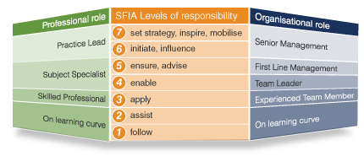
Using the Skills Framework for the Information Age model
Notes:
We will be looking to fill roles that match to the SFIA model in terms of skills and competencies, across the range from 1 – follow to 7 –set strategy, inspire and mobilise.
We expect our partners to be highly conversant with the SFIA model

Slide 24
Current Supplier Alignment Models
(Tribe Level)
Squad
Tactical Supplier1
Outcome
Squad
Tactical Supplier2
Outcome
Tribe
Squad
Tactical Supplier3
Outcome
Changing to
Tactical Supplier4
Outcome
Notes:
This is our current supplier model at tribe level which are looking to change.

Slide 25
Potential Supplier Alignment Models
(Tribe Level)
Met Office Tribe Leadership Comprising of (at least) supplier management,
senior product ownership and solution architect oversight
Strategic
Supplier
Blended Team
Outcome
Outcomes are delivered by blended teams
using Met Office and supplier capabilities
under direct supervision
Blended Team
Outcome
Outcome
Outcome is delivered by strategic
supplier with limited direction and supervision
Met Office Technical Oversight
Tactical Supplier Team
Outcome
Outcome is delivered by a tactical supplier with direct Met Office direction and supervision
Tactical Supplier Team
Outcome
Outcome is delivered by a tactical supplier
supplier with limited direction and supervision
Notes:
This is how we see our future supplier model operating.

Slide 26
Potential Supplier Alignment Models
(Tribe Level)
Met Office Tribe Leadership Comprising of (at least) supplier management,
senior product ownership and solution architect oversight
Strategic
Supplier
Met Office Mode 1
or 2
Blended Team
Outcome
Blended Team
Outcome
Met Office Mode 3
Outcome
Met Office Mode 2
Met Office Technical Oversight
Tactical Supplier Team
Outcome
Met Office Mode 3
Tactical Supplier Team
Outcome
Notes:
And this is how this fits into our Mode model.

Slide 27
Engage with us

Slide 28
Use our portal (https://procontract.due-north.com/Login) to raise any questions or queries
Complete and upload the questionnaire to our portal by no later than 17 August 2020.
The information from this early market engagement will inform our future procurement strategy.

Slide 29
Indicative timescales
EME Completion – End of August/early September 2020.
ITT – November 2020
Framework Award – March 2021

