Slide 1
Community Based Wellbeing Services
Specification Development workshop 1
November 2019

Slide 2
Contents
Section 1 – Background
Section 2 – Spend Analysis
Section 3 – Demographic Analysis
Section 4 – Procurement Approach
Section 5 – Consultation feedback
Section 6 – Social Value Toolkit
2

Slide 3
Background
Adult Social Care has historic grant arrangements in place with voluntary and community sector providers across the county. These grants provide a contribution towards the costs of services that support older people, people living with dementia, people with a physical disability and people with sensory impairments.
There are currently 48 of these historic grants remaining, all of which fall within the scope of this project.
Key findings from a review are:
Grants are historically not based on needs of residents
Most of the funding is supporting Day Services (accounting for the majority of people accessing grant funded services)
Some organisations use their grants for specific services, others put their grant into a central pot to subsidise several services (a challenge in truly understanding how funding is being spent)
3

Slide 4
Spend Analysis
4

Slide 5
Spend Analysis – by service type
Community Based Wellbeing Services
£8,197,068
OP Support
£4,040,656
Physical Disability Support
£160,100
Dementia Support
£606,494
Carers Short Breaks
£3,089,499
Sensory Support
£1,080,000
6

Slide 6
Spend Analysis - by Area
Community Based Wellbeing Services
£5,936,733*
*excl Carers Short Breaks
DGS
£1,067,899
Swale
£649,010
West Kent
£1,688,822
East Kent
£2,531,000
8

Slide 7
Demographic Analysis
4

Slide 8
Demographic Analysis
Dementia: According to PH (JSNA) prevalence of Dementia within Kent is approximately 1.37%
9

Slide 9
Procurement Approach
4

Slide 10
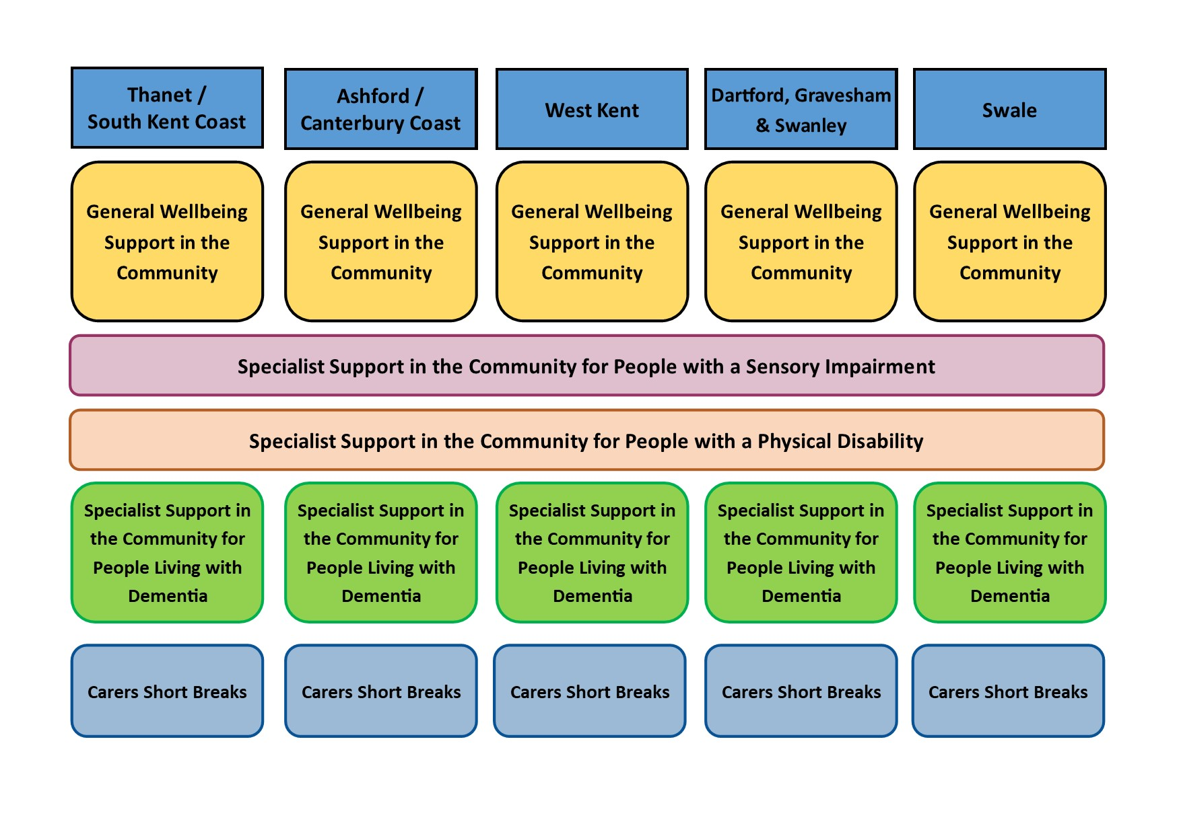
Procurement Approach – Agreed Contract Model
12

Slide 11
Procurement Approach
The phased procurement approach will be:
Phase 1 | Phase 2 | Phase 3
January - March 2020 | April – June 2020 | October – December 2020
Sensory Impairment | Physical Disability | Carers Short Breaks
Wellbeing: Thanet / SKC | Wellbeing: DGS | Wellbeing: Ashford / Canterbury
Wellbeing: West Kent | Specialist Dementia (all) | Wellbeing: Swale
13

Slide 12
Consultation Feedback
4

Slide 13
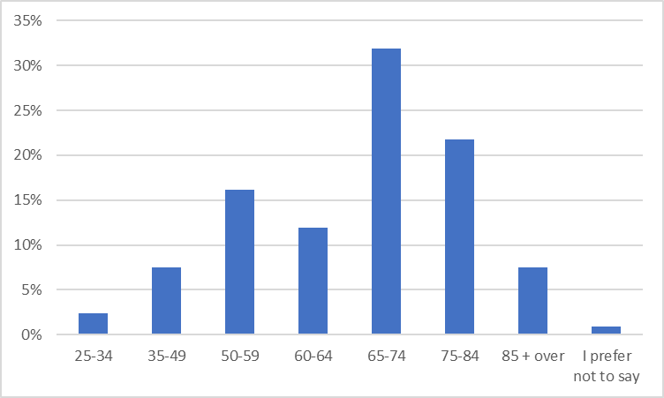
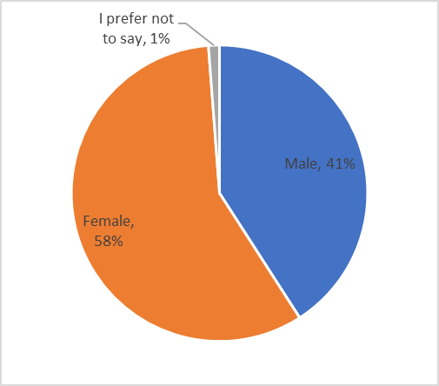
Consultation feedback (snapshot 13/11/2019)
Currently 458 responses
77% residents / 11% Carers / 6% social care or health professional / 6% other
3

Slide 14
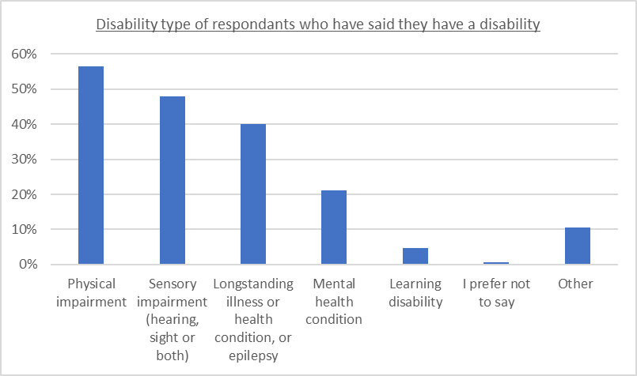
Consultation feedback (snapshot 13/11/2019)
Disability
152 responded they considered themselves to have a disability
3

Slide 15
Consultation feedback (snapshot 13/11/2019)
Where respondents live: 85% Kent resident / 2% Medway / 12% Outside Kent
Total population | Popn |  | Response
 | 2019 |  | # | %
Gravesham | 107,100 | 7% | 24 | 6%
Dartford | 112,700 | 7% | 10 | 2%
Folkestone & Hythe | 112,700 | 7% | 61 | 14%
Dover | 117,900 | 7% | 49 | 12%
Tunbridge Wells | 119600 | 8% | 16 | 4%
Sevenoaks | 121,200 | 8% | 28 | 7%
Ashford | 131000 | 8% | 38 | 9%
Tonbridge & Malling | 131100 | 8% | 38 | 9%
Thanet | 142100 | 9% | 38 | 9%
Swale | 148600 | 9% | 49 | 12%
Canterbury | 165,500 | 10% | 32 | 8%
Maidstone | 172,500 | 11% | 40 | 9%
Kent | 1,582,100 |  | 423
3

Slide 16
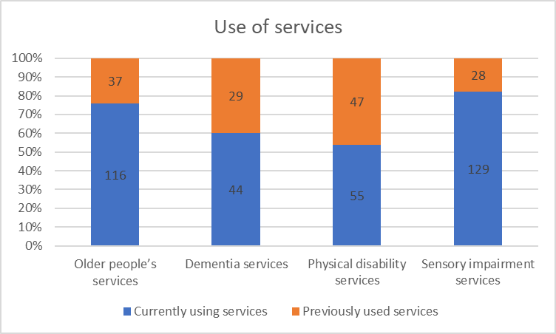
Consultation feedback (snapshot 13/11/2019)
3

Slide 17
Consultation feedback (snapshot 13/11/2019)
Personal Outcomes: Information and Advice
12

Slide 18
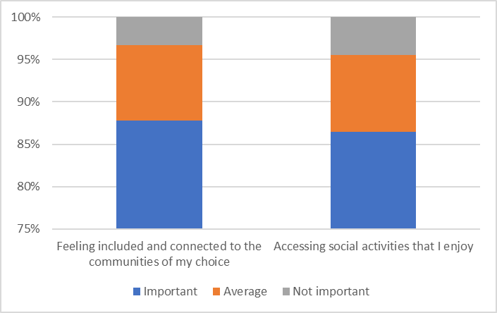
Consultation feedback (snapshot 13/11/2019)
Personal Outcomes: Social Inclusion
12

Slide 19
Consultation feedback (snapshot 13/11/2019)
Personal Outcomes: Care and Support
12

Slide 20
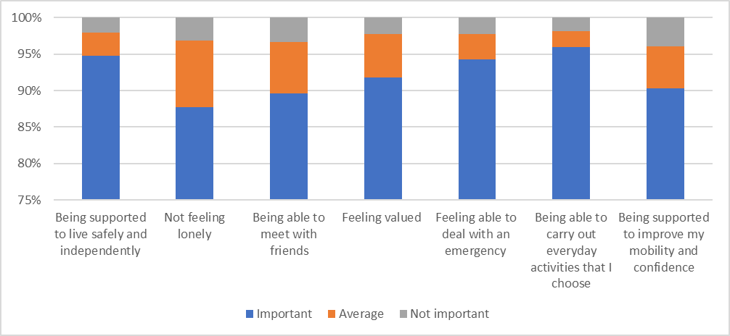
Consultation feedback (snapshot 13/11/2019)
Personal Outcomes: Health
12

Slide 21
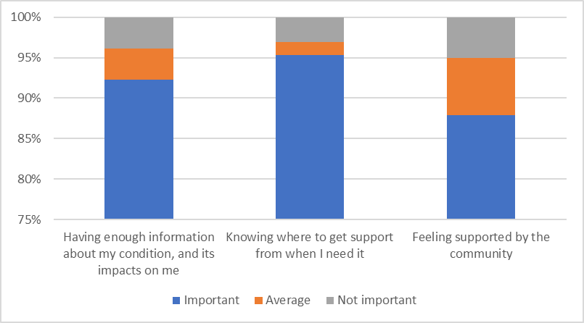
Consultation feedback (snapshot 13/11/2019)
Personal Outcomes: Dementia specific
12

Slide 22
Consultation feedback (snapshot 13/11/2019)
Personal Outcomes: Other
12

Slide 23
Consultation feedback (snapshot 13/11/2019)
Community Based Activities of choice
12

Slide 24
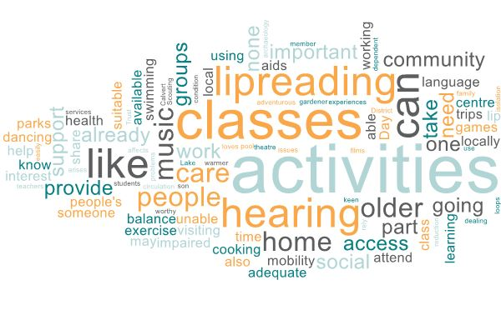
Consultation feedback (snapshot 13/11/2019)
Community Based Activities of choice
12

Slide 25
Consultation feedback (snapshot 13/11/2019)
Choice of place where to access services
12

Slide 26
Consultation feedback (snapshot 13/11/2019)
Choice of place where to access services
12

Slide 27
Exercise
Given all the consultation feedback you have. In your small groups:
Discuss the feedback (overall) and highlight the top three things it is saying to you
Discuss the OUTCOMES feedback and list the TOP 10 outcomes you feel should be used within the specifications
When deciding on the top 10 outcomes please think about the following:
Is the outcome specific enough?
Is the outcome measurable?
Is the outcome achievable?
Is the outcome a realistic one?
Can achievements be made against the outcomes in a realistic timeframe?
12

Slide 28
Social Value Toolkit
4

Slide 29
Social Value Toolkit
Kent County Council has five social value themes/priorities derived from the Strategic Statement and which are particularly relevant to the organisation.
Assessing Social Value as part of any Commissioning process is now a statutory duty of Local Authorities. In line with the 2015 Public Contract Regulations, the consideration and application of social value must be relevant to the subject matter of the contract and proportionate without any unequal treatment of bidders.
The following slides are some simple and practical ideas of how service providers might support these themes/priorities, with some suggestions for how commitments could be sought and evaluated in the procurement and then incorporated into the service contract.
Kent County Council’s Social Value Priorities
SV 1 Local Employment
SV 2 Local Economy
SV 3 Community Development
SV 4 Good Employer
SV 5 Green and Sustainable
12

Slide 30
Social Value Toolkit - Local Employment
Creation of local employment and training opportunities to reduce unemployment and raise local skills
No. of local people (FTE) employed on contract for one year or the whole duration of the contract, whichever is shorter
% of local people employed on contract (FTE)
No. of employees (FTE) taken on who are long term unemployed (unemployed for a year or longer), not in employment, education, or training (NEETs) or who are care leavers, or who are rehabilitating young offenders (18-24)
No. of hours dedicated to supporting unemployed people into work by providing career mentoring, including mock interviews, CV advice, and careers guidance (over 24)
No. of local school and college visits, e.g. delivering careers talks, curriculum support, literacy support, safety talks (no. hours, includes preparation time)
No. of training opportunities on contract (BTEC, City & Guilds, NVQ, HNC, Apprenticeship) that have either been completed during the year, or that will be supported by the organisation to completion in the following years – Level 2, 3, or 4+
No. of apprentices on the contract that have either completed, or will be supported by the organisation to completion in the following years – Level 2, 3, or 4+
% of employees on the contract that have either completed, or will be supported by the organisation to completion in the following years – Level 2, 3, or 4+
No. of hours dedicated to support young people into work (e.g. CV advice, mock interviews, careers guidance) – (under 24)
No. of weeks spent on meaningful work placements or pre-employment course; 1-6 weeks student placements (unpaid)
No. of meaningful work placements that pay National Living wage according to eligibility – 6 weeks or more (internships)
12

Slide 31
Social Value Toolkit - Local Economy
Buying locally where possible to support local business growth
Total amount (£ / %) spent in local supply chain through the contract.
Total amount (£ / %) spent through contract with local micro businesses and SMEs
Total amount (£ / %) spent with VCSEs within the supply chain
Total number of new local businesses (micro businesses and SMEs) accessing subcontracting and other business opportunities
Total number of new local businesses (VCSE) accessing sub-contracting and other business opportunities
Provision of expert business advice to SMEs and VCSEs (e.g. financial advice / legal advice / HR advice / HSE training, mentoring, peer support)
12

Slide 32
Social Value Toolkit – Community Development
Development of resilient local community and community support organisations, especially in those areas and communities with the greatest need
Donations or in-kind contributions to council-led local community projects (£ & materials)
No. of hours volunteering time provided to support local community projects
Initiatives aimed at passing on professional experience, skills, and knowledge and understanding onto individuals within the community (e.g. professional carers offering advice and guidance to those with care-giving responsibilities)
Initiatives aimed at reducing crime (e.g. knife crime reduction, gang crime reduction, support for youth groups, lighting for public spaces, private security, etc.)
Initiatives taken or supported to engage people in health interventions (e.g. stop smoking, obesity, alcoholism, drugs, etc.) or wellbeing initiatives in the community, including physical activities for adults and children
Initiatives to be taken to tackle homelessness (supporting temporary housing schemes, etc.)
Initiatives to be taken to support older, disabled and vulnerable people to build stronger community networks and reduce social isolation (e.g. befriending, digital inclusion clubs)
Equipment or resources donated to VCSEs (£ equivalent value)
No. of voluntary hours donated to support VCSEs (excludes expert business advice)
12

Slide 33
Social Value Toolkit – Good Employer
Support for staff development and welfare within providers’ own organisations and within their supply chain
% of staff on the contract paid the National Living Wage
Prime contractor's mean gender salary pay gap for staff in relation to the performance of the contract No. and type of initiatives in place to reduce the gender pay gap for staff employed on the contract
% of people who are mothers returning to work to be employed on the contract, as a proportion of the total workforce employed on the contract
% of people with disabilities to be employed on the contract, as a proportion of the total workforce employed on the contract
% of BAME people to be employed on the contract, as a proportion of the total workforce employed on the contract
% of people who are care leavers to be employed on the contract, as a proportion of the total workforce employed on the contract
Type and no. of wellbeing courses offered to staff (e.g. counselling, meditation, stress management)
No. of contracts that include commitments to ethical and sustainable procurement, including to verify anti-slavery and other relevant requirements
% of contracts with the supply chain on which Social Value commitments, measurement and monitoring are required
12

Slide 34
Social Value Toolkit – Green and Sustainable
Protecting the environment within the providers’ own organisation and within their supply chain
No. and type of initiatives to reduce environmental impacts in relation to the contract (e.g. water consumption, reduction of waste, reduction of single-use plastics)
Annual percentage by which environmental impacts will be reduced in the delivery of the contract (e.g. water consumption, reduction of waste, reduction of single-use plastics)
Demonstrable savings in CO2 emissions through the contract (specify how this will be measured)
Car miles saved on the contract and/or associated initiatives (e.g. cycle to work programmes, promotion of public transport, or carpooling programmes)
No. of low / no emission staff vehicles used on the contract and miles driven
No. of voluntary hours dedicated to the creation or management of green infrastructure, to increase biodiversity, or to keep green spaces clean
Value (£) of materials, equipment or resources donated to support green infrastructure
% of contracts that include sustainable procurement commitments or other relevant requirements and certifications (e.g. water consumption, reduction of waste, reduction of single-use plastics)
12

Slide 35
Exercise
Given 5 Social Value priorities and the possible measures. In your small groups:
Discuss the Social Value priorities. What are your feelings about Social Value being included within the specification?
Discuss the priorities and list the TOP 10 priorities (from across the 5 areas) you feel could be used within the specifications – you can also discuss and suggest your own priorities!
When deciding on the top 10 please think about the following:
Is the priority specific enough?
Is the priority measurable?
Is the priority achievable?
Is the priority a realistic one?
Can achievements be made against the priorities in a realistic timeframe?
12

Slide 36
Next Steps
Workshop #1
East Kent (20 November – Dover)
West Kent (22 November – Maidstone)
Workshop outputs will be shared on Kent Portal to allow further comments
Summary findings report from consultation (mid-December)
Workshop #2
East Kent (10 December – Dover)
West Kent (11 December – Maidstone)
Workshop outputs will be shared on Kent Portal to allow further comments
Draft Specification (on Kent Portal – prior to workshop #3)
Workshop #3
East Kent (date in January and venue to be confirmed)
West Kent (date in January and venue to be confirmed)
Procurement goes live (towards end of January 2020)
12

