Slide 1
Domiciliary Care Procurement Market Shaping Event 28th September 2016

Slide 2
Domiciliary Care Procurement Market Shaping Event
Welcome Housekeeping and Introductions
Neil Haddock
Chief Officer: Commissioning & Resources

Slide 3
Event Programme 28th September 2016
10.00am – 10.10am | Welcome Housekeeping and Introductions Neil Haddock Chief Officer: Commissioning & Resources
10.10am – 10.25am | The Vision Gill Vickers Director, Adult Social Care, Health and Housing
10.25am – 10.35am | Outline of the Event Lynne Lidster Head of Joint Commissioning
10.35am – 11.00am | Domiciliary Care Procurement (presentation) Penny Crane and Rifit Hussain-Curtis
11.00am – 12.20pm | Co-Production Session (refreshments) Case Studies and Ideas
12.20pm – 12.50pm | Feedback and Question & Answer Session (working lunch)
12.50pm – 12.55pm | Closing Comments and Next Steps Neil Haddock Chief Officer: Commissioning & Resources
1.00 pm | Event Closes

Slide 4
Domiciliary Care Procurement Market Shaping Event
The Vision
Gill Vickers
Director, Adult Social Care, Health and Housing

Slide 5
Domiciliary Care Procurement Market Shaping Event
Co-production Events
Providers – notes from today
Community/Voluntary Sector - 14th October
People who will use the services
Staff
Feedback following today’s event
Will be emailed to everyone who registered

Slide 6
Domiciliary Care Procurement Market Shaping Event
Tender timetable – Light Touch Regime
As soon as possible
Taking into account what providers tell us
Competitive dialogue/negotiation
Draft Specification
Further workshop with providers and stakeholders – 8th November 2016 @ 2pm Bracknell Sports and Leisure Centre
Timescales
Tender planned for December 2016
Contract Award – Spring 2017

Slide 7
Domiciliary Care Procurement
An Open Conversation
28th September 2016

Slide 8
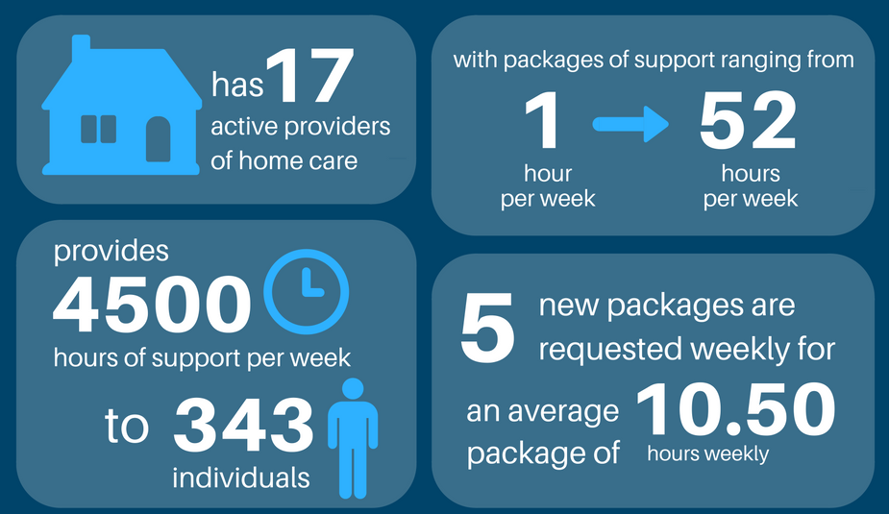
Current Provision
Under the current contract Bracknell Forest Council:

Slide 9
Year on Year Picture
Notes:
Showing the year on year increase in the number of people supported until 2015 when finances caused a re-consideration, projection for year end 2017
Showing the substantial increase in hours provided per week, whereas the number of people has shown a lesser increase/decrease, projection for year end 2017

Slide 10
Current Landscape
Range of needs complex
Maintenance planning
(no focus on improvement)
Maintenance of the individual- passive recipients of care and support
Encouraging dependency
Lack of focus on well being
Social Isolation and Loneliness

Slide 11
Current Limitations
Time and Task
Provider knowledge not maximised
Low expectation of outcomes for the individual
Workforce scope
Providers are disconnected from the care planning process
Sustainability

Slide 12
Ideas for Discussion Partnership through collaboration
Notes:
Working in partnership with people and providers to promote the highest sustainable quality of life
Allowing for a more collaborative approach to working

Slide 13
Community Sector Provision
Non-health and social care related practical help and support in the community
Support Mechanisms
Resource Guide
Live Directories (CCG and BFC)
Training for upskilling staff
Rally Round
Relationship building with the voluntary and community sector (initial contacts)

Slide 14
Community Sector Provision
Non-health and social care related practical help and support in the community
Sitting/Visiting
service
Voluntary sector
Library (Groups and 1:1)
Shopping
Social activities
Faith centres (churches, synagogues, mosques)
Gardening
Housework/Cleaning
Courses
Physical Activities
(Green Gym, allotments)
Clubs (music, theatre, bowling, Royal British Legion)
Befriending
Groups (knitting, reading, painting, crafts, chess, singing, yoga, weight management, walking groups, dance)
Notes:
Voluntary sector
Social activities
Housework/Cleaning
Befriending
Sitting/Visiting service
Shopping
Gardening
Physical Activities (Green Gym, allotments)
Groups (knitting, reading, painting, crafts, chess, singing, yoga, weight management, walking groups, dance)
Library (Groups and 1:1)
Faith centres (churches, synagogues, mosques)
Courses
Clubs (music, theatre, bowling, Royal British Legion)

Slide 16
Domiciliary Care Procurement Market Shaping Event
Co Production Session

Slide 17
Domiciliary Care Procurement Market Shaping Event
Feedback and Q&A Session
(working lunch)
12.20pm - 12.50pm

Slide 18
Domiciliary Care Procurement Market Shaping Event
Closing Comments and Next Steps
Neil Haddock
Chief Officer: Commissioning & Resources
12.50pm - 12.55pm

Slide 19
Domiciliary Care Procurement Market Shaping Event
Event Closes
1.00pm

