Slide 1
Alternative Learning Provision (ALP) Framework 2022-2027
Provider information event

Slide 2
Agenda
TOPIC | TIME
Introductions and networking | 17:30 – 17:40
What is ALP and who is it for? | 17:40 – 17:45
Belonging in Education – the vision for ALP | 17:45 – 17:55
How we will deliver this | 17:55 – 18:10
BREAK | 18:10 – 18:15
Joining the Framework | 18:15 – 18:25
Equalities | 18:25 – 18:40
Business Continuity | 18:40 – 18:50
Social Value | 18:50 – 19:05
Tendering and using ProContract | 19:05 – 19:20
QUESTIONS | 19:20 – 19:30

Slide 3
Housekeeping
Please mute yourself when you’re not talking
Chance for questions after each section – or put questions in the chat
Slides will be circulated afterwards

Slide 4
Alternative Learning Provision

Slide 5
What is ALP?
Local authorities have a statutory duty to arrange suitable full-time education for permanently excluded pupils or those who can not attend mainstream school because of illness or other reasons.
Schools can also commission ALP for pupils on their roll
ALP can include:
Full-time or part-time education outside of mainstream school
Pupil Referral Units (PRUs)
Hospital education
Education for children in custody
Support to prevent exclusion from school

Slide 6
Use of ALP
The use of ALP in Bristol has historically been high when compared to other local authorities
Benchmarking of local authorities in 2019 had Bristol as 8th highest rate of pupils in ALP (83 per 10,000 pupils)*
South Gloucestershire 49th highest (41 per 10,000 pupils)
North Somerset 87th highest (30 per 10,000)
Figures do not include part-time provision where pupil is single-rolled in mainstream
Need expected to rise at least in short-term due to impact of COVID.
Many pupils with an EHCP placed in ALP currently - significant work is underway to increase the sufficiency of specialist SEND placements
*Analysis from Centre for Social Justice, Warming the Cold Spots of Alternative Provision, 2019. Out of 144 LAs with verified data

Slide 7
Who uses ALP in Bristol? - Demographics
From analysis of a snapshot of pupils in full-time ALP, June 2020
69% of pupils in full-time ALP are male, compared to 49% of secondary pupils in Bristol overall (2020 school census)
97% of pupils in full-time ALP are in Key Stage 4 (38% in year 10, 59% in year 11)
There is a lower proportion of BAME pupils in full-time ALP (17.9%) (compared to 29.8%)
As per the national picture, there is a higher proportion of pupils from a Black Caribbean or Gypsy, Roma and Traveller (GRT) heritage background in full-time ALP*
A majority of pupils in full-time ALP are from South Bristol (63%) (compared to 37%)
43% of pupils were eligible for Free Schools Meals (compared to 21%)
57% of pupils in full-time ALP had SEN support needs (SEMH), 22% had a recorded EHCP or EHCP assessment in progress, whilst 20% of pupils had no recorded SEND. (compared to 15% with SEN support needs or an EHCP)
The proportion of pupils recorded as children in care was almost six times higher than the rate in the wider secondary population*
*Small pupil numbers for these groups mean this is subject to significant confidence intervals

Slide 8
Who uses ALP in Bristol? – Pupil Needs
From the 2020 review into ALP in Bristol:
“While some pupils make expected progress, other were coming from a very low starting point (one student identified in year 10 by the ALP provider’s SENCO as having been missing from education since year 6 for a variety of reasons)”
“Undiagnosed educational needs, especially speech and language problems, were all given as reasons for poor outcomes”
“There were high numbers of pupils who have been moved around the system a number of times to different settings”
“Some cases were found where safeguarding information and educational difficulties were not being forwarded to a child’s new school”
“Pupils in ALP are also more likely to have Adverse Childhood Experiences (ACEs), with one full-time provider carrying out an estimate of its pupils in 2019 that they had an average of 6 ACEs each”

Slide 9
What support is needed?
Stakeholder feedback identified need for more provision for:
Those at risk of or engaged in Child Criminal Exploitation, serious youth violence and gang involvement
Children in care returning to Bristol from out of area
Pupils in KS1 and KS2
Trauma-informed support for pupils who have experienced multiple ACEs
Feedback from Bristol schools on reasons for referring pupils to ALP include:
Persistent disruptive behaviour
Threatening or violent behaviour towards adults or pupils
Needs unable to be met in mainstream school (often related to SEND)
Prevention of permanent exclusions
Disengagement with education

Slide 10
Strategic Vision – Belonging Strategy
Belonging Strategy 2021-24
Co-produced with children and young people, setting out what belonging meant to them and how to achieve this
Sets out the One City vision for CYP across four pillars, one of which is ‘Belonging in Education’.
Supporting CYP to have the best possible start in life.
Children and young people clearly identified education and school as key to their sense of belonging.

Slide 11
Belonging in Education
“Do you feel like you BELONG in your school?”

Slide 12
Strategic Vision – ALP SOA
Alternative Learning Provision Statement of Action 2021
31 recommendations to ensure:
Understanding needs to enable genuine engagement, collaboration and co-production with children & young people, and their families
All professionals working with pupils recognise when a child might have an alternative educational need so that these are identified and assessed early, and appropriate and effective support provided
Pupils with disabilities and alternative educational needs can access good education, feel included, make progress and achieve their full potential.
Pupils and their parent/carers have a positive experience of the alternative education system, that plans reflect their needs and aspirations, and enable them to reach their full potential and prepare them for adulthood

Slide 13
Commissioning ‘Belonging’ in ALP

Slide 14
ALP Commissioning Strategy 2022-27
Sets out commissioning approach for the next 5 years to promote belonging in Alternative Learning Provision
Informed by Belonging Strategy and ALP Statement of Action (SOA)
Informed by consultation and engagement with pupils, parents/carers, schools and ALP settings
The refreshed strategy will be published next year, incorporating further developments through the ALP SOA
Alternative Learning Provision Commissioning Strategy, 2022-27 (October 2021)

Slide 15
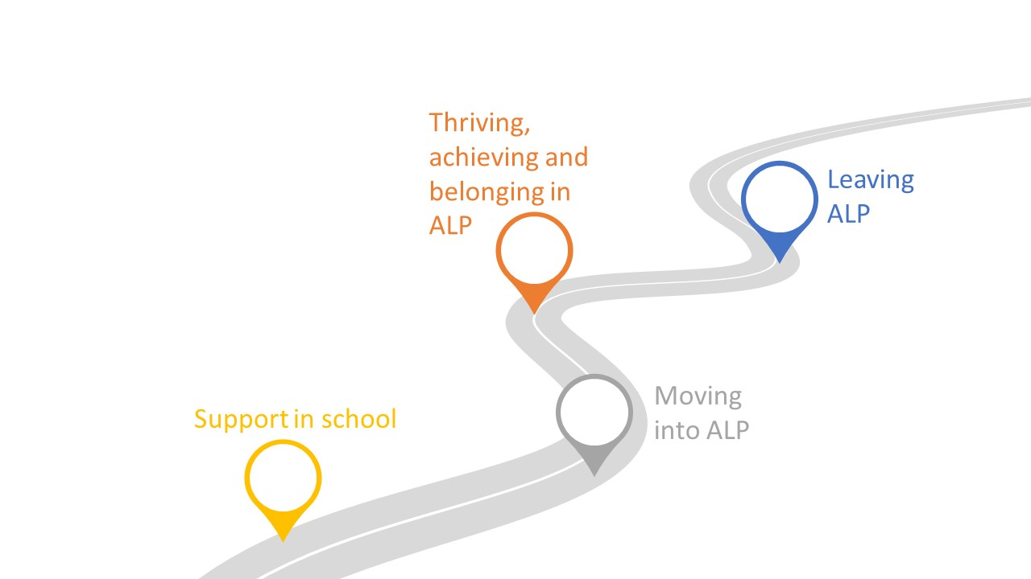
The ALP journey
The strategy details priorities and recommendations covering the following 4 stages of a pupil’s journey:

Slide 16
Values underpinning the 4 stages
Pupils feel a sense of belonging in their education setting
Pupils have a voice and can shape their education provision
High quality provision matches the needs and aspirations of pupils, allowing them to achieve their full potential
High quality provision reflects and understands the needs of Bristol’s communities
Education professionals can identify alternative education needs early, and are informed and confident accessing the full range of provision available to Bristol pupils

Slide 17
Commissioning Approach
5 year framework, jointly commissioned by Bristol, North Somerset and South Gloucestershire
Ceiling of £4.55m per year across the three local authorities
Catalogue of approved provision
Schools expected to commission from providers on the catalogue
Greater range of provision and providers commissioned through 3 contract lots
Full-time ALP (registered independent schools only)
Part-time ALP
In-school support

Slide 18
Aims and Objectives
Improve outcomes for children and young people, including:
Ensure all pupils are in an education setting that best suits them, be that in a mainstream school, specialist school or alternative learning provision (ALP) (this includes timely progression from ALP).
Reducing attainment gap between pupils in ALP and mainstream school, particularly for children in care, children with SEND and children entitled to Free School Meals
Reduce unnecessary travel for children and young people.
Are safe and feel safe | Attainment of academic and/or vocational qualifications
Improved attendance | Successful pathway back to mainstream school, special school or onto post-16 opportunities
Improved engagement in learning | Achievement of positive post-16 destinations through further education, employment and or/training
Improved emotional health and well-being including resilience | Improved social skills and life-skills
Progress in learning | Improved employability

Slide 19
Priorities
ACE & Trauma Informed Practice
Safeguarding
Partnership working
‘Keep in Touch’ offer
Pupil voice and parent/carer involvement
Responsive to SEND need, particularly SEMH

Slide 20
Full-Time Lot
Aspirational, broad & challenging curriculum offer, including Careers education
Long-term placements – up to 1-2 years (Key Stage 4)
Short-term ‘revolving door’ interventions – typically 12 weeks
Full-time places can be delivered by one F/T provider or a blended package with a lead provider

Slide 21
Part-Time Lot
Additional and complimentary support
Varied according to pupil needs, aspirations and preferences
Programmes for individuals or groups
Programmes can be developed and delivered in partnership with the on roll school/setting
Bristol guidance on full-time and part-time education

Slide 22
In-School Lot
Graduated response - support prior to referral into off-site ALP
Support much earlier in ALP journey
Early intervention to enable schools to be more inclusive and help keep pupils in mainstream school wherever possible
Delivery in different school settings – adaptable offer
Variety of types of support, schools have identified need for:
Therapeutic, trauma informed and counselling support
Mentoring
Behavioural support

Slide 23
Outcomes and Monitoring
Monitoring of:
Attendance
Academic Learning
Individual Pupil Progress
Safe Service
Pupil Voice
Equitable Service
Monitoring through:
Pupil progress meetings
By each pupil’s home local authority
Contract monitoring meetings (6-monthly)
Quality Assurance visits (‘learning walks’)
Either by one local authority or jointly between two/three

Slide 24
Framework call-offs
Direct award, based on following criteria
Views of the pupil
Views of the parents/carers
Setting best able to meet pupils’ academic or personal progress outcomes
Relevant specialism of the provision
Availability
Location that best meets pupil needs
Setting named on pupil EHCP
Cost
Quality Assurance monitoring information including Ofsted monitoring information
Mini-competition
Block contracts (if these meet commissioning requirements of one of the three local authorities)

Slide 25
Indicative Timescales
First tender round opens January 2022
Two rounds before framework goes live, September 2022
Round closes usually every 3 months from September 2022 onwards, no limit on number of bids
Bid for each lot individually
Indicative timetable (subject to change):
STAGE | DATE
Issue procurement documents (tender opens) | 17/01/2022
Closing date – round 1 | 25/02/2022 12:00hrs (noon)
Closing date – round 2 | 03/06/2022 12:00hrs (noon)
Commencement date of contract | 01/09/2022

Slide 26
BREAK

Slide 27
Joining the ALP Framework

Slide 28
Procurement Process
Policies
Providers will need to have the following policies and documents in place:
Safeguarding and child protection (including safer recruitment)
Health and safety (to include policy on substance misuse)
Attendance
Behaviour
Anti-bullying
Complaints (in language accessible to pupils)
Careers advice and/or post-16 progression
Workforce model
Service summary (for ALP catalogue)

Slide 29
Procurement Process
Safeguarding
Any questions on safeguarding please contact Bristol’s Safeguarding in Education Team:
Meet the Safeguarding in Education Team

Slide 30
Procurement Process
Costings
Providers will need to submit a costings schedule:
Include any bulk discounts to daily/hourly rate (e.g. above a certain number of weeks, above a certain number of pupils)
Price will be fixed for duration of contract
Annual uplift can be applied for based on inflation-based formula, up to maximum of 2.5% per year, with evidence of increase in costs
Based on feedback from sector:
Providers can submit costings for new or distinct service through the duration of the contract
Uplift requests can be larger in case of extraordinary or unforeseen circumstances from time of submission – evidence will be required

Slide 31
Procurement Process
Quality Questions
These will look to assess how you will meet the key service requirements set out in the specification(s):
Engagement
Curriculum and service offer
Appropriate transition
Partnership working
Safeguarding*
Business continuity*
Equality and Diversity*
Providers will also be evaluated on ‘Social Value’
* These areas do not require a separate answer for each lot – one answer will suffice for all 3 lots

Slide 32
Equalities and Diversity Evaluation
Equalities & Inclusion Team

Slide 33
What we will be asking
Ask providers about any findings of unlawful discrimination or complaints upheld (pass/fail)
A compulsory equalities question scored for quality
Request providers to submit relevant policy or evidence of relevant actions

Slide 34
Equalities and diversity
“Demonstrate a good understanding of the Equality Act 2010, including the Public Sector Equality Duty”
Accurate reference to the nine protected characteristics
References the need to tackle discrimination, harassment and victimisation
Reference to public sector equality duty
Replacing previous equality legislation/not refer to out of date legislation
Reference to reasonable adjustments

Slide 35
Equalities and diversity
“Demonstrate as an employer that equality of opportunity is integral to vacancy advertising, recruitment, retention, promotion, training and grievances.”
Advertise to ensure wide pool of applicants
Job requirements do not contain discriminatory statements/reference to job descriptions
Equality training for interview panels/fair transparent recruitment process
A complaints and grievance procedure is in place
there are arrangements for equality training, incl. commitment to providing access to training for all employees.

Slide 36
Equalities and diversity
“Demonstrate that services will be tailored and regularly reviewed to include understanding of the various service user needs, backgrounds and their differing requirements.”
Reference service user needs, backgrounds and their differing requirements.
Organisational review- Equality action plans/use of impact assessment/annual reviews by management
Equalities monitoring of service users and/ or outcomes, evidence of producing and using data
individual reviews - Feedback from service users or individual reviews of cases
Evidence of making access improvements

Slide 37
Making a difference…
To get a higher score (4 or 5) for each sub-criteria we need to see additional examples of good practice e.g.
An example of how a service was changed as a result of the organisation reviewing equality or community cohesion issues
Positive action in recruitment eg apprentices
An example of how service user consultation resulted in a change to how the organisation conducts its business.
Providing promotional information in different languages and different formats ( not just on request)
Outreach with community organisations to increase service uptake of job applications from under represented communities
Evidence of activities to foster good relations, tackling prejudice and promoting understanding
A really accessible customer feedback process – different languages/easy read
A formalised feedback system which includes people from equalities communities
Encouraging reporting of harassment and domestic abuse for staff or service users.
Other good examples

Slide 38
Introduction to Business Continuity
John Hilton

Slide 39
What is Business Continuity?
The capability of an organisation to continue delivery of products or services at acceptable predefined levels following disruptive incident.

Slide 40
Our Expectation
Business Continuity Management
A holistic management process that identifies potential threats to an organisation and the impacts to business operations those threats if realised might cause, and which provides a framework for building an organisational resilience with the capability of an effective response that safeguards the interests of its key stakeholders, reputation, brand and value creating activities

Slide 41
The Risks to Service Delivery
Fuel Supply Disruption
Loss of Buildings, Places of Work
IT Failure / Data Breach
Flooding
Resources / Staff
Severe Weather
Utility Failures
Supply Chains / Access to Commodities
Dependencies – Third Party / Partners
All could Impact on your ability to deliver your critical activities and functions

Slide 42
The Information We Need
As a potential partner you are expected to have your own Business Continuity Plan/s in place, therefore describe how your plans create resilience within your service / business, what critical activities and functions have you identified and how will your plans mitigate against known risks and reduce level of impact from disruption?

Slide 43
What We look For!
That a Business Continuity Management Structure / Approach is there.
That an individual or group of people are responsible to maintain plans.
Plans are embedded into the organisation / company.
Plans are linked to a Risk Management process.
Risks have been clearly identified.
Critical Activities and Functions have been identified.
Recovery Timelines are realistic and tested.
How plans are exercised.
How plans are shared with staff.
Method of approach to communicate with (staff, service users, stakeholders etc.).

Slide 44
Civil Contingencies Act 2004
Single legal framework for emergency planning in the UK
Established a clear set of roles and responsibilities for those involved
Identifies the Category 1 and 2 responders
Establishes emergency powers
Sets out statutory duties
Notes:
Established a clear set of roles and responsibilities for those involved who are responding at a local level

Slide 45
Category 1 & 2 Responders
Category 1s
Police
Fire & Rescue Authorities
Ambulance Services
Local Authorities
NHS Acute Trusts
NHS England
Port Health Authorities
Environment Agency
Maritime & Coastguard Agency
Category 2s
Highways England
Utilities (gas, electric, water, telecoms)
Airport Operators
Clinical Commissioning Groups
HSE
Without duties under the CCA
Voluntary sector
The Military
Met Office
Notes:
45
Session 2 - CCA Underlying legislation V5-0

Slide 46
Duties under the Act
Assess the risks of emergencies occurring
Produce and maintain emergency plans
Put in place business continuity management
Warn & Inform public (Community Risk Register)
Share information with other responders
Co-operate with other responders
Promote awareness of Business Continuity (LAs only)

Slide 47
Any Questions?
?

Slide 48
Social Value
Tom Allen, Strategic Procurement

Slide 49
Bristol City Council’s Social Value Policy
Aims and Objectives
Create/promote local employment, training and inclusive economic sustainability
Raise the living standards and prosperity of local residents
Build capacity and sustainability of the VCSE
Promote the local economy
Involve local people/organisations
Promote equity and fairness
Support fair and ethical trading
Promote environmental sustainability

Slide 50
Social Value in BCC’s Tender & Contracts
BCC Policy is to award 20% of the available marks on social value
Bidders will be asked to provide which social value commitments they can offer and evidence that these commitments will be measured, monitored and delivered within the life of the contract
Providers bidding for in-school or part-time lots will answer a written, qualitative question on their social value commitments
Providers bidding for the full-time lot will submit their answer through the separate Social Value Portal (SVP)
Information is on BCC webpage including Social Value Toolkit & policy, providing advice for bidders.
Further details will be available in the ITT.

Slide 51
Social Value Portal
A management fee is charged for providers using the SVP - Charged as a proportion of money received from the local authorities through the framework
Details on proportions/percentages will be included as part of the ITT, so that this can be accounted for in your cost submission(s)
The following slides on the Social Value Portal only apply to bidders to the full-time lot
However, other providers may find these useful as an illustration of what is meant by Social Value

Slide 53
Introduction to Social Value

Slide 54
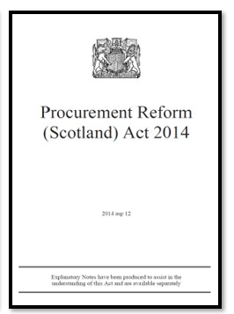
What is social value?
RELEVANT LEGISLATION AND THE POLITICAL CONTEXT
“Social Value refers to wider financial and non-financial impacts of projects and programmes including the wellbeing of individuals and communities, social capital and the environment”
“An Act to require public authorities to have regard to economic, social and environmental wellbeing in connection with public services contracts and for connected purposes”
Social Value Portal
3

Slide 55
How Social Value is Measured

Slide 56
Measuring social value
Put a value on an intervention
Context and cultural background
SALARY
SALARY + SOCIAL VALUE
On the one hand…
On the other hand…
New Job
Good education
Good CV
Dependent on state benefits
Impact on mental health
Once we take into account “what would have happened anyway”….
+ £20,481
Social Value Portal
5
5 Social Value for SMEs June 2020

Slide 57
The National TOMs Framework

Slide 58
Themes
Measuring Social Value – TOMs Overview
Outcomes
Measures
Units
Value
Local Skills and
Employment
More opportunities for disadvantaged
people
No. ex-offenders employed
No. people
£16,349/per
Growth of Responsible and Local Business
More opportunities for local SMEs and VCSEs
Reducing inequalities
No. voluntary hours
No. hrs
£13.86/hr
Healthier, Safer and more Resilient Communities
Vulnerable people helped to live independently
Spend in local supply chain
£ spent
Local Spend Multiplier
Decarbonising and Safeguarding our World
Carbon emissions are reduced
Tonnes CO2e reduced
tCO2e
£67.01/tCo2e
Social Innovation
Safeguarding the natural environment
Total Social Value = Sum(Measures*Value)
Social Value Portal
7

Slide 59
The Bristol TOMs
Theme | Outcome (Bristol Corporate Strategy Key Commitments)
Empowering and Caring | Community support
Fair and Inclusive | Local employment and apprenticeships
 | Training and support for local employees
 | Targeted local recruitment
 | Experiences of work
Wellbeing | Environmental measures
Social Value Portal
8

Slide 60
Example measures
Community Support:
Support for local community projects or VSCEs - £ invested inc. staff time volunteering, materials, resources etc.
Spend with Local Suppliers
Particularly MSME organisations
Local staff and apprentices working on the contract
With particular focus on wards of increased deprivation
Staff training towards qualifications
EDI training to staff or supply chain
Staff given access to wellbeing programmes
£ spent on mental health campaigns
Recruitment of staff
From local area, including particular focus on wards of increased deprivation
From particular groups – long-term unemployed, staff with physical disability or mental health issue, BAME staff etc.
Work placements
Engagement with schools and colleges (not in the delivery of ALP)
Car miles avoided or delivered through low/no emission vehicles
Recycling partnerships
De-carbonisation plan
Other environmental initiatives to respond to climate and ecological emergencies

Slide 61
Making a Social Value Submission

Slide 62
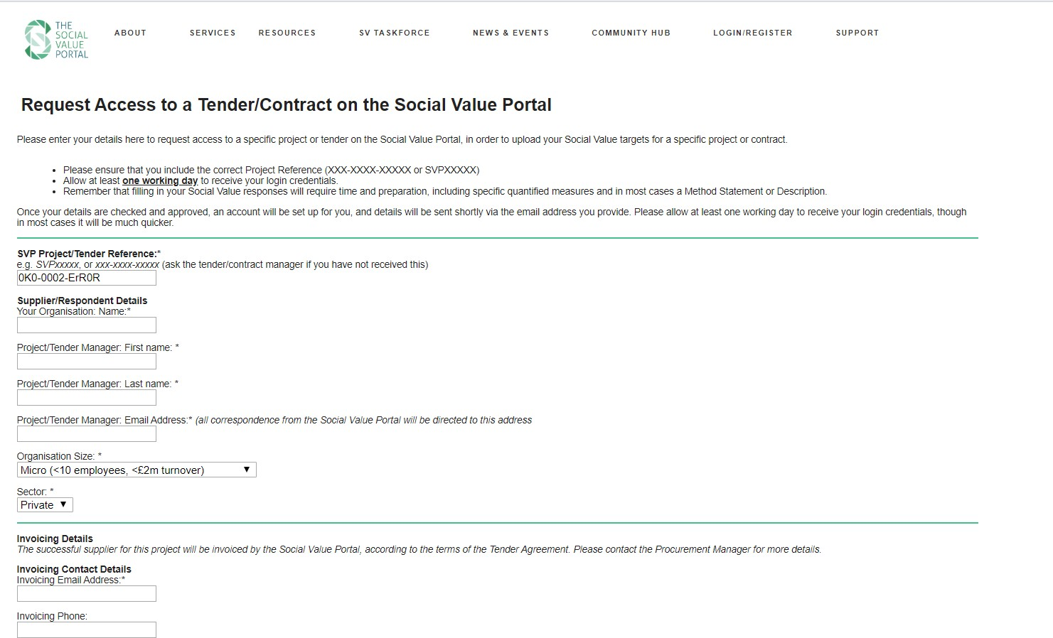
Registering for a Project
The Registration link in the ITT will direct bidders to the Social Value Portal registration page.
Bidders should submit their organisation contact details and will be auto registered
You will receive an email to
confirm your registration
Social Value Portal
62

Slide 63
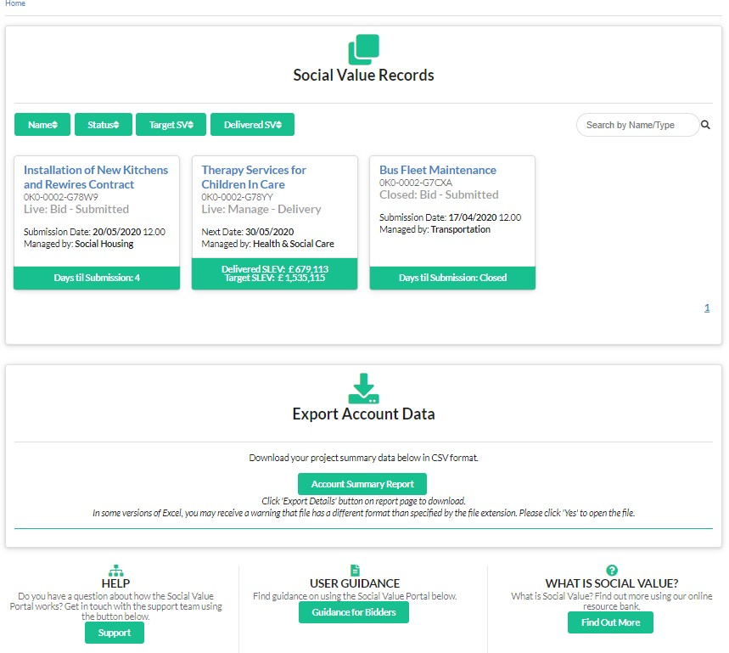
Portal Home Page
Social Value Portal
63

Slide 64
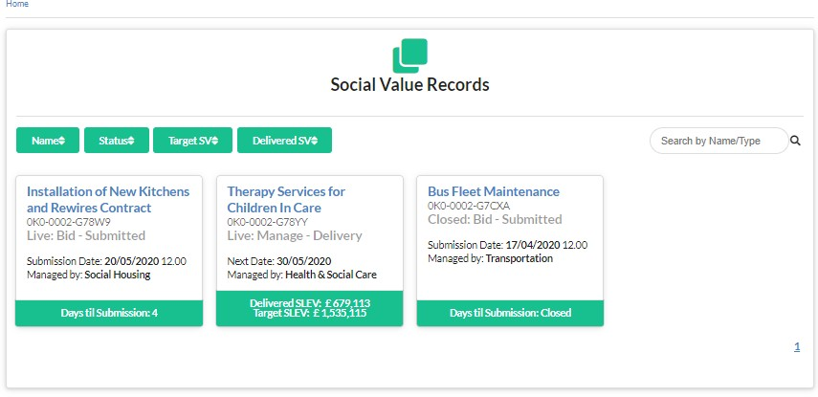
Finding your Project
Social Value Portal
64

Slide 65
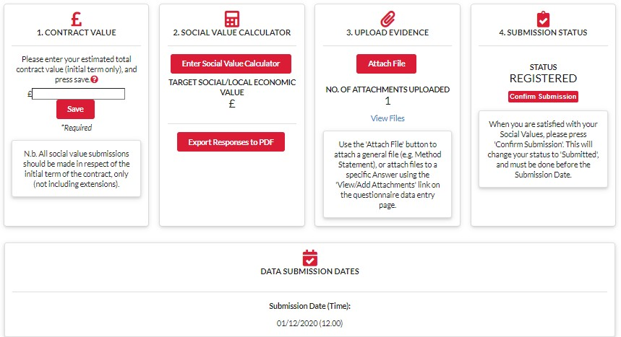
Your Social Value Record
Enter Social Value Targets &
Upload evidence
Enter contract
value
Confirm Social Value bid submission
The tender submission deadline
Download and Save your Social Value targets as a PDF
Social Value Portal
13

Slide 66
Do’s and Don’ts

Slide 67
DO remember to account for employment correctly
1. Accounting for employment (FTE)
Time spent on project (Full Time) | FTE
12 months | 1
6 months | 0.5
3 months | 0.25
1 month | 0.083
1 week | 0.0192
Social Value Portal

Slide 68
1. Accounting for employment (FTE)
DO remember to account for employment correctly
Local employment (BT27/BT27a) | Disadvantaged people into work
Can be counted for every year of employment Example: if you hire a local person on a full-time basis (FTE), for 2 years, you may enter 2. Include all local people working on the project | Can only be counted for the first year of employment Example: if you hire an ex-offender on a full-time basis (FTE) for 2 years, you may enter 1. Only include new employees who were previous unemployed
Differences between local employment and disadvantaged people into work
measures
Social Value Portal

Slide 69
2. Double Counting
DON’T Double Count – general rule of thumb
What is Double Counting?
Double counting is when you count the same target/deliverable under two or more measures.
Example 1: If hours volunteering in the local community are claimed, these same hours cannot also be claimed
under hours volunteering on local school / college visits.
Example 2: If you count local employees under BT27/27a (local employees), you cannot also count the cost of hiring these employees in BT21/BT22 (your local supply chain spend). You will need to deduct those wages (by using the BT27 proxy value) from your local spend.
Social Value Portal

Slide 70
2. Double Counting
2 exceptions to double counting
1) Disadvantaged People into work
Due to the different outcomes and impacts that contribute to the proxy values you cannot count an employee as being two
different types of disadvantaged.
Example: if you hire someone who was both not in employment, education, or training (NEETs) and a young offender, they can only be counted once. As this should be the result of an recruiting programme, enter the employee under the measure most appropriate for the recruitment programme through which they were hired.
Disadvantaged people into work measures can ONLY be counted for the first year of employment.
However, if this same person is also local to the project, they can count as both disadvantaged and local as those are based on
different outcomes.
Example: 2 year contract, you hire someone on a full-time basis who is local and NEET, you can enter the same employee as 2 in BT27 and 1 in BT10
Note: Disadvantage people into work measures are Social Value,
while local employment measures are Local Economic Value
Social Value Portal

Slide 71
2. Double Counting
2 exceptions to double counting
2) VCSE and Local Spend
If you spend money with a local VCSE, you can input the amount in both BT17 (VCSE spend) and BT21 (Local spend) or BT22 (Local MSME spend).
On one side, we are measuring the additional social value from spending with a VCSEs (BT17) and on the other we are measuring the benefits to the local economy (BT21 -local spend- or BT22 -local MSME spend).
Example: You spend £1,000 with a small local VCSE and £2,000 with a local MSME.
BT17 (VCSE spend) = £1,000 (social value) BT21(local spend) = £0
BT22 (local MSME spend) = £3,000 (local economic value)
Note: Spend with VCSE’s is counted as Social Value while local spend measures are Local Economic Value
Social Value Portal

Slide 72
3. Additionality
DON’T include ‘core contract’ work
Services or actions that the bidder is required to provide as part of the core contract requirements
cannot also be counted as social value.
Example: if the contract is about supporting people back to work you cannot claim social value for getting people back to work as that is part of the requirements of the core contract.
Social value is about ‘additionality’ i.e. what will you provide over and above the core contract.
Social Value Portal

Slide 73
4. Proportionality
DO remember ‘proportionality’
None of the measures are mandatory (unless specified) and suppliers should ensure that their proposals are relevant and proportional to this contract.
The proposal must relate directly to the contract in question and should be proportional to the overall contract value (for example, social value bids that are in excess of 100% of the contract price may not be deliverable).
The proposal must relate directly to the initial term of the contract in question (not including any potential extensions) unless stated otherwise.
If you are only responsible for a proportion of an initiative, only claim what you are directly responsible for.
Social Value Portal
73
21

Slide 74
5. Definition of local
DO keep in mind the definition of ‘local’
The definition of ‘Local’ for this project is within Bristol, North Somerset or South Gloucestershire
Social Value Portal
74
21

Slide 75
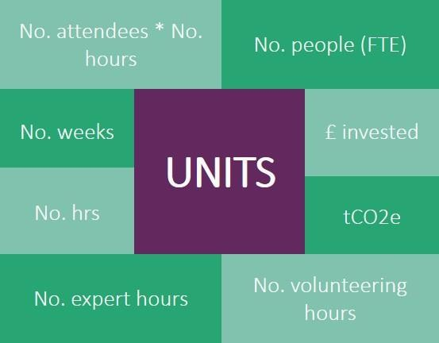
6. Units
DO Double-check the unit for the measure DON’T Just enter the same values you receive
Each measure has a corresponding unit and associated proxy value
Some measures may have units you may not expect.
Example: apprenticeships are measured in weeks and not number of apprentices. Support to unemployed people is measured in no. of hours (session) * no. of attendees (your audience).
Some measures have ‘record only’ under units – this is where the proxy value is £0 as the measure is only an indicator. All %s are ‘record only’
Staff time should be valued using the proxy values, ie the proxy values for volunteering or expert time.
Social Value Portal
75
21

Slide 76
Final Thoughts & Questions

Slide 77
Bidding and using ProContract
Tom Allen, Strategic Procurement

Slide 78
Procurement Process
Procurement Process
Through the Council’s e-procurement system – Pro-contract.
Using the open tender process meaning providers will need to submit responses to a range of questions and the cost to deliver the service. Questions include:
Suitability Assessment Questionnaire (Self Certify – Blacklist, Insurance, GDPR etc) https://www.gov.uk/government/publications/procurement-policy-note-816-standard-selection-questionnaire-sq-template
Quality Questions – Safeguarding, Equalities & other questions linked to the service specification
Tender will be evaluated on Quality and Social Value

Slide 79
Procurement Process
Tender Documents
Instructions to Tenderers (ITT)
Terms & Conditions
Specification, including demand information
Contract monitoring requirements
Pricing Schedule
Non collusive & non canvasing certificate
TUPE information

Slide 80
Procurement Process
Bidding Models
In addition to a single provider applying for this contract, other bidding models will be accepted – further information will be available in the ITT
Bidding models include:
Sub-Contracting
Consortia bidding
Lead partner / joint and severally liable
Special purpose vehicle (subsidiary of parent company)

Slide 81
Scoring Matrix
Scoring Matrix
Assessment | Scores 0-5 | Reason to award this score based on evidence provided against the criteria included
Unacceptable | 0 | Does not meet the requirement; Does not comply and/or insufficient information provided to demonstrate that the bidder has the ability, understanding, experience, skills, resource & quality measures required to provide the service, no evidence to support the response.
Serious reservations | 1 | Satisfies the requirement with major reservations; Considerable reservations of the bidder’s relevant ability, understanding, experience, skills, and resource & quality measures required to provide the service, with little evidence to support the response.
Minor reservations | 2 | Satisfies the requirement with minor reservations; Some minor reservations of the bidder’s relevant ability, understanding, experience, skills, and resource & quality measures required to provide the service that partially supports the response.
Satisfactory | 3 | Satisfies the requirement; Demonstration by the bidder of the relevant ability, understanding, experience, skills, resource & quality measures required to provide the service with evidence to support the response
Good | 4 | Satisfies the requirement with minor additional benefits; Above average demonstration by the bidder of the relevant ability, understanding, experience, skills, resource & quality measures required to provide the service; Response identifies factors that will offer potential added value, with evidence to support the response.
Excellent | 5 | Significantly exceeds the requirement; Exceptional demonstration by the bidder of the relevant ability, understanding, experience, skills, resource & quality measures required to provide the service; Response identifies factors that will offer potential added value, with evidence to support the response

Slide 82
Procurement Process
Tendering Tips
Base your bid on the Specification & Terms and Conditions, don’t provide a generic answer; make your answer specific to the contract; answer the question fully.
Only include publicity material in your submission if you have specifically been asked to.
If something is not clear, send a dialogue to the Council through the e-procurement system.
Observe the deadlines for clarifications, don’t wait until the last minute.
Don’t qualify your bid (place conditions upon your bid). These can not be accepted.
Further information available on our Internet https://www.bristol.gov.uk/tenders-contracts/procurement-support

Slide 83
Procurement Process
Tendering Tips
Use your responses to demonstrate understanding, knowledge, experience and ability to deliver clearly explaining your methodology, innovative solutions & added value.
Observe any word counts that are imposed, otherwise this could mean that this information is not taken into account.
Don’t rely on previous knowledge or contracts held by the Council - Evaluators can only evaluate what is in front of them, using the scoring matrix detailed in the tender.

Slide 84
Procurement Process
Tendering Tips
Provide all of the information requested. If you cannot provide some of the information, for whatever reason, ask for advice, this can be done through the e-procurement portal.
Ensure that all the sub-criteria/guidance points are covered within the answer, this is what you will be scored on.
Use previous commissioning feedback & build it in to your submission.
Ensure that you have plenty of time before the closing date.

Slide 85
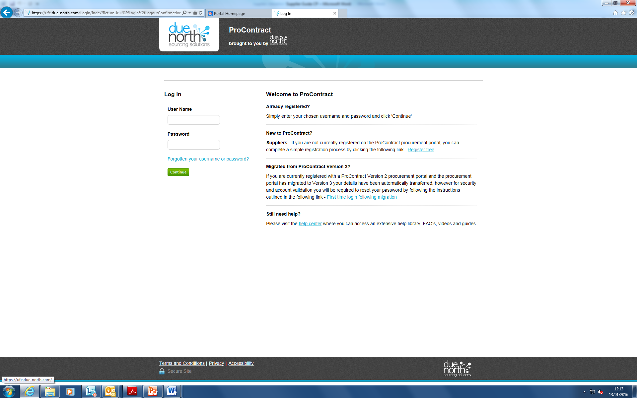
Procurement Process
Pro-Contract
https://procontract.due-north.com

Slide 86
Procurement Process
Pro-Contract – System Navigation
Register interest in the contract
Click ‘Start my Response’ button
Access to tender documents
Access to submit tender response
Access to ask clarification questions and receive responses to questions asked by other interested providers

Slide 87
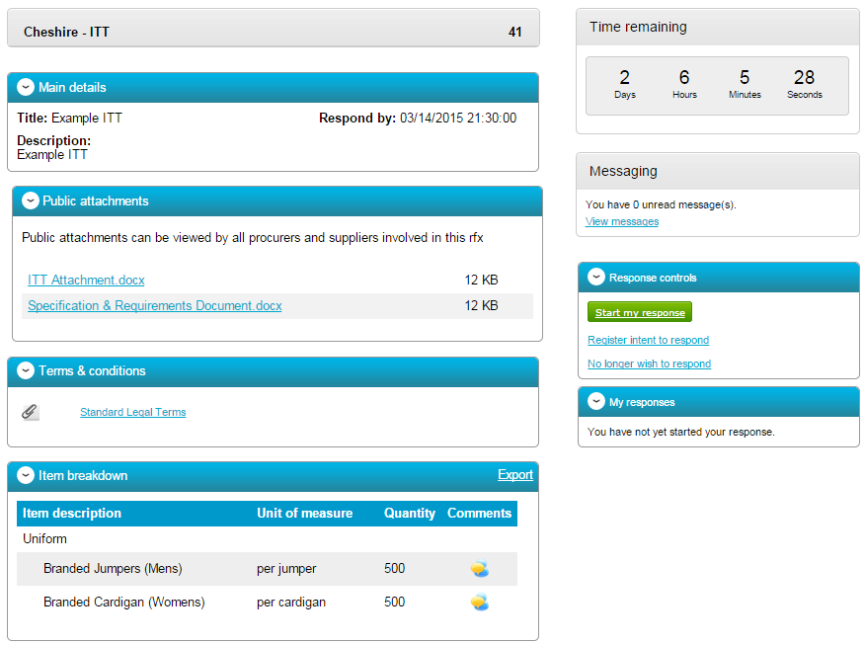
Procurement Process
Pro-Contract – System Navigation

Slide 88
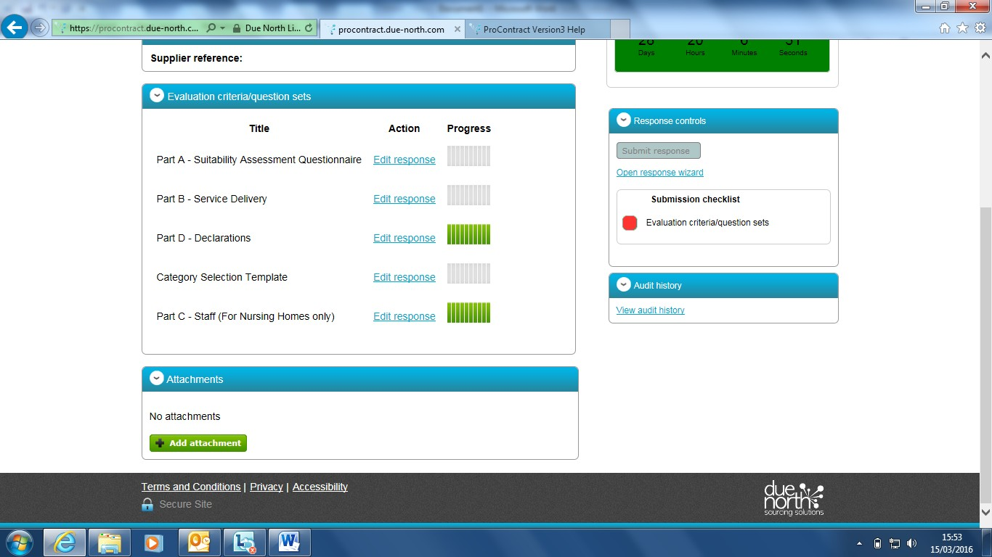
Procurement Process
Pro-Contract – System Navigation

Slide 89
Procurement Process
Pro-Contract – System Navigation

Slide 90
Procurement Process
Pro-Contract – Contact Details
If any system or technical issues with ProContract, contact ProContract eTendering System Support
procontractsuppliers@proactis.com
0330 005 0352
08:30 – 17:30 Monday - Friday

Slide 91
Any Questions?
Your questions and comments

