Slide 1
0-19 years Healthy Child Programme (HCP) Service Contract
Market Engagement Event
Derys Pragnell
Head of Public Health Programmes

Slide 2
0-19 years Healthy Child Programme (HCP) Service Contract Market Engagement Event
We would like to invite you to attend a market engagement event for suitably qualified and experienced organisations, who are interested in tendering for the contract to provide this service.
The Council’s intention for the 0-19 HCP Service is that it will:
provide the full, service offer of the 0-19 Healthy Child Programme, with timely and appropriate access to health visiting and school nursing services;
address the 6 High Impact Areas – in both health visiting and in school nursing – in order to improve outcomes for children, young people and families;
be delivered through an integrated and innovative approach to health and wellbeing;
have significant impact for all children, young people and families (especially those needing more support), and impact on reducing health inequalities.
The expected term of the contract will be from 1 April 2020 for 5 years with the option to extend for a further 2 + 2 years.
The budget per annum is around £4.5M

Slide 3
Agenda
Items
Introductions
0-19 Population and Health Needs
Current contract, client group and new contract
Council Plan & Health and Wellbeing Strategy
Procurement timetable
Q&A

Slide 4
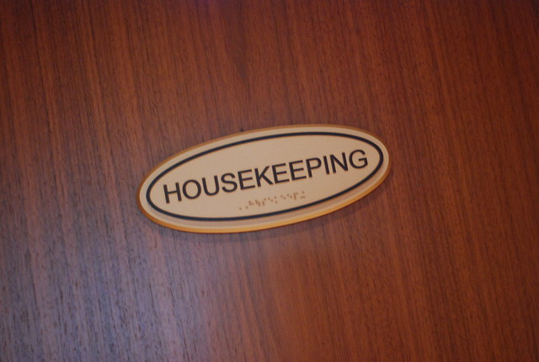
Introductions and housekeeping
About MKC

Slide 5
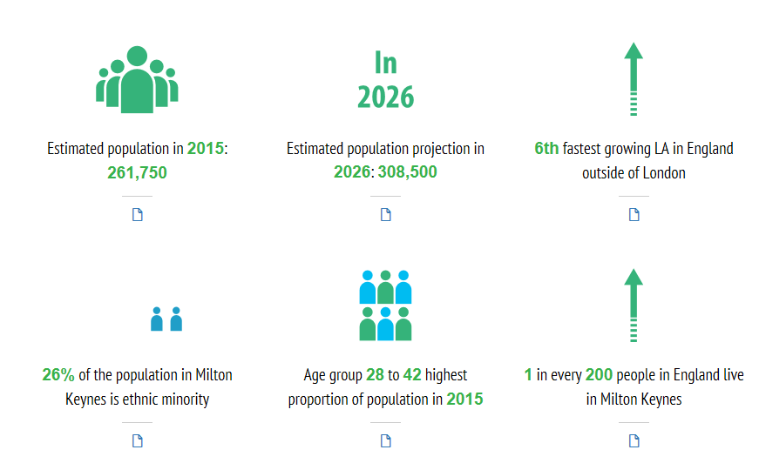
About Milton Keynes
Notes:
Population increasing.

Slide 6
0-19 Population
73,000 CYP aged 0-19 living in MK in 2019
Increasing year on year peaking at just over 76,000 in 2025
In 2017/18 3,475 babies were born in MK
Around 40% school population BME
 | 2020 | 2021 | 2022 | 2023 | 2024 | 2025 | 2026 | 2027 | 2028
0-4 | 19,167 | 18,917 | 18,843 | 18,721 | 18,606 | 18,503 | 18,411 | 18,332 | 18,257
5-18 | 54,588 | 55,638 | 56,357 | 56,970 | 57,523 | 57,715 | 57,739 | 57,536 | 57,307
Total (0-18) | 73,755 | 74,555 | 75,200 | 75,691 | 76,130 | 76,219 | 76,149 | 75,868 | 75,565
Notes:
ONS data - almost 73,000 CYP aged 0-18 (inclusive) living in Milton Keynes in 2019. The population in this age range (particularly amongst school aged children) is projected to increase gradually year on year, peaking at just over 76,000 in 2025, following which it begins to fall.
Breastfeeding initiation
Breastfeeding prevalence at 6-8 weeks after birth (current method)
Hospital admissions as a result of self harm (10-24 years)
(PHE CHIMAT, accessed 2019)

Slide 7
0-19 Detail
Milton Keynes CYP wellbeing indicators compared to England & Statistical Neighbours
Indicator | England | Statistical Neighbours
Infant Mortality
Population Vaccine coverage MMR
15-17 year olds NEET
Admission for alcohol related conditions (under 18 yrs)
Hospital admissions caused by unintentional injuries
Family homelessness (2017/18) is significantly
worse than England
31% of cilden in MK live inpoverty, after housing costs are taken into account
Children in care immunisations decreasing and getting worse
Teenage prncy rate is similar to England with 89 girls becoming pregnant in a year
Hitl admissions for asthma under 19 years is significantly worse than England average
Source: PHE, Child Health Profile (2019) and Children's Services Statistical Neighbour Benchmarking Tool (2015)
Notes:
health outcomes for CYP in MK are often similar to the England average but can be worse than our statistically similar neighbours. We aspire to reach the top 5%. Partnership approach is key. The provider will be a key partner in driving health improvement for CYP and their families forward.

Slide 8
0-19 Detail
Milton Keynes CYP wellbeing indicators compared to England & Statistical Neighbours
Indicator | England | Statistical Neighbours
Family Homelessness
Hospital Admissions for Asthma (under 19)
Obese (10-11 yr olds)
Smoking at time of delivery
Family homelessness (2017/18) is significantly
worse than England
31% of cilden in MK live inpoverty, after housing costs are taken into account
Children in care immunisations decreasing and getting worse
Teenage prncy rate is similar to England with 89 girls becoming pregnant in a year
Hitl admissions for asthma under 19 years is significantly worse than England average
Source: PHE, Child Health Profile (2019) and Children's Services Statistical Neighbour Benchmarking Tool (2015)
Notes:
Compared to England our performance for family homelessness and hospital admissions for Asthma is poor. We also perform badly for childhood obesity (age 10-11) and SATOD when considering statistical neighbours.

Slide 9
Ensure children and vulnerable people are protected from harm and neglect and work with partners to integrate services, improve outcomes and reduce health inequalities.
A well-managed, balanced budget
Supporting vulnerable children & reducing child poverty
Tackling homelessness & delivering more affordable housing
Getting the basics right
Prevention is better than cure
Stronger communities
Staying Well: a strong focus on prevention
Closing the Gap: reducing inequalities in life chances
An integrated, innovative approach to health and wellbeing
Notes:
https://www.milton-keynes.gov.uk/your-council-and-elections/council-information-and-accounts/strategies-plans-and-policies/council-plan-2016-2020.
https://www.milton-keynes.gov.uk/social-care-and-health/health-and-wellbeing-board/health-and-wellbeing-strategies-and-the-jsna/joint-health-and-wellbeing-strategies. Emphasis on CYP. Prevention, integration and innovation

Slide 10
0-19 Health Child Programme
Current
Two separate service specifications. 0-5 (health visiting) and 5-19 (school nursing).
Transformation towards a more integrated approach.
Proposed
Single contract. Duration 5+2+2
Working in partnership with professionals and stakeholders to provide a seamless, high quality accessible and comprehensive integrated 0-19 service in line with the nationally evidenced 4,5,6 approach.
Focussing on early identification of risk and issues, keeping CYP healthy and safe and improving health outcomes for individuals and the population.
Notes:
Flexible and innovative provider

Slide 11
Vision
Working in partnership with professionals and stakeholders to provide a seamless, high quality accessible and comprehensive integrated 0-19 (school nursing and health visiting) service in line with the nationally evidenced 4, 5, 6 approach.
The service will focus on early identification of risk and issues, keeping CYP healthy and safe and improving health outcomes for individuals and the population.
Notes:
5 years +2 +2 expectation that there will be flexibility within the contract to support integration moving forward.

Slide 12
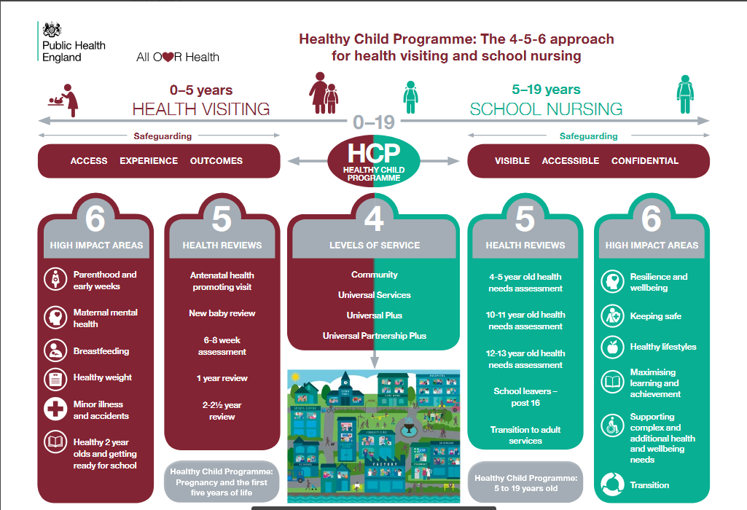
Integration
Partnership
Innovative
Mental Wellbeing
Digital
Safeguarding
Seamless
Vulnerable Groups
flexible
Notes:
Service specification based on the national 4-5-6 approach. Words arising frequently. Looking for a flexible, innovative approach to delivery working towards integration with partners across 0-19 services.

Slide 13
Procurement timetable
Aug 2019 - Market engagement event
Aug 2019 - Tender on Pro-Contract
Sept 2019 – Supplier Bid to be returned
Oct 2019 - Moderation completed
Dec 2019 – Approval to award and Pre Award Letter issued
Jan 2020 - Award letter subject to finance and legal approval followed by mobilisation meeting
1 April 2020 - Contract start date
About MKC

Slide 14
Questions

