Slide 1
Weston Heritage Action Zone DPS Workshop 9 January 2020
Welcome

Slide 2
2.30 Welcome: Cara MacMahon. Heritage Action Zone Officer
2.35 Overview: Cara MacMahon.
Background to The Heritage Action Zone
Overview of the Shopfront Enhancement Scheme
2.50 Introduction to DPS- Geoff Wall. Projects and Resources Manager
3.10 Open Questions session
3.30 Next Steps
3.45 Opportunity for contractors to ask specific questions
AGENDA

Slide 3
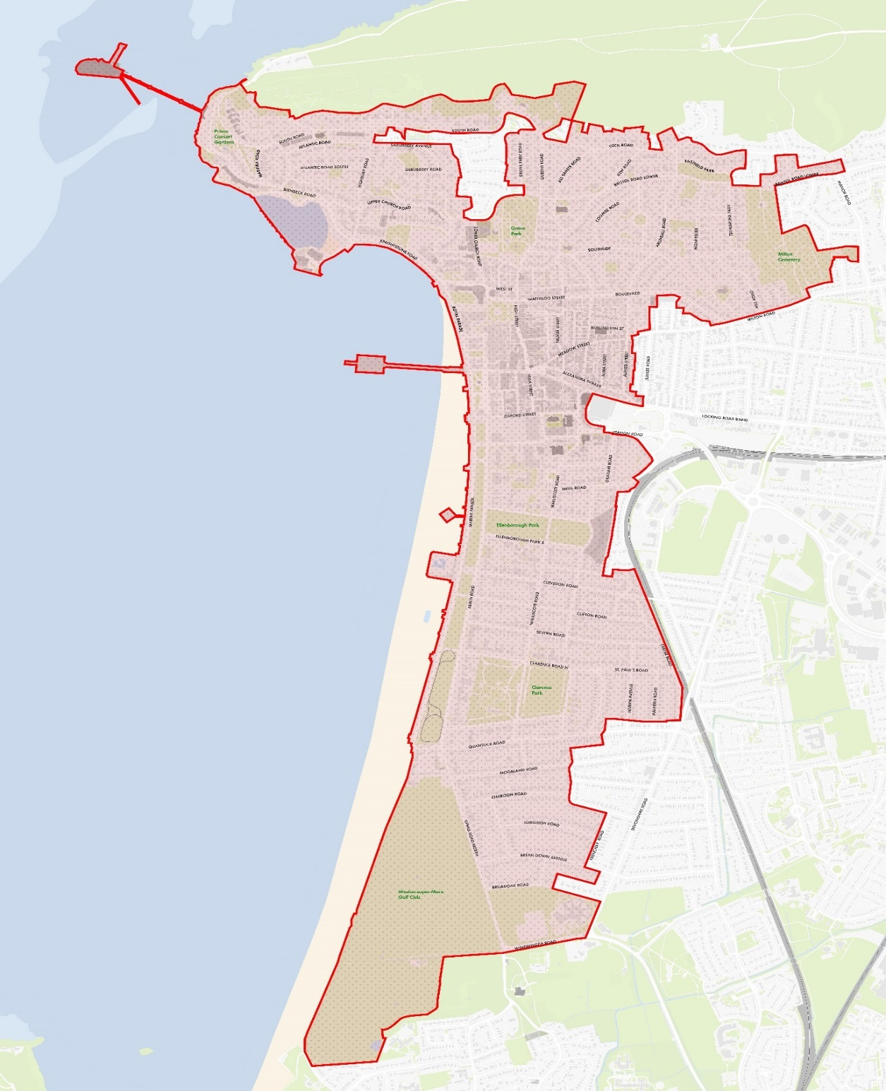
Great
Weston
Conservation
Area

Slide 4
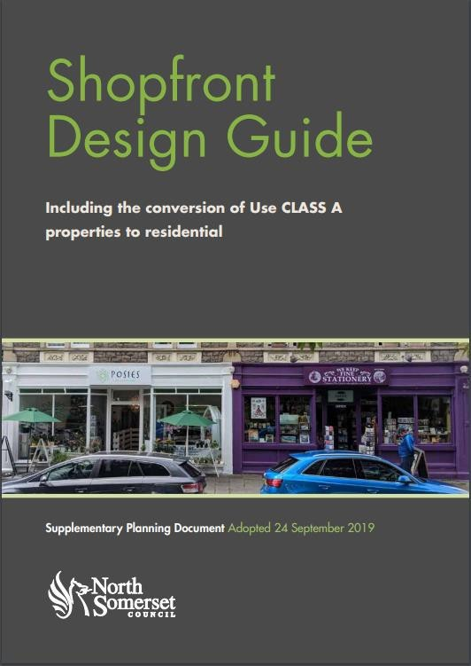
Newly adopted Shopfront Design Guide

Slide 5
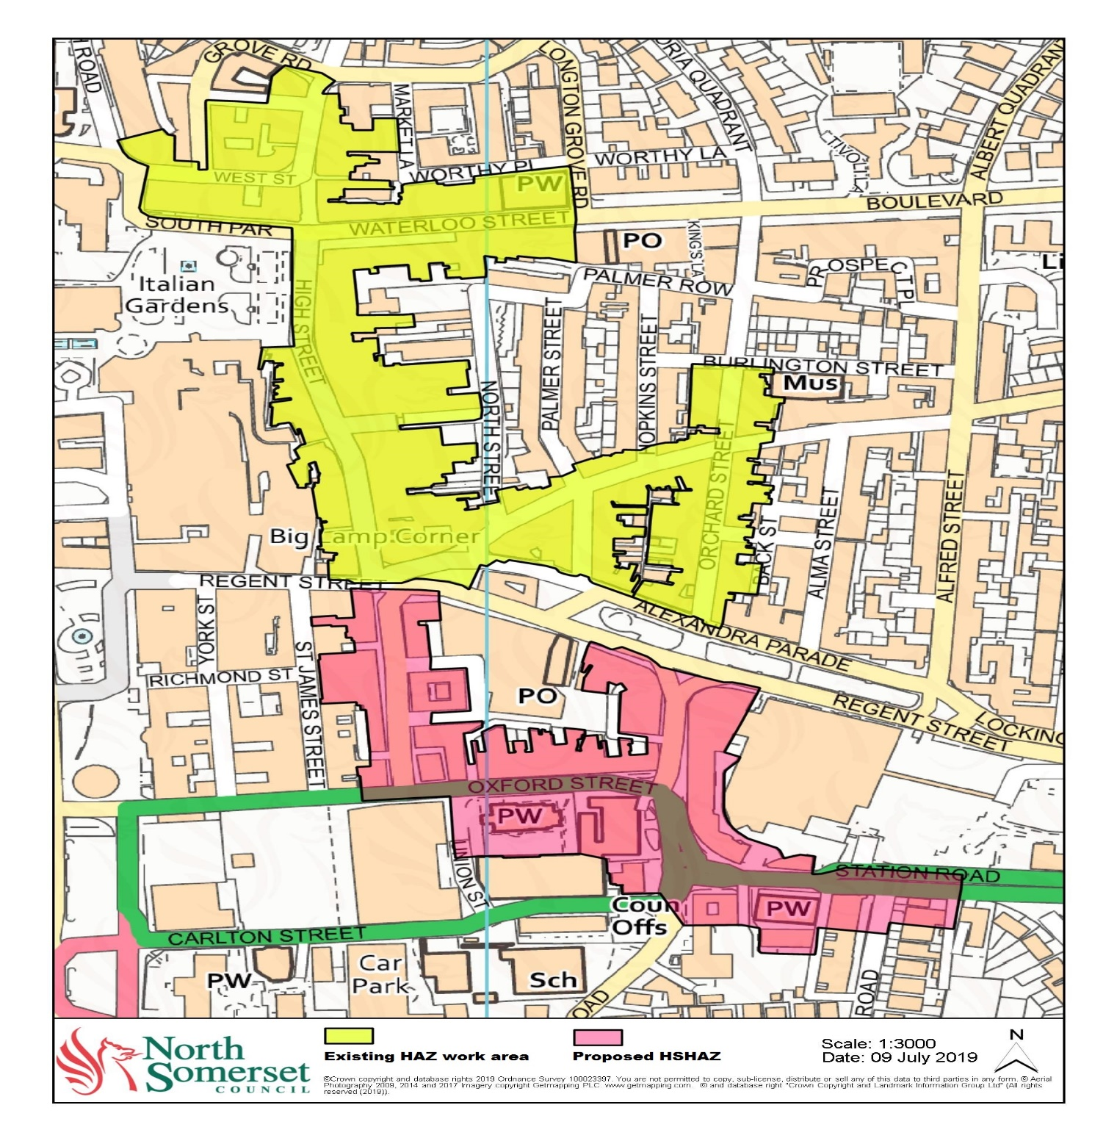
Footprint for the shop front enhancement work 2020-2024

Slide 6
The scheme offers grants of up to 75% of eligible capital costs to retailers to enhance their shopfronts and 1st/ 2nd floor facades
We provide ‘free’ design service to retailers
Once a retailer has agreed to be part of the scheme we offer a full design and costing service
We will gain relevant planning consents
We also will procure the contractors for each unit
Contractors who have successfully registered on the DPS will be invited to tender for each shop enhancement
What we have done so far
The Offer to Shops

Slide 7
Procurement of Architect team- Chris Dyson Architects
Work includes-
Design for each shopfront/ facade
Submission of planning permissions
Draft costing for each shopfront/ facade
Support to develop tender brief for each piece of work
Oversight of contractors for each shopfront
What we have done so far
The Architects

Slide 8
Gaining buy in from retailers
Work includes-
Informing all retailers about the scheme
Gaining initial interest from retailers
Draft design and costing for 4 premises
Interest from a further 10 more premises to date
First shop ready to be developed- Walker & Ling
What we have done so far
The retailers

Slide 9
DPS – What does it entail?
Introduction
What is a DPS?
Dynamic Purchasing System
Pre-Approved list of suppliers
Open to applications at all times
Advantages of joining the DPS
£1m worth of work
1 initial application form
All Suppliers Invited to quote
Prices/rates not asked for at time of joining
Free to join
The Council is commitment to be a fair client and to pay its suppliers on time.

Slide 10
Trade | Lot
Joinery and millwork, specifically classical shop front construction and installation in timber | 1
Decoration | 2
Minor electrical works (external lighting etc) | 3
Minor demolition | 4
Brick repairs / Repointing / Stone repairs/ lime mortar rendering | 5
Timber window installation | 6
Leadwork | 7
Scaffolding | 8
Internal security grills | 9
Shop doorway/ doors automatic and manual | 10
Traditional tiling (Victorian floor tiles and 20th century wall tiling) | 11
Signage | 12
Main contractor - Some or all the trades above and managing and supervising sub-contractors where used. | 13
DPS – What does it entail?
Lots

Slide 11
https://tinyurl.com/WSM-Shops-DPS
Three main documents
1 –Introductory Document – Tells you about the DPS and how it will work
2 - Selection Questionnaire – which needs to be completed and returned
3 – Example RFQ – Used for future quotation requests.
DPS – What does it entail?
Applying

Slide 12
Doc 2 – Selection Questionnaire
Introduction and guidance
Part 1 – Details about your Company
Part 2 – Exclusion Grounds
Part 3 –
Financial
Technical – example of 3 previous contracts
Insurance - £5m
Health and Safety
Policy https://www.hse.gov.uk/simple-health-safety/policy/index.htm
Risk Assessments https://www.hse.gov.uk/risk/casestudies/
Equalities and Diversity –Acas model E&D policy
https://www.acas.org.uk/equality-policy-template
Part 4 – Assessment Criteria
DPS – What does it entail? Selection Questionnaire

Slide 13
Quotation process
All Companies within Lot invited
Run through the Portal
Opportunity to raise Q&A’s
Request for Quote (RFQ)
Scope of works
Pricing schedule
Form of contract
Questions confirming eligibility to quote
Scheme specific questions
Evaluation criteria
DPS – What does it entail?
Operational

Slide 14
Social Value
Social, Economic and Environmental benefits
NSC policy
https://www.n-somerset.gov.uk/my-business/tenders-procurement/procurement-strategy/our-social-value-policy/
Heritage Skills
DPS – What does it entail?
Social Value

Slide 15
Timelines
Round 1 applications –1 PM 20 January
DPS competitions start – February
DPS remains open until March 2024.
Procurement Portal –
Supplyingthesouthwest.org.uk
Used for the DPS
All advertised Opportunities
Free to register
DPS – What does it entail? Timelines and Portal

Slide 16
Open session
Queries
and
Questions

