Slide 1
0-19 Healthy Child Programme
Pre-Market Engagement
July 2024

Slide 2
Welcome and Introductions

Slide 3
Agenda
Purpose of Meeting
Outline of Evidence Base and Service Model
Outline of the Contract and Procurement Approach
Discussion and Feedback from Provider
Close and Thank You
This pack also contains demographic data in appendix 1 for your information. This will not form part of the presentation, but we are sharing now in case you have any questions you’d like to raise with us.

Slide 4
Purpose of Event:
We would like to understand more about the market and so are seeking your feedback on the following:
- Service model
- Any information you require to support with bidding
- Any factors which might affect your ability to bid
The learning from these conversations may be used in the development of the Service Specification and procurement process.
Please note that any questions asked by providers and consequent responses given by commissioners will be collated and published (anonymously) as part of the procurement.

Slide 5
The Proposed Updated Model

Slide 6
1. National 0-19 HCP Policy and Guidance
What is the evidence-base informing the new model?
6. Financial Envelope
2. Family Wellbeing Needs Analysis
Cumberland 0-19 Healthy Child Programme
5. Engagement with 0-19 HCP staff
3. Experiences and views of our Families
4. Feedback from our partners

Slide 7
Principles of an Integrated Approach
Co-location (where possible) of the 0-19 offer in multi-agency prevention and early help locality teams
(e.g. prevention and early help workers, nursery nurses, health visitors and 5-19 school-aged nursing staff co-located in geographically defined locality teams)
Alignment to the high impact areas defined nationally, but also the risk factors we know impact on family wellbeing in Cumberland
Poverty, Mental Health, Neurodiversity, Alcohol/Drug misuse and Domestic Violence
A continued focus on public health prevention as defined through the ‘Modernised 0-19 Healthy Child Programme Model’

Slide 8
Using national policy to create the service framework

Slide 9
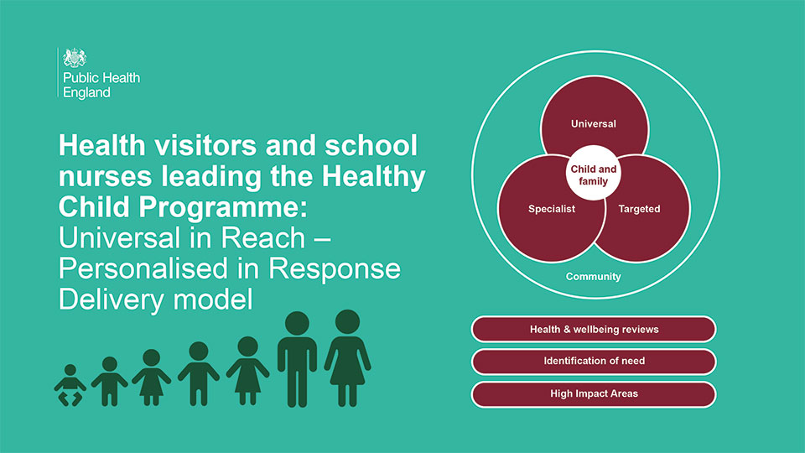

Slide 10
Framework definitions:
Universal | Targeted | Specialist
No known risk factors for poor mental or physical health. Any existing physical or mental health conditions managed well. No known safeguarding issues. No known housing, financial or social issues impacting on health and wellbeing Focus on maintaining health & wellbeing and early identification of need Estimated to be 75% of the population eligible for 0-19 HCP | One or more moderate risk factors for poor health and wellbeing present in the family. Risk to be assessed by suitably qualified member of staff, but may include: Poverty and poor housing Poor mental health Neurodiversity Domestic Violence Substance misuse (drugs and alcohol) Long term health conditions Parents who have experienced care Children and young people who are carers Children in Need (if identified health need) Estimated to be 20% of the population eligible for 0-19 HCP | One or more significant risk factors for poor health and wellbeing present in the family. Risk to be assessed by a suitably qualified member of staff, but may include: Severe mental illness Refugee and asylum seekers Children on a Child Protection Plan (if identified health need) Young parents Estimated to be 5% of the population eligible for 0-19 HCP
Community (delivered by Cumberland Locality Prevention Teams) - tbc
Classes and group sessions held in community settings open to all families across universal, targeted and specialist pathways. Additional targeted classes may take place (needs-led).
Digital Information Advice and Guidance offer

Slide 11
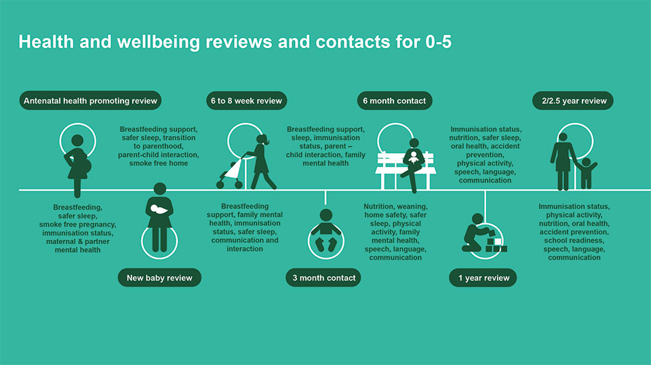

Slide 12
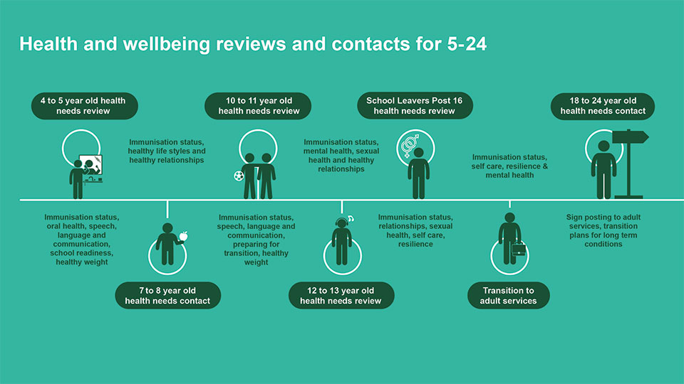

Slide 13
Key point | Community sessions (tbc) | Universal | Targeted | Specialist
Antenatal health promoting review (28 weeks +) | Antenatal | Home | Home | Home
New baby review | New baby: 0-6 mths | Home | Home | Home
6-8 week review |  | Clinic | Home | Home
3 month contact |  | Digital | Virtual | Home
6 month contact | Growing baby 6-12 mths | Digital | Virtual | Home
1 year review | Toddler 1-3 years | Clinic | Clinic | Home
2-2.5 year review |  | Clinic | Clinic | Home
4-5 year-old health needs review | Ready for school 3-4 years | SRQ & NCMP & Vision Screen | Virtual | F2F
7-8 year-old health needs contact | Needs-led | Survey | Virtual | F2F
10-11 year-old health needs review | Needs-led | Survey & NCMP | Virtual | F2F
12-13 year-old health needs contact | Needs-led | Survey | Virtual | F2F
School leavers post 16 review | Digital | Digital | Digital | Virtual
Transition to adult services | Digital | Digital | Digital | Virtual
18-24 year-old health needs contact | Digital | Digital | Digital | Virtual
Notes:
Key:
Community (yellow boxes): Groups sessions taking place in community settings, led by staff from Cumberland’s prevention and early help service, but with leadership and guidance from clinical staff
Home: A face-to-face review, in the home setting, carried out by a qualified Band 6 Health Visitor
Clinic: A face-to-face review, in a community-based clinic, carried out by a qualified Band 6 Health Visitor (or suitably qualified member of staff with supervision by a health visitor, such as a staff nurse or nursery nurse)
SRQ: School readiness questionnaire. Results inform training and support offer to schools
Vision screen: children’s vision checked in school by a trained screener (alternative offer for home-schooled)
NCMP: children’s height and weight measured in school as part of National Child Measurement Programme by a trained screener
Needs-led: content of sessions informed by findings from data analysis and SRQ / Surveys with schools and / or families
Survey: Survey carried out with schools, families and /or children and young people to identify predominant health needs. Results inform training and support offer to schools
Virtual: E-school nurse contact offered with PH school nurse or other suitably qualified staff member
F2F: Face-to-face contact with family (or young person) in a suitable setting (can be home, education setting or community)
Digital: Comprehensive information, advice and guidance available online.

Slide 14
Workforce
Model based on qualified staff and appropriate skill mix
Leadership model
Safeguarding
Caseload model prioritising resources according to deprivation and need
Adequate staffing at all time
Staff skills and competencies to enable the Service to be delivered
Invest in a ‘grow your own’ workforce programme

Slide 15
The Contract
Start date 1st April 2025
Contract term of 3-year initial term with an option to extend for up to a maximum of 8 years
Current provider NCIC NHS Foundation Trust
Cumberland Council aims to facilitate provision of TUPE information
Currently looking at whether premises could be offered and on what basis- to support integration in localities
Please note this procurement is currently going through internal council governance processes so may be subject to change

Slide 16
The Procurement Approach
This will be procured under a Competitive Process under the Provider Selection Regime
It will be advertised via The Chest Procurement Portal
We are aiming for opening early autumn 2024 and to maximise mobilisation time
The evaluation criteria will include quality and innovation, value, integration, collaboration and service sustainability, improving access, reducing health inequalities and facilitating choice, social value.
Please note these dates and timelines may change.

Slide 17
Appendix 1: Population & Demographics

Slide 18
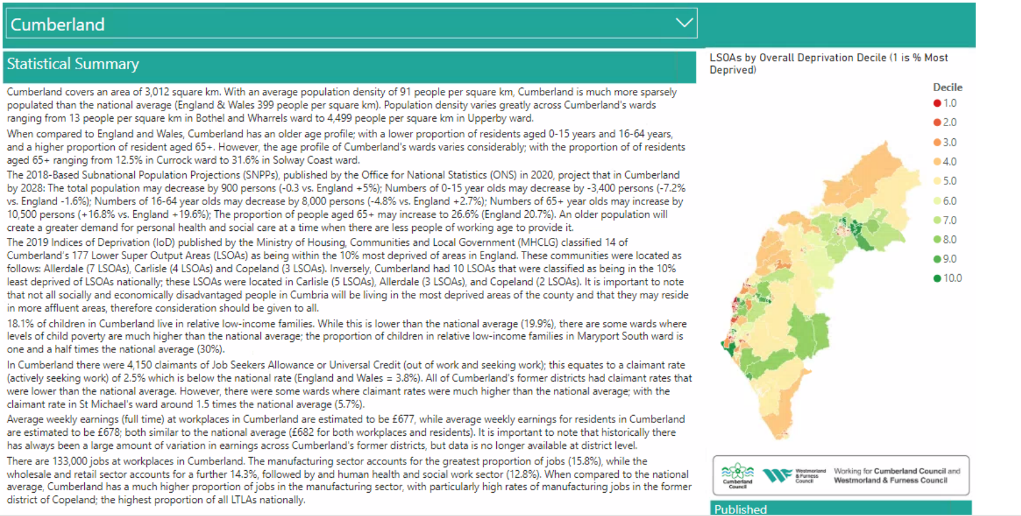

Slide 19
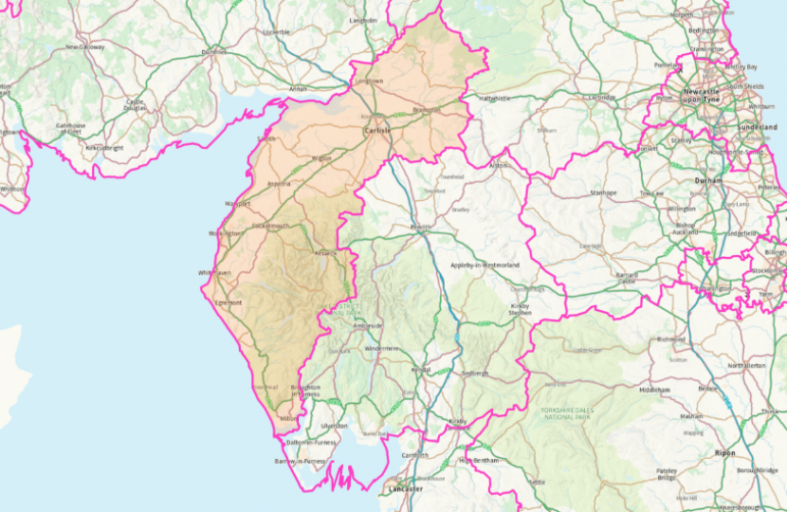
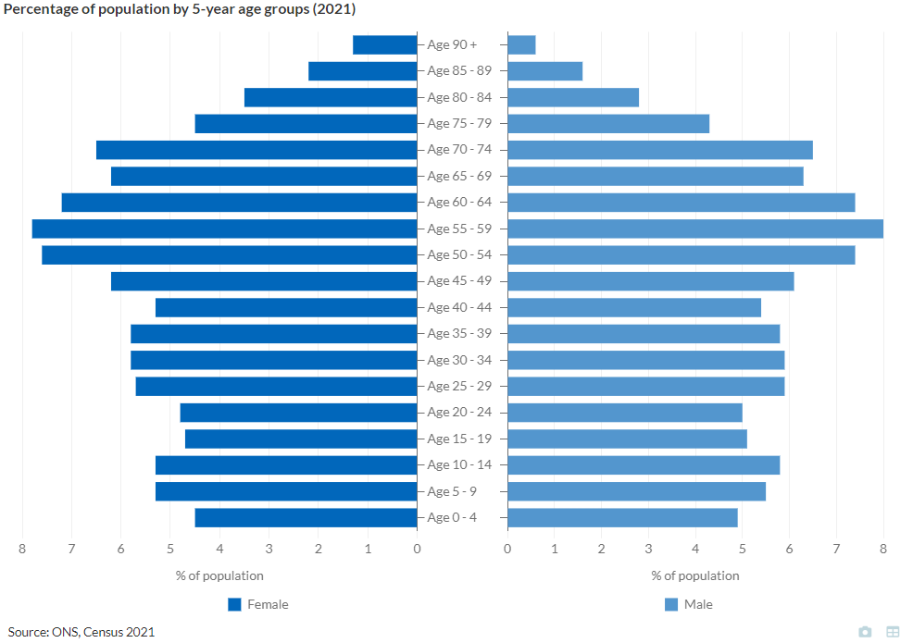
In 2021 ONS Census;
Total population in Cumberland was 273,200
The former Carlisle district population was 110,000
The former Allerdale district population was 96,200
The former Copeland district was 67,100
Cumberland

Slide 20
Live Births by former district
https://www.nomisweb.co.uk/query/construct/submit.asp?menuopt=201&subcomp=
The number of births in Cumberland has remained fairly static over the last 4 years
However, the number of births has steadily fallen in the last 10 years

Slide 21
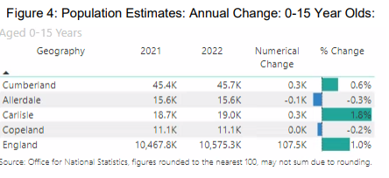
0-15 Population (mid-2022)
The 0-15population has increased overall
The former district area of Carlisle has solely contributed to this.
The number of 0-15yr olds in former Allerdale & former Copeland have decreased
0-15 population makes up 16% of the Cumberland population

Slide 22
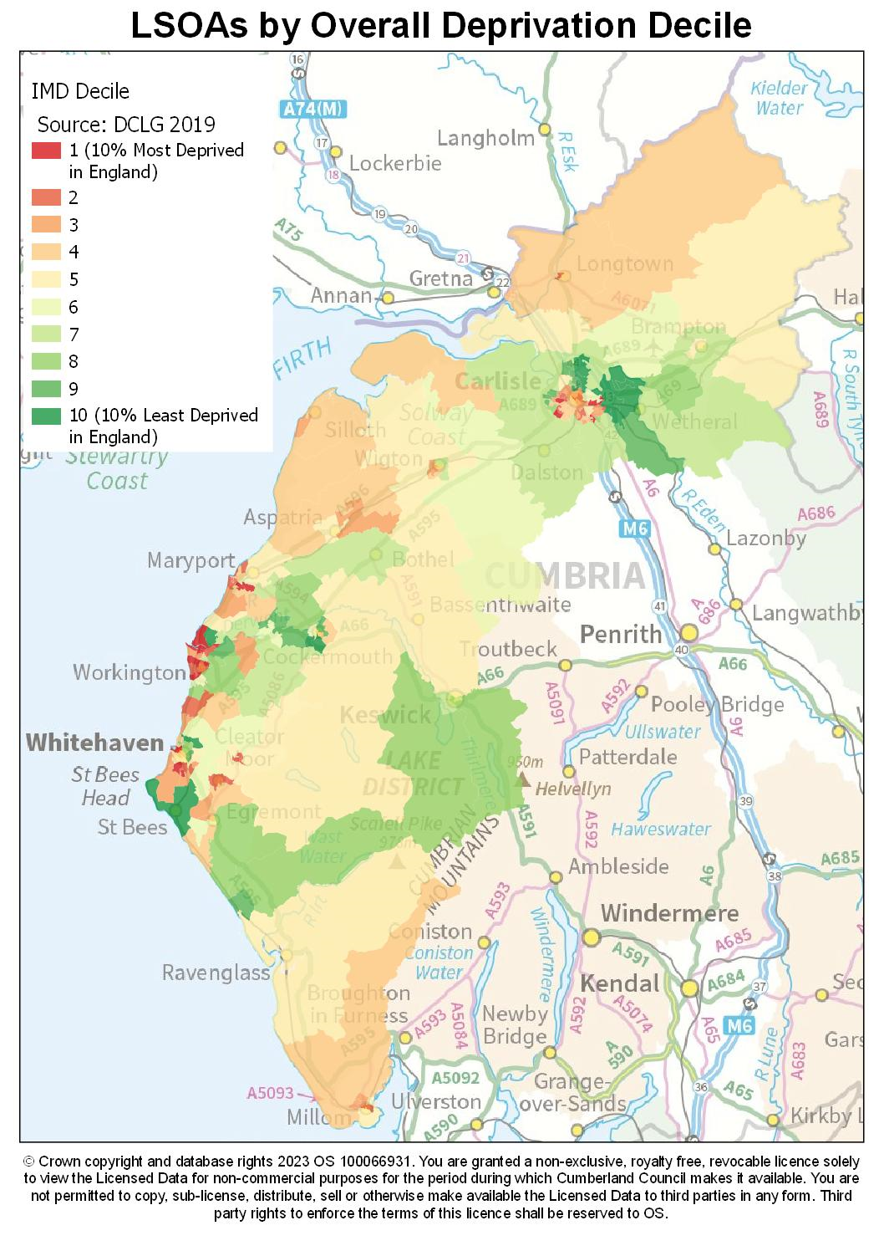
Poverty
 | Estimated Proportion of people living in deprivation deciles
 |  | Allerdale | Carlisle | Copeland | Cumberland
Most Deprived 10% | 1 | 11.80% | 6.30% | 6.70% | 8.30%
 | 2 | 8.20% | 11.30% | 16.40% | 11.50%
 | 3 | 10.40% | 14.60% | 17.50% | 13.80%
 | 4 | 14.10% | 13.90% | 15.70% | 14.40%
 | 5 | 10.70% | 9.90% | 14.20% | 11.30%
 | 6 | 11.70% | 5.60% | 11.70% | 9.30%
 | 7 | 14.20% | 16% | 0.00% | 11.40%
 | 8 | 8.20% | 6.00% | 6.50% | 6.90%
 | 9 | 5.40% | 8.90% | 6.10% | 7.00%
Least Deprived | 10 | 5.10% | 7.40% | 5.10% | 6.00%

Slide 23
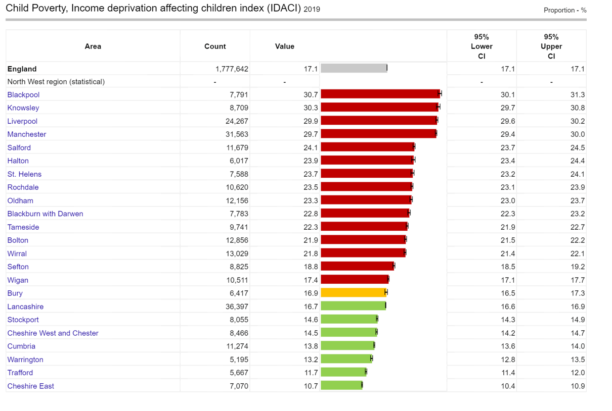
Child Poverty

Slide 24
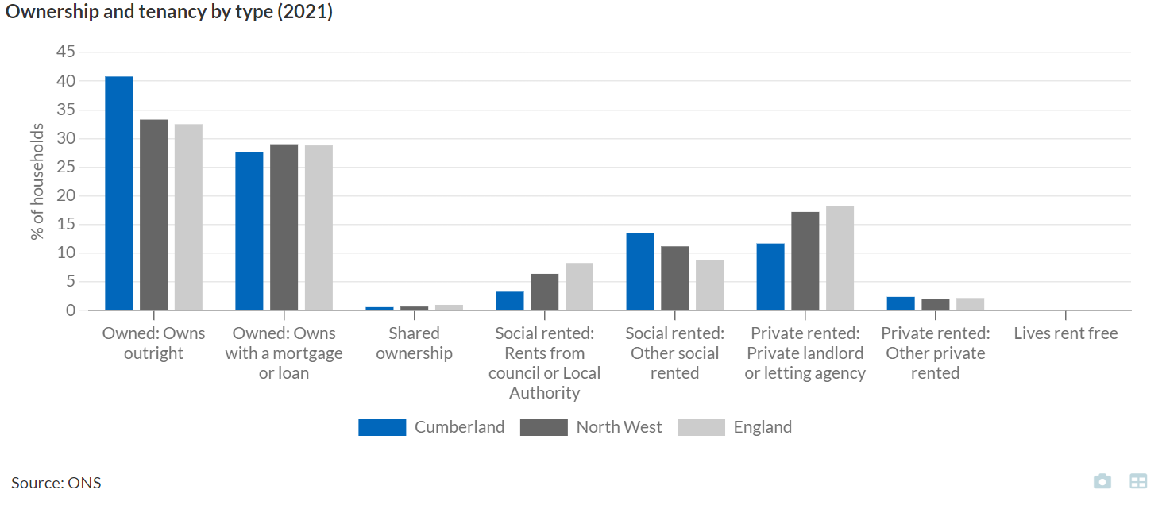
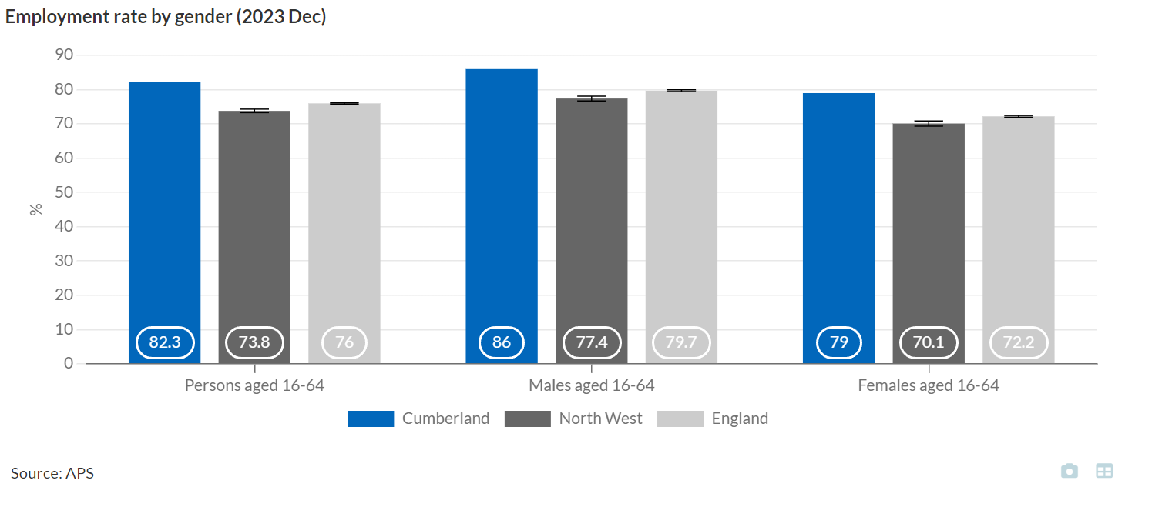
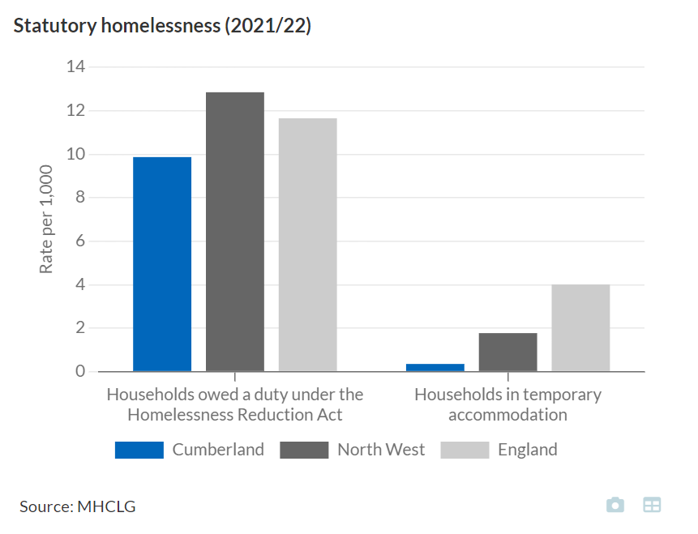
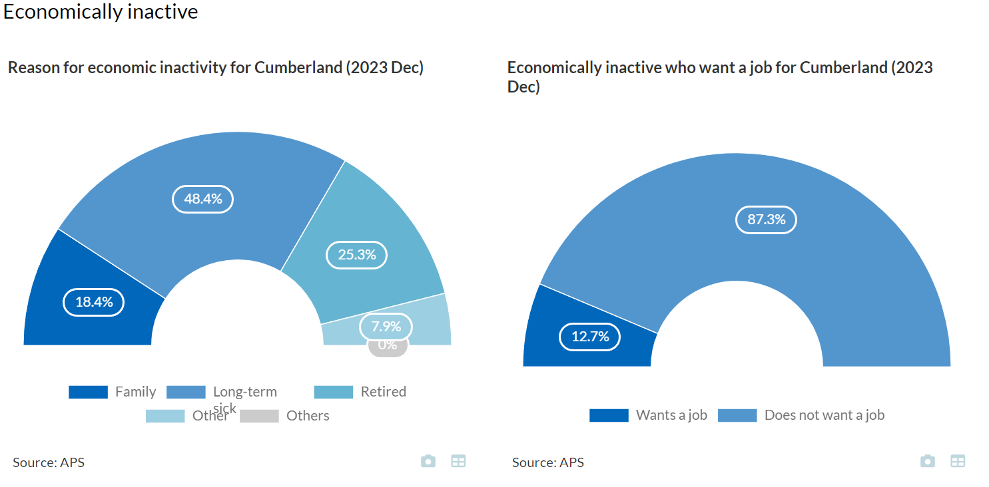
Housing & Homelessness
Employment

Slide 25
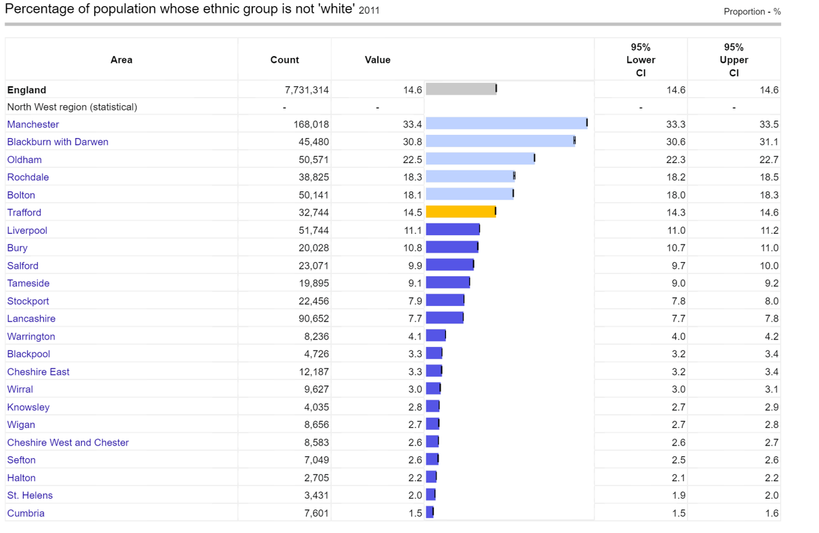
Ethnicity
Local health, public health data for small geographic areas - Data - OHID (phe.org.uk)
Notes:
School Census January 2024
The School Census is taken 3 times annually in January, May and October and provides the best proxy data on ethnicity, languages spoken and nationality between censuses. This information has been updated with the January 2024 School Census (which will include updated Refugee and Asylum Seeker figures for schools).
Key points from the Census show:
Ethnic diversity has increased since 2001 across all districts in Cumberland.
There were 90 different languages recorded as spoken in schools in Cumberland.
There are pockets of diversity in which the proportion of people from an ethnic minority background is equal to or higher than the UK national average:
Urban centres, especially central Carlisle
Lake District National Park
January 2023 numbers in brackets. The largest increases over the year were in the Malayam and Shona categories.

Slide 26
Ethnicity
Local Authority | Cumberland
Total % of children from an ethnic minority group | 8.5% (7.4% in Jan 2023)
District with highest ethnic minority school figures | Carlisle 12.8% (11.5% in 2023)
Schools with the highest % of ethnic minority pupils | Carlisle primary 72.2% (63.3% in 2023)
Number of schools with more than 10% pupils from ethnic minority groups | 2024: 36 schools (20 in Carlisle) 2023: 34 schools (21 in Carlisle)
Ethnicity profile of Cumberland schools
Ethnic group | Cumberland
White British (inc. White English, White Scottish) | 35,656 (35,975 – Jan 2023)
White Other (excluding Gypsy Roma and Travellers) | 911 (987 – Jan 2023)
Mixed heritage | 764 (697 – Jan 2023)
Asian heritage | 503 (343 – Jan 2023)
Black heritage | 527 (234 – Jan 2023)
Chinese | 76 (68 – Jan 2023)
Gypsy Roma and Travellers | 91 (75 – Jan 2023)
Local Authority | Cumberland
Total languages | 90 languages
Total average EAL | 5.1% pupils EAL
District with highest EAL | 8.9% pupils Carlisle
Rank 1 | Polish 414 pupils (413)
Rank 2 | Malayalam 192 pupils (81)
Rank 3 | Romanian 100 pupils (80)
Rank 4 | Ukranian 83 pupils (84)
Rank 5 | Shona 77 pupils (13)
Rank 6 | Turkish 63 pupils (49)
Rank 7 | Arabic 57 pupils (54)
Rank 8 | Portuguese 36 pupils (39)
Rank 9 | Chinese 35 pupils (29)
Rank 10 | Lithuanian 35 pupils (35)
Notes:
School Census January 2024
The School Census is taken 3 times annually in January, May and October and provides the best proxy data on ethnicity, languages spoken and nationality between censuses. This information has been updated with the January 2024 School Census (which will include updated Refugee and Asylum Seeker figures for schools).
Key points from the Census show:
Ethnic diversity has increased since 2001 across all districts in Cumberland.
There were 90 different languages recorded as spoken in schools in Cumberland.
There are pockets of diversity in which the proportion of people from an ethnic minority background is equal to or higher than the UK national average:
Urban centres, especially central Carlisle
Lake District National Park
January 2023 numbers in brackets. The largest increases over the year were in the Malayam and Shona categories.

Slide 27
Child in Need Plan and Child on a Protection Plan numbers:
Child In Need Plan – 416 (end May 2024)
Child Protection Plan – 233 (end May 2024)

Slide 28
What does the data tell us about health needs in Cumberland?

Slide 29
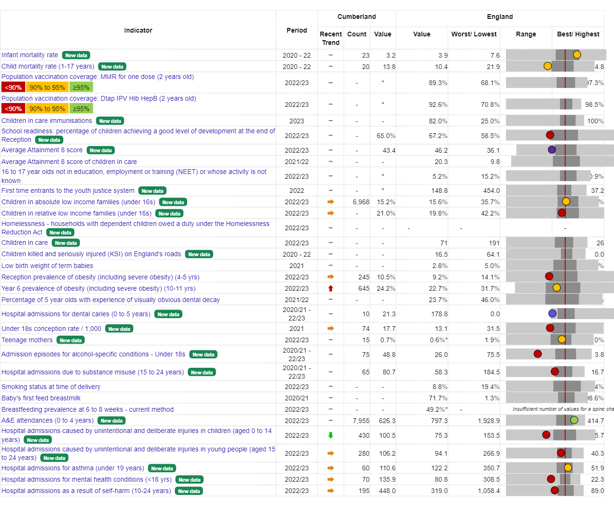

Slide 30
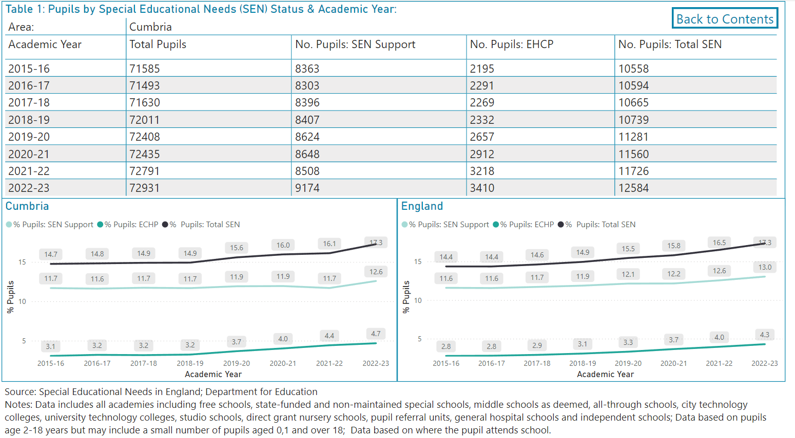
Special Educational Needs

Slide 31
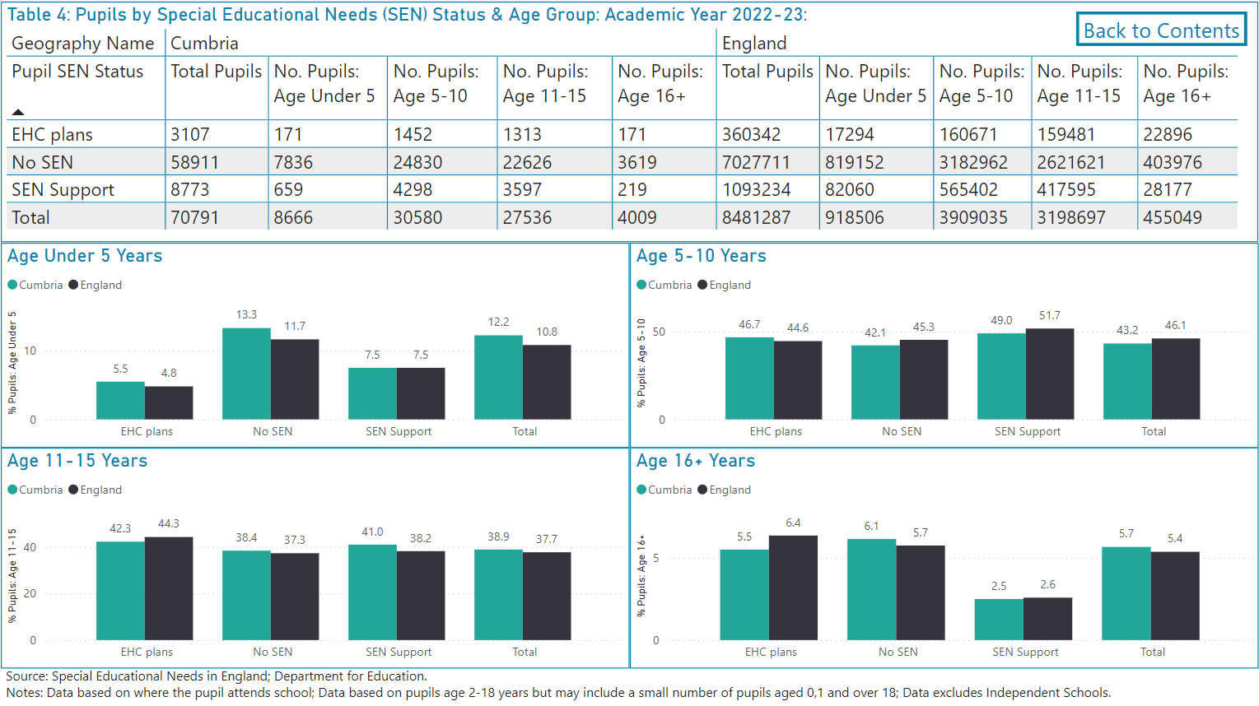

Slide 32
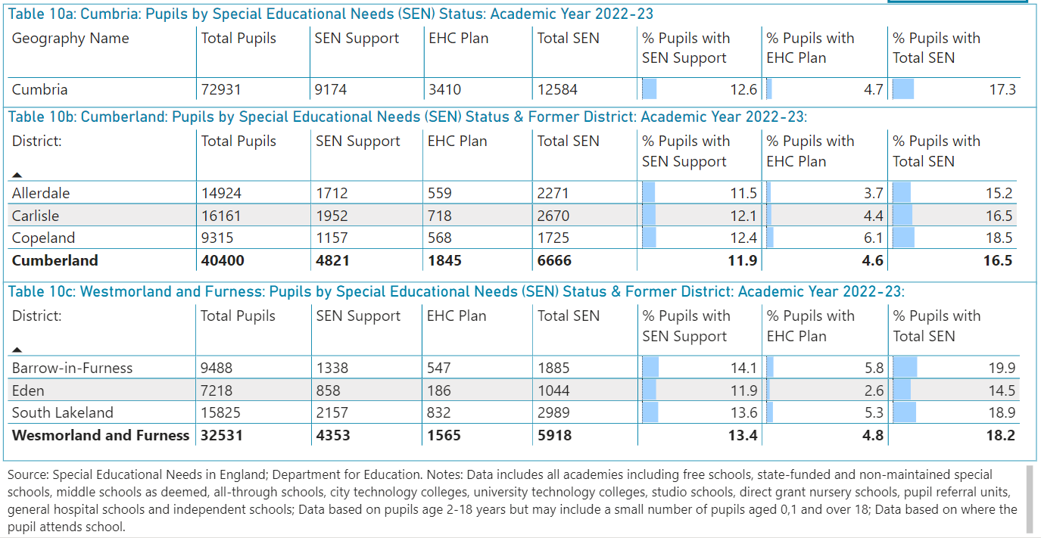

Slide 33
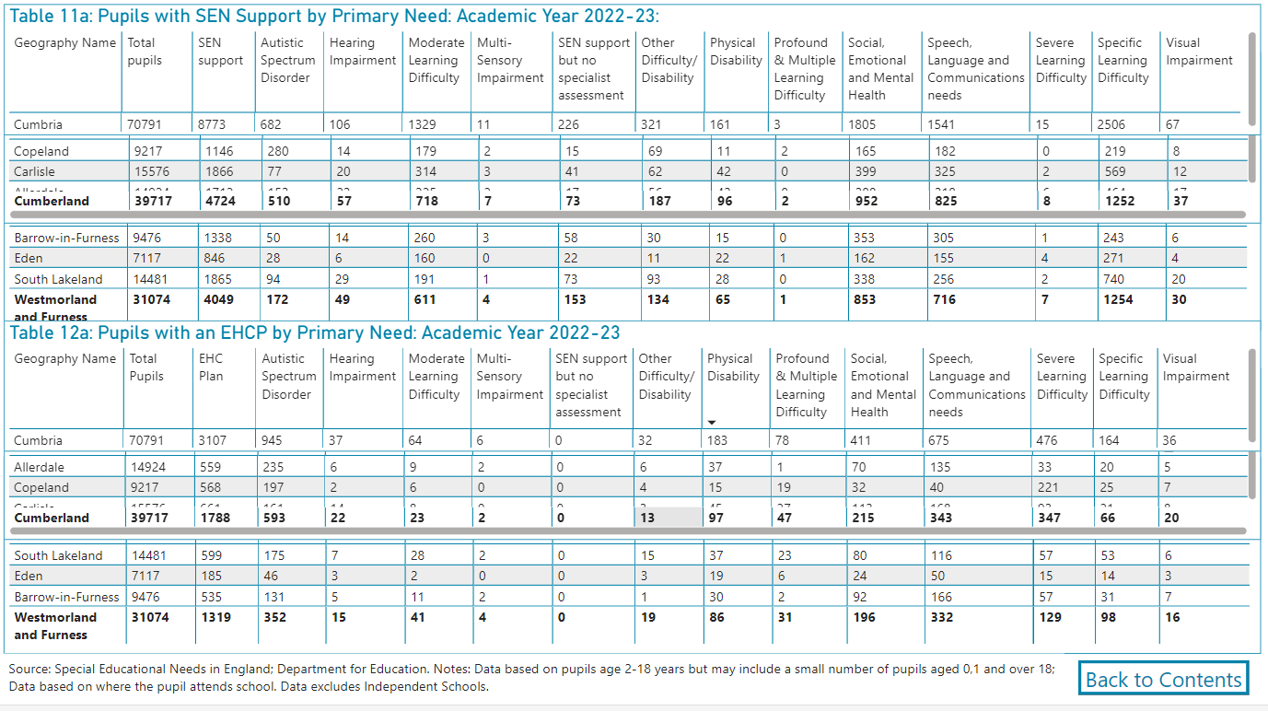

Slide 34
School Readiness Questionnaire 2023

Slide 35
Discussion –
Any questions from you?
Questions from us:
- Is the service model deliverable? What are the strengths? What might be the risks or challenges in delivering this?
- What factors, if any, might affect your ability to bid?
- What requirements or other considerations would need to be considered relating to any premises used in support of this contract?
- Is there any further information you require to support with bidding?
.

Slide 36
Close and Thank You
Email any further questions to strategic.commissioning@cumberland.gov.uk
But please note that any questions asked by providers and consequent responses given by commissioners will be collated and published (anonymously) via the Chest as part of the procurement when the tender is live.

