Slide 1
Direct Payment Support Service Market Engagement Event 11th November 2020

Slide 2
Purpose of Today
To outline our requirements in commissioning a Direct Payment Support Service; including:
Approach to Direct Payments
What’s in Scope
An opportunity to highlight key elements of the procurement process
The Commercial Approach
An opportunity for us to seek your views
An opportunity for you to ask questions –please jot down the questions on the chat and the appropriate person will pick it up and answer in the Q&A section.

Slide 3
Approach to supporting Direct Payments at the Council County Manager - Theo Jarratt

Slide 4
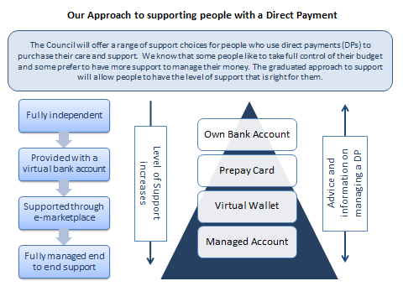
Notes:
LCC currently commissions a range of services supporting direct payments. These range from low to high need for support. The need to re-procure the DPSS provides an opportunity to investigate a more holistic approach to supporting people direct payments.

Slide 5
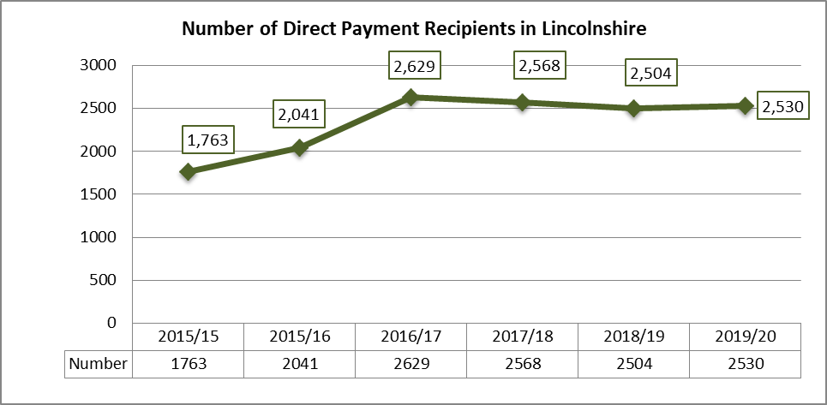
Direct Payments in Lincolnshire – Some Context
September 2020
2,179 people
80 new DPs
every month
Growing younger adults usage of all client types
Declining usage for older adults

Slide 6
Aims for Direct Payment Support Service
To provide an information, advice and guidance service for all Direct Payment users.
To provide a front loaded ‘hand holding’ service to ensure that the start of the DP is smooth and efficient.
To enable people to move to the most appropriate level of support for them
Working with the Council and CCG to facilitate the person’s path to independence.
Notes:
To provide an information, advice and guidance service for all DP users.
To provide a front loaded hand holding service to ensure that the start of the DP is smooth and efficient.
To enable people to move to the most appropriate level of support for them taking into account the other Direct Payment Support services commissioned by the Council and facilitating the individuals path to independence.

Slide 7
Direct Payment Support Service Requirements
The main areas of services to be provided to all Direct Payment recipients who meet the criteria are:
Information, advice, brokerage and signposting on setting up, most appropriate banking solution, services to meet outcomes, insurance and other services available in the market, including sourcing and training for PA’s.
Support with becoming an Employer including Training, Recruitment and dealing with Employment issues e.g. DBS, Advertising, interviewing and end of contract issues etc.
A Fully Managed Account service
Support on the Virtual Wallet and Prepaid Card
Notes:
To provide an information, advice and guidance service for all DP users.
To provide a front loaded hand holding service to ensure that the start of the DP is smooth and efficient.
To enable people to move to the most appropriate level of support for them taking into account the other Direct Payment Support services commissioned by the Council and facilitating the individuals path to independence.

Slide 8
Direct Payment Support Service requirements
The service provision will also include access to the following, this can be directly or through a third party provider:
Access to a suitable Insurance provider
Access to a Suitable Person service
Access to a Payroll Service

Slide 9
Commercial Overview Commercial Team – People Services Reena Fehnert

Slide 10
Procurement Process
Pre-Procurement Phase – Market Engagement
Previous events 19th Nov 2019 and 27th Feb 2020
Today’s event
Questions
Allows us to explore any changes in the market, any factors that will influence the ultimate contract solution and procurement process, especially in relation to the impact of COVID 19 on:
Council’s and Health’s requirements
Mobilisation

Slide 11
Provisional Procurement Timeline
Stages | Timescales
Pre-Procurement Phase | Until 10th Dec 2020
Tender Documents Issued | 15th January 2021
Deadline for bids | 16th February 2021
Evaluation | 17th February to 16th March 2021
Standstill Period | 18th March 2021 to the 29th March 2020
Mobilisation and Implementation | 90 days
Go Live | 1st July 2021

Slide 12
Procurement Process
Procurement undertaken in accordance with regulations 74 to 76 of the Public Contract Regulations 2015 under “Light Touch Regime”
Enables us to design an competitive process that best fits
Use of an Open Procedure

Slide 13
Procurement Process
Business Information
Minimum Standards to meet
pass/fail
Financial assessment
Award Criteria
Balance of Quality and Price factors
Best overall Value for Money proposals for the council and CCG based upon service quality, ability to meet demand, as well as sound transition planning.

Slide 14
Commercial Approach
We are looking to use a Series of Key Performance Indicators with a payment mechanism to ensure:
Higher level of intervention at the start of an individual’s journey
All individuals are receiving a quality service
Individuals are encouraged (if capable) to be independent
Being matched to the best banking support
Reduce the likelihood of failure of direct payments
Notes:
They feel they are receiving a quality service
That they are being matched …
Reduced likehood of failure of a dp take up, after all that is the whole point of the DPSS service- to mitigate risk and support the individual with their DP.

Slide 15
Contract Structure
Approach:
Use of separate Lots through a joint tender
aligned contracts with minor modifications
Consortia bids very welcome
County-wide Service
Equity of access and consistency are important
Initial contract Term of 3 years
with options to extend by further periods up to two years

Slide 16
Contract Structure
Budget
LCC £472k per annum
CCG £150k per annum
Pay mechanism
Will seek to balance management of risk for both provider and Council and the provider and the CCG
Block or fixed costs based on activity with payment incentivisation linked to outcomes
Performance Management
Based around the provision of key performance, management and quality monitoring information

Slide 17
LCC Forecast Growth
Approximately 8805 adults in Lincolnshire are eligible for a Personal Budget with 2179 in receipt of a Direct Payment.
There has been a trend of slight increases in numbers of younger adults taking up direct payments.
Projection on Type of Support %
Own Bank Account 31%
Pre-paid Accounts 22%
Virtual Wallet 20%
Fully Managed Account 27%
Notes:
LCC Adult Social Care strategy is to offer direct payments as a first choice to any eligible adult whose needs may be met through community based services. The Virtual wallet will go live and will reduce the number of people who require a fully managed account

Slide 18
Additional Resources
Pro-contract portal: https://procontract.due-north.com/Login
Other:
Websites - national, regional and local www.sourcelincolnshire.co.uk
www.businesslincolnshire.com
Procurement Lincolnshire – http://www.lincolnshire.gov.uk/procurement/
TED (tenders electronic daily) http://ted.europa.eu/TED/browse/browseByBO.do
Notes:
Source Lincolnshire / Delta /Contracts Finder /OJEU (OJEC) /Business Link
Procurement Lincolnshire – templates – Standard Docs
E-Pack (supplier training resources / information pack)
Portal adverts – use key words to get notifications on Pro-contract
OJEU notices on TED
Learn Direct and workshops

Slide 19
NHS Requirements NHS Lincolnshire Clinical Commissioning Group Rachel Rogers

Slide 20
NHS Lincolnshire
CCG CHC Team
CCG Activity
CCG Forecast Growth

Slide 21
CCG CHC Team
September 2018 business case approved for end to end CHC Service, with all facets of CHC being brought together in one team
Encompasses Clinical, Business & Performance, Finance & Contracting and Quality (including personal health budgets)
Aims include to improve relationships with providers and improve financial planning
Improve joint working with the local authority

Slide 22
CCG Activity
Approximately 75% of PHB budgets are Direct Payments
Of the 75% Direct Payments, approximately 55% are fully managed, 27% self-managed and 18% use the payroll only service
Reduction of fully managed accounts in 20/21 but backlog due to COVID
2019/20 Activity
Fully managed | Payroll Only | Self- Managed
97 | 31 | 47

Slide 23
CCG Activity Forecast
The NHS Long Term Plan outlined the acceleration of the roll out of Personal Health Budgets and nationally aim to have 200,000 people benefiting from a Direct Payment by 2023/24.
The CCG anticipates a significant increase of PHBs by 23/24

Slide 24
Round up and Finish
Next steps
Q&A – please jot down the questions on the chat and the appropriate person will pick it up and answer
Finish

Slide 25
Notes:
This feedback is very important as it will allow the NHS and the Council to shape the specification/s and ensure that the offering to the market will be able to attract what we are aiming to achieve. Increase confidence and empower the DP service user, encourage the provider to take a person centric view in the services provided as well as get the best value from the public purse. We are using a workshop format as it will encourage an overall market view

